Slide 1
Presented by:
[ Name of Instructor ]
Copyright © 2010 – 2023 Financial Educators Network®
Notes:
Before You Begin:
Welcome attendees
Introduce self and course
Read any required disclosures
Introduce course format and any other important logistical topics, such as scheduled breaks and the location of the bathrooms
Get Them Thinking:
“I encourage you to ask as many questions as you can during this course. We have a lot of material to cover, but I’ll answer as many as I possibly can. As this is an educational presentation only, I will not be able to talk about any specific financial product or financial advice.”

Slide 2
[Broker-Dealer Disclosure]
This material is intended to provide general financial education and is not written or intended as tax or legal advice and may not be relied on for purposes of avoiding any Federal tax penalties. Individuals are encouraged to seek advice from their own tax or legal counsel. Individuals involved in the estate planning process should work with an estate planning team, including their own personal legal or tax counsel. This material is for informational purposes only and is not an offer to sell or a solicitation of any offer to buy any securities.
Course instructors are not employees or agents of Financial Educators Network®. Financial Educators Network® prohibits instructors from making specific recommendations and endorsing or selling products during the course. Once the course has ended, instructors may offer financial advice, products, or other services as an agent for insurance companies and/or broker-dealer firms. These services are not offered on behalf of Financial Educators Network®. Financial Educators Network® does not sell or endorse any insurance or investment products.

Slide 3
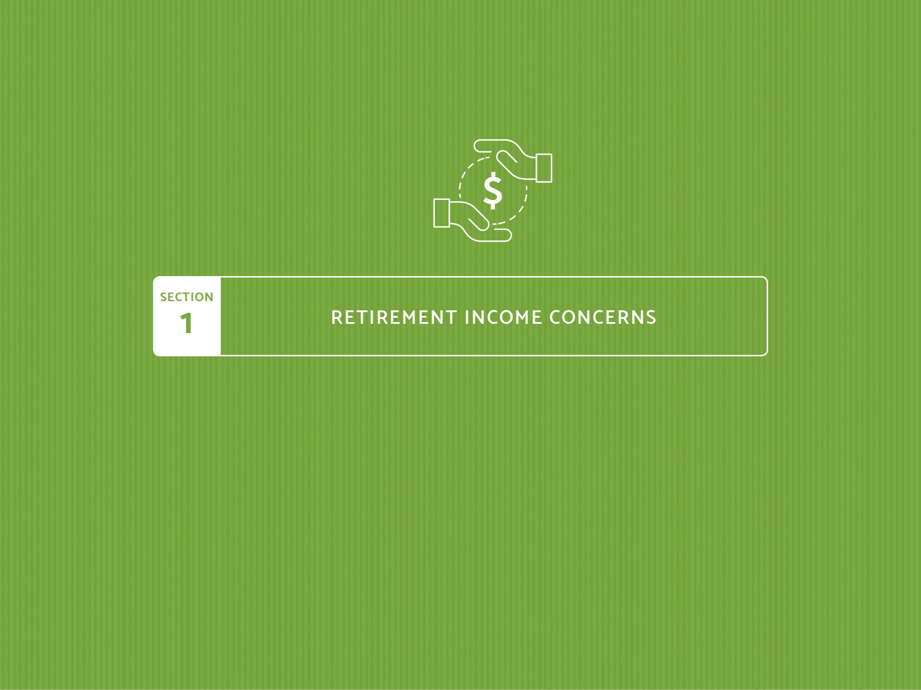

Slide 4
Retirement Income Concerns
Page 1-1
Introduction
How did your parents retire?
Your experience so far may have been very different
Combined with increasing lifespans and (in some cases) earlier retirement, today’s seniors may spend more than a quarter of their lives in retirement
What’s your unique vision of an ideal retirement?
Notes:
How did your parents retire? Like most in their generation, they may have worked for many years at the same company, retired around age 65 and received their income between their pension and Social Security. Retirement was a generally simple concept for them.
Your experience so far may have been very different. Our changing society has given us retirement options your parents likely had never dreamed of, and with those opportunities a nearly overwhelming number of decisions and added responsibilities.
Many retirees can expect their good health to last longer than that of their parents. Combined with increasing lifespans and (in some cases) earlier retirement, today’s seniors may spend more than a quarter of their lives in retirement. As a result, many have become increasingly concerned about outliving their money.
What’s your unique vision of an ideal retirement? What would make this chapter of life as secure, fulfilling and purposeful as possible? Take a moment to think about what this means to you as we begin the process of exploring ways to financially rejuvenate your retirement.

Slide 5

Retirement Income Concerns
Page 1-2
Finding Balance in Retirement

Slide 6
Retirement Income Concerns
Page 1-3
About This Course
Section 1: Retirement Income Concerns
Many retirees can expect their health to last longer than their parents
Today’s seniors may spend more than a quarter of their lives in retirement
Many have become increasingly concerned about outliving their money
What’s your unique vision of an ideal retirement?
What would make this chapter as secure, fulfilling and purposeful?
Take a moment to think about what this means to you as we begin the process of exploring ways to financially rejuvenate your retirement
Notes:
Section 1: Retirement Income Concerns
Many retirees can expect their good health to last longer than that of their parents. Combined with increasing lifespans and (in some cases) earlier retirement, today’s seniors may spend more than a quarter of their lives in retirement. As a result, many have become increasingly concerned about outliving their money.
What’s your unique vision of an ideal retirement? What would make this chapter of life as secure, fulfilling and purposeful as possible? Take a moment to think about what this means to you as we begin the process of exploring ways to financially rejuvenate your retirement.

Slide 7
Retirement Income Concerns
Page 1-3
About This Course
Section 2: How Long Will My Money Last?
What are your retirement income goals, and what will it take to meet them? This section will include information on how to:
Estimate your annual retirement withdrawal expenses
Estimate the income you will receive from various sources
Determine your estimated annual withdrawals
Understand inflation and its effects on your assets
Understand market timing and the effects of investing into a declining market
Notes:
Section 2: How Long Will My Money Last?
What are your retirement income goals, and what will it take to meet them? This section will include information on how to:
Estimate your annual retirement withdrawal expenses
Estimate the income you will receive from sources such as Social Security, your pension, investments and other sources
Determine your estimated annual withdrawals
Understand inflation and its effects on your assets
Understand market timing and the effects of investing into a declining market

Slide 8
Retirement Income Concerns
Page 1-4
About This Course
Section 3: Investments
This section will help you to:
See how investment selections should be determined by analyzing your goals and objectives as well as your personal financial situation
Review and evaluate how you feel about money
Understand what your risk tolerance may be
Understand how important it is to align your investment behavior with your attitudes, risk tolerance and goals
Notes:
Section 3: Investments
Investment selections should be determined by analyzing your goals and objectives as well as your personal financial situation. This section will help you to review and evaluate how you feel about money, what your risk tolerance may be, and to understand how important it is to align your investment behavior with your attitudes, risk tolerance and goals.

Slide 9
Retirement Income Concerns
Page 1-4
About This Course
Section 4: Retirement Income Sources
This section will discuss some of the issues most important to retirement income, including:
Social Security claiming strategies, earnings penalty and taxation
IRAs, Roth IRAs, conversions and required minimum distributions
Tax efficiency and withdrawal order
Employer-Sponsored Retirement Accounts (including 401(k), 403(b) and 457 plans)
Pension decisions
Life insurance comparisons and annuity withdrawal choices
Notes:
Section 4: Retirement Income Sources
This section will discuss some of the issues most important to retirement income, including:
Social Security claiming strategies, earnings penalty and taxation
IRAs, Roth IRAs and required minimum distributions
Tax efficiency and withdrawal order
IRA to Roth IRA conversions
Employer-Sponsored Retirement Accounts (including 401(k), 403(b) and 457 plans)
401(k) rollover considerations
Pension decisions
Life insurance comparison
Annuity withdrawal choices

Slide 10
Retirement Income Concerns
Page 1-5
About This Course
Section 5: Health Care Planning
One of the biggest concerns for retirees is their health
Everyone is aware that aging may increase the need for medical treatment
While we cannot reverse the aging process, we can take steps to stay healthy and to plan for the future
Medical planning should help you prepare for health care, long-term care, incapacity and end of life
Notes:
Section 5: Health Care Planning
One of the biggest concerns for retirees is their health. Everyone is aware that aging may increase the need for medical treatment. While we cannot reverse the aging process, we can take steps to stay healthy and to plan for the future. Medical planning should help you prepare for health care, long-term care, incapacity and end of life.

Slide 11
Retirement Income Concerns
Page 1-5
About This Course
Section 6: Estate Planning
How much do you want to give family, friends and charities?
How can you give as little as necessary to the government?
Topics covered in this section include:
  Ownership transfers
  Probate and wills
  Types of trusts
  Income from annuities
  Estate taxes
Notes:
Section 6: Estate Planning
For many people, the objective of estate planning is to give as much as possible to family, friends and charities, while giving as little as necessary to the government.
Topics covered in this section include ownership transfers, probate and wills, types of trusts, income from annuities and estate taxes.

Slide 12
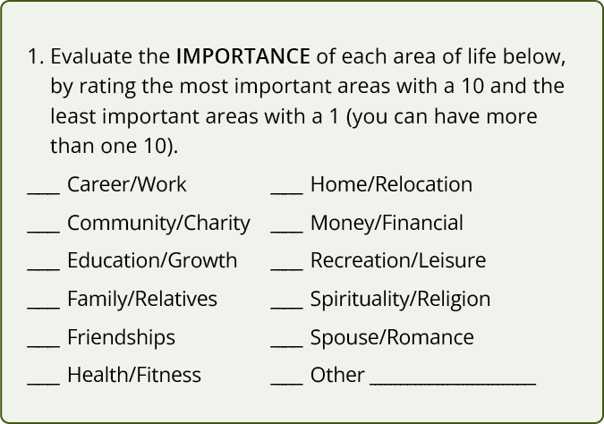
Retirement Income Concerns
Page 1-6
Exercises: Evaluate Your Retirement
Evaluate the importance of each area of life using your workbook.
Rate the most important areas with a 10 and the least important with a 1.

Slide 13
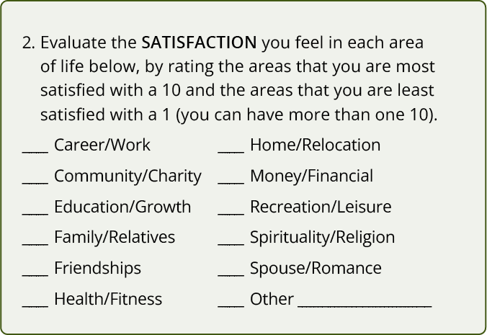
Retirement Income Concerns
Page 1-6
Exercises: Evaluate Your Retirement
Evaluate the satisfaction you feel in each area of life using your workbook.
Rate your most satisfied areas with a 10 and the least satisfied with a 1.

Slide 14

Retirement Income Concerns
Page 1-7
Exercises: Plan Your Retirement

Slide 15
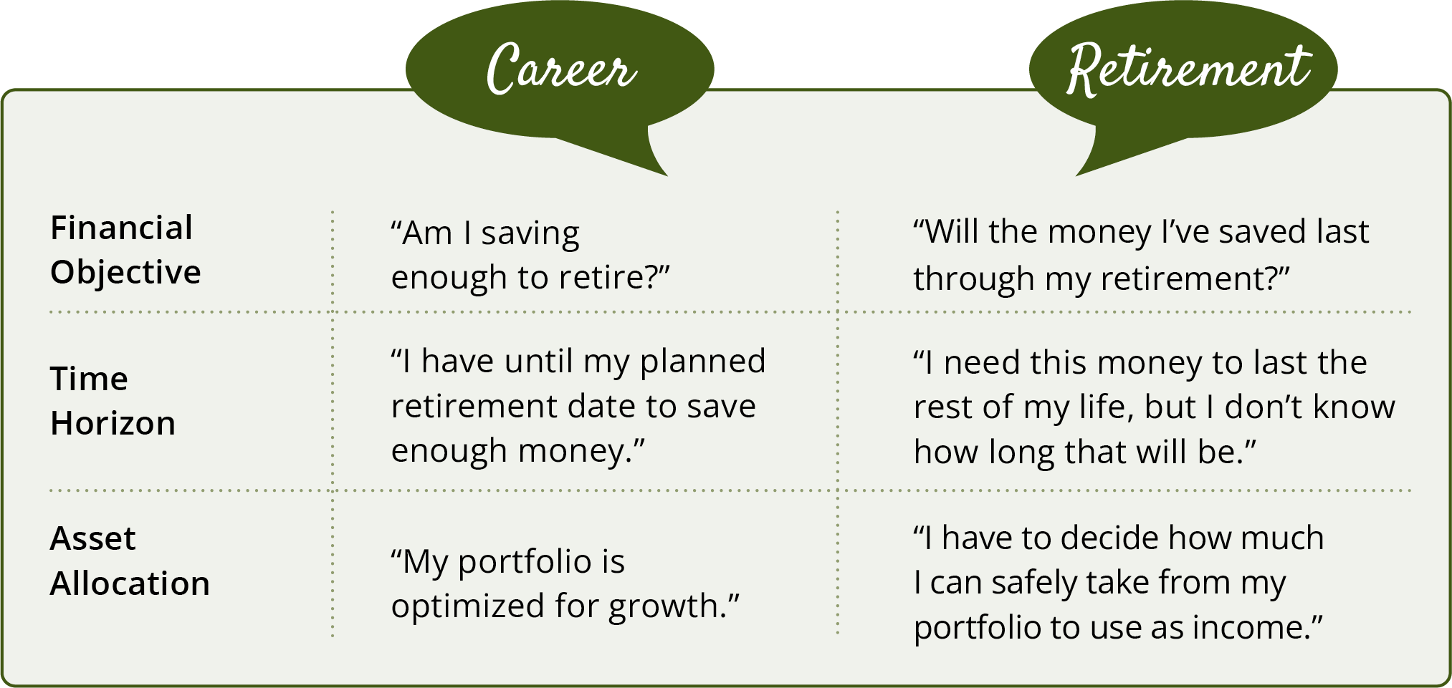
Retirement Income Concerns
Page 1-8
Financial Rules Change at Retirement
Notes:
You’ve lived through economically turbulent times over the course of your career and life. Trends such as offshoring, mergers and downsizing fundamentally changed the relationship between corporate employers and their employees. Many long-term, loyal employees found themselves laid off.
Between these uncertainties and an increasingly mobile workforce, corporations and public sector employers have spent the last decades pivoting away from defined benefit retirement plans like pensions in favor of defined contribution plans like 401(k)s. In doing so, they have often shifted the responsibility of retirement planning from employer to employee.
Your retirement responsibilities may have shifted during your career. Now that you’ve retired, the questions you’re asking yourself may have changed.

Slide 16
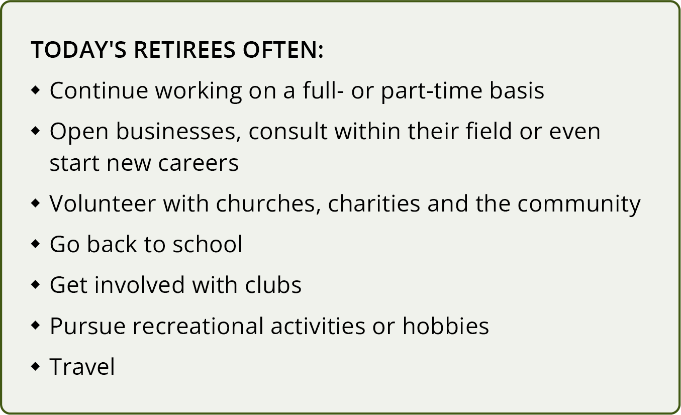
Retirement Income Concerns
Page 1-9
Embracing a Self-Reliant Retirement
Notes:
Most retirees have worked for several companies during their careers; others have been self-employed for some or all of their working lives. The sense of self-reliance you’ve developed over the course of your career will help you enormously throughout retirement.
Since so many people enter their retirement years in good health, many decide to continue working in some capacity. Others pursue opportunities to accomplish things they never had time for during their careers. These pursuits enable today’s retirees to stay creative, involved and active. After all, happiness in retirement depends on much more than just financial security.

Slide 17
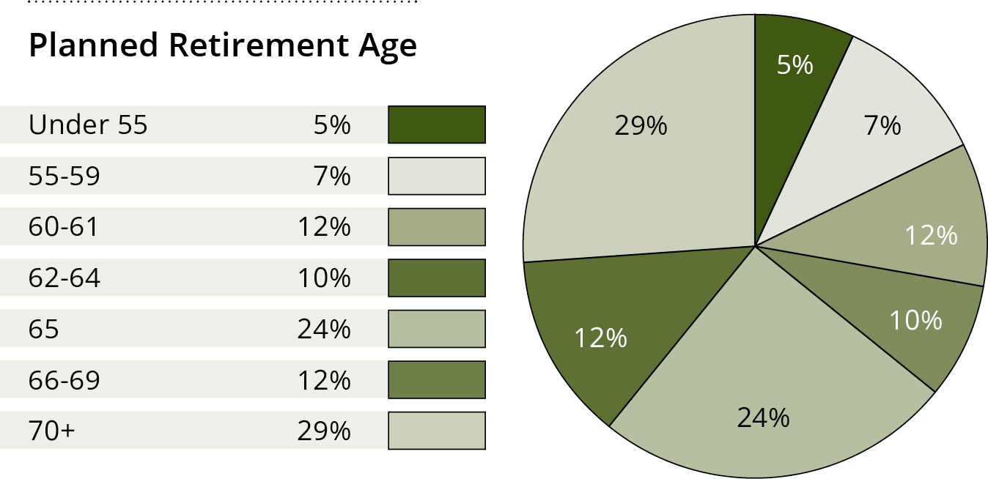
Retirement Income Concerns
Page 1-10
Americans Retire Earlier Than Expected¹
¹ The 2022 Retirement Confidence Survey. Greenwald & Associates, Employee Benefit Research Institute
Notes:
Many Americans retire earlier than they expected—were you one of them?

Slide 18
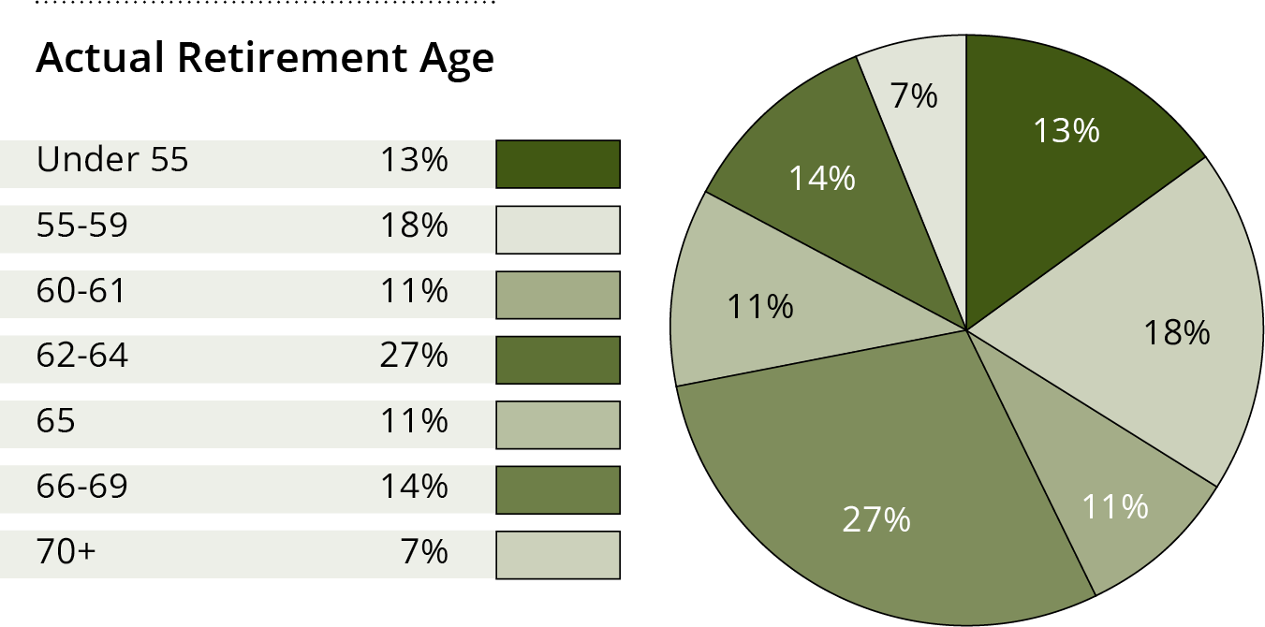
Retirement Income Concerns
Page 1-10
Americans Retire Earlier Than Expected¹
¹ The 2022 Retirement Confidence Survey. Greenwald & Associates, Employee Benefit Research Institute
Notes:
Even a few years’ difference in when you switch from accumulation to distribution can make a big difference in how long your money lasts.

Slide 19



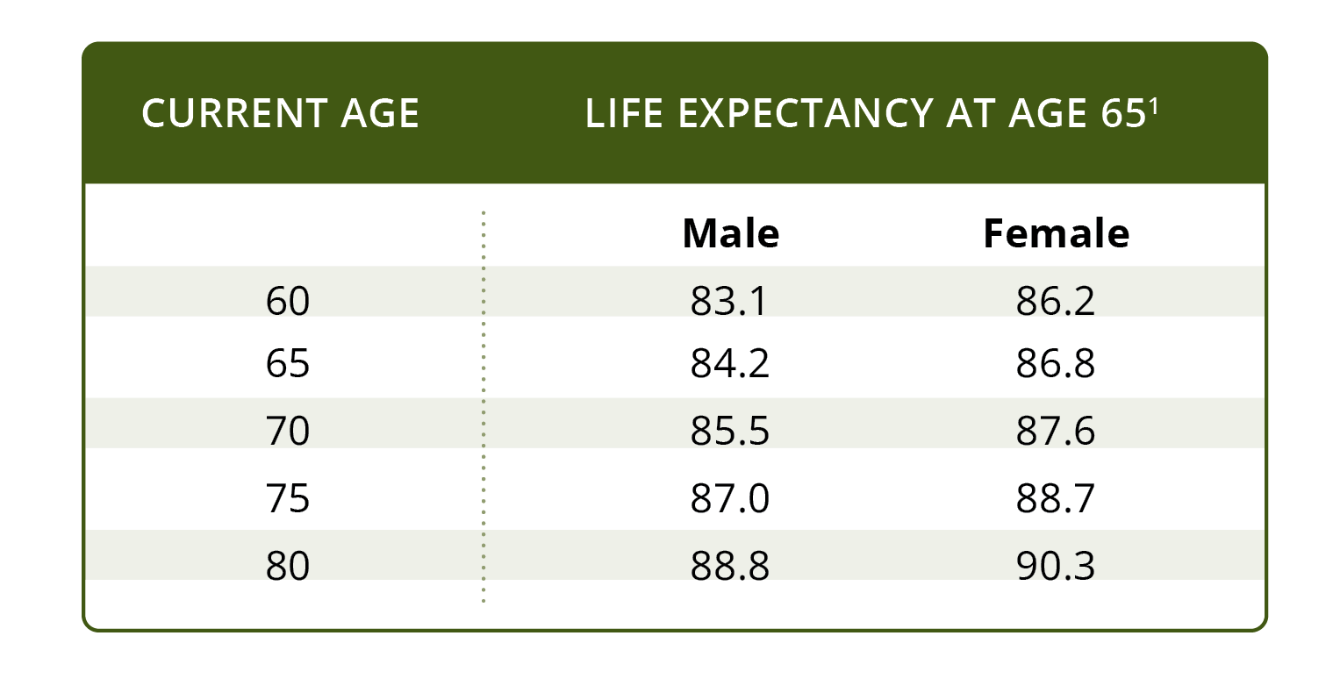
Retirement Income Concerns
Page 1-11
Americans Are Living Longer
¹ Source: Social Security Administration, 2023 Retirement & Survivors Benefits: Life Expectancy Calculator. Calculated based off current age as of November 1, 2022.
Notes:
The average life expectancy of Americans has generally risen over time. This may be due to a combination of factors including medical advances, better nutrition and healthier lifestyles. When planning for your retirement, it is important to consider that you may live to be 80 . . . 90 . . . 100 . . . or more. Your financial plan should be designed to help you maintain independence and preserve your lifestyle throughout retirement.

Slide 20
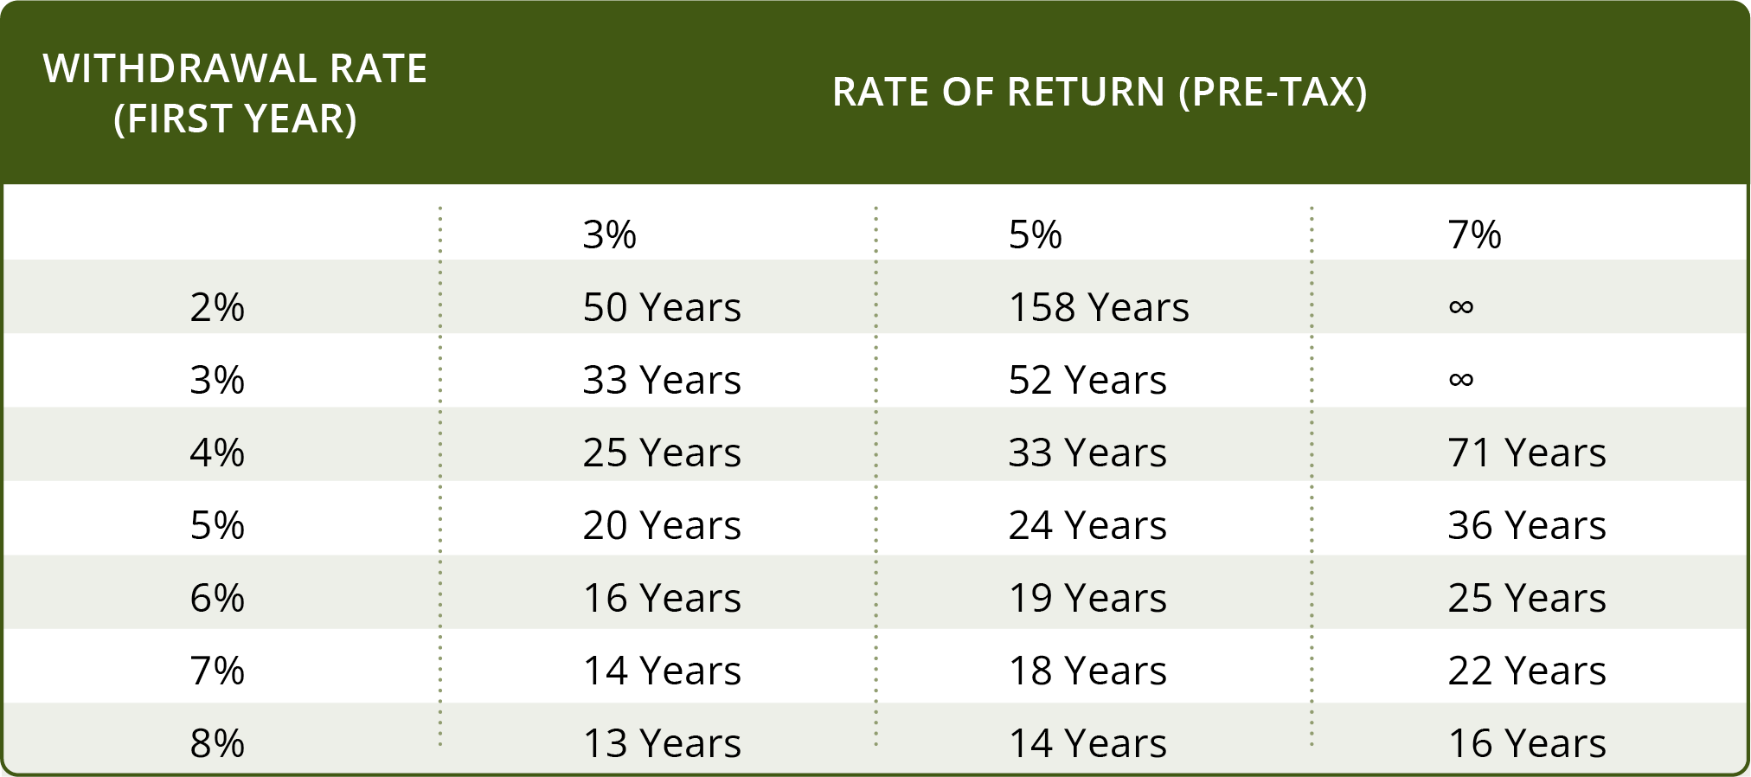
Retirement Income Concerns
Page 1-12
How Long Will My Money Last?
Notes:
This chart is another way of looking at how long your invested money will last once you begin regular withdrawals. Many investors conceivably optimize their portfolio for a 4-5% withdrawal and a 3-5% rate of return. Your investment could last indefinitely so long as the rate of return outpaces your withdrawals and inflation.
Please note that this chart comes with a few assumptions, including the following:
Withdrawals are taken at the beginning of each year
Annual withdrawals increase by 3% each year to compensate for future inflation
The chart does not include any of the fees or expenses that would be incurred by an actual investment
These investment results are hypothetical and do not represent any specific investment or product; they are for illustrative purposes only

Slide 21
Retirement Income Concerns
Page 1-13
Transferring Longevity Risk
The challenge of making money last in retirement has never been greater:
In general, life expectancies are increasing
Fewer people have traditional defined benefit pensions
Most retirees are covered by Social Security but this program
faces financial challenges
Stock and bond market volatility can be high and interest from
bank accounts and CDs can be low
Notes:
The challenge of making your money last for an unknown number of years in retirement has never been greater:
In general, life expectancies are increasing
Fewer people have traditional defined benefit pensions
Most retirees are covered by Social Security but this program faces financial challenges
Stock and bond market volatility can be high and interest from bank accounts and CDs can be low

Slide 22
Retirement Income Concerns
Page 1-13
Transferring Longevity Risk
Single Premium Immediate Annuities (SPIA) can provide:
A guaranteed lifelong income to cover basic expenses (all guarantees are based on the financial strength of the issuing insurance company)
Fixed income payments, or for an additional premium, provide increased payouts each year by a specific percentage
Notes:
Single Premium Immediate Annuities (SPIA) purchased from one or more insurance companies can provide:
A guaranteed lifelong income to cover basic expenses (all guarantees are based on the financial strength of the issuing insurance company)
Fixed income payments, or for an additional premium, provide increased payouts each year by a specific percentage

Slide 23
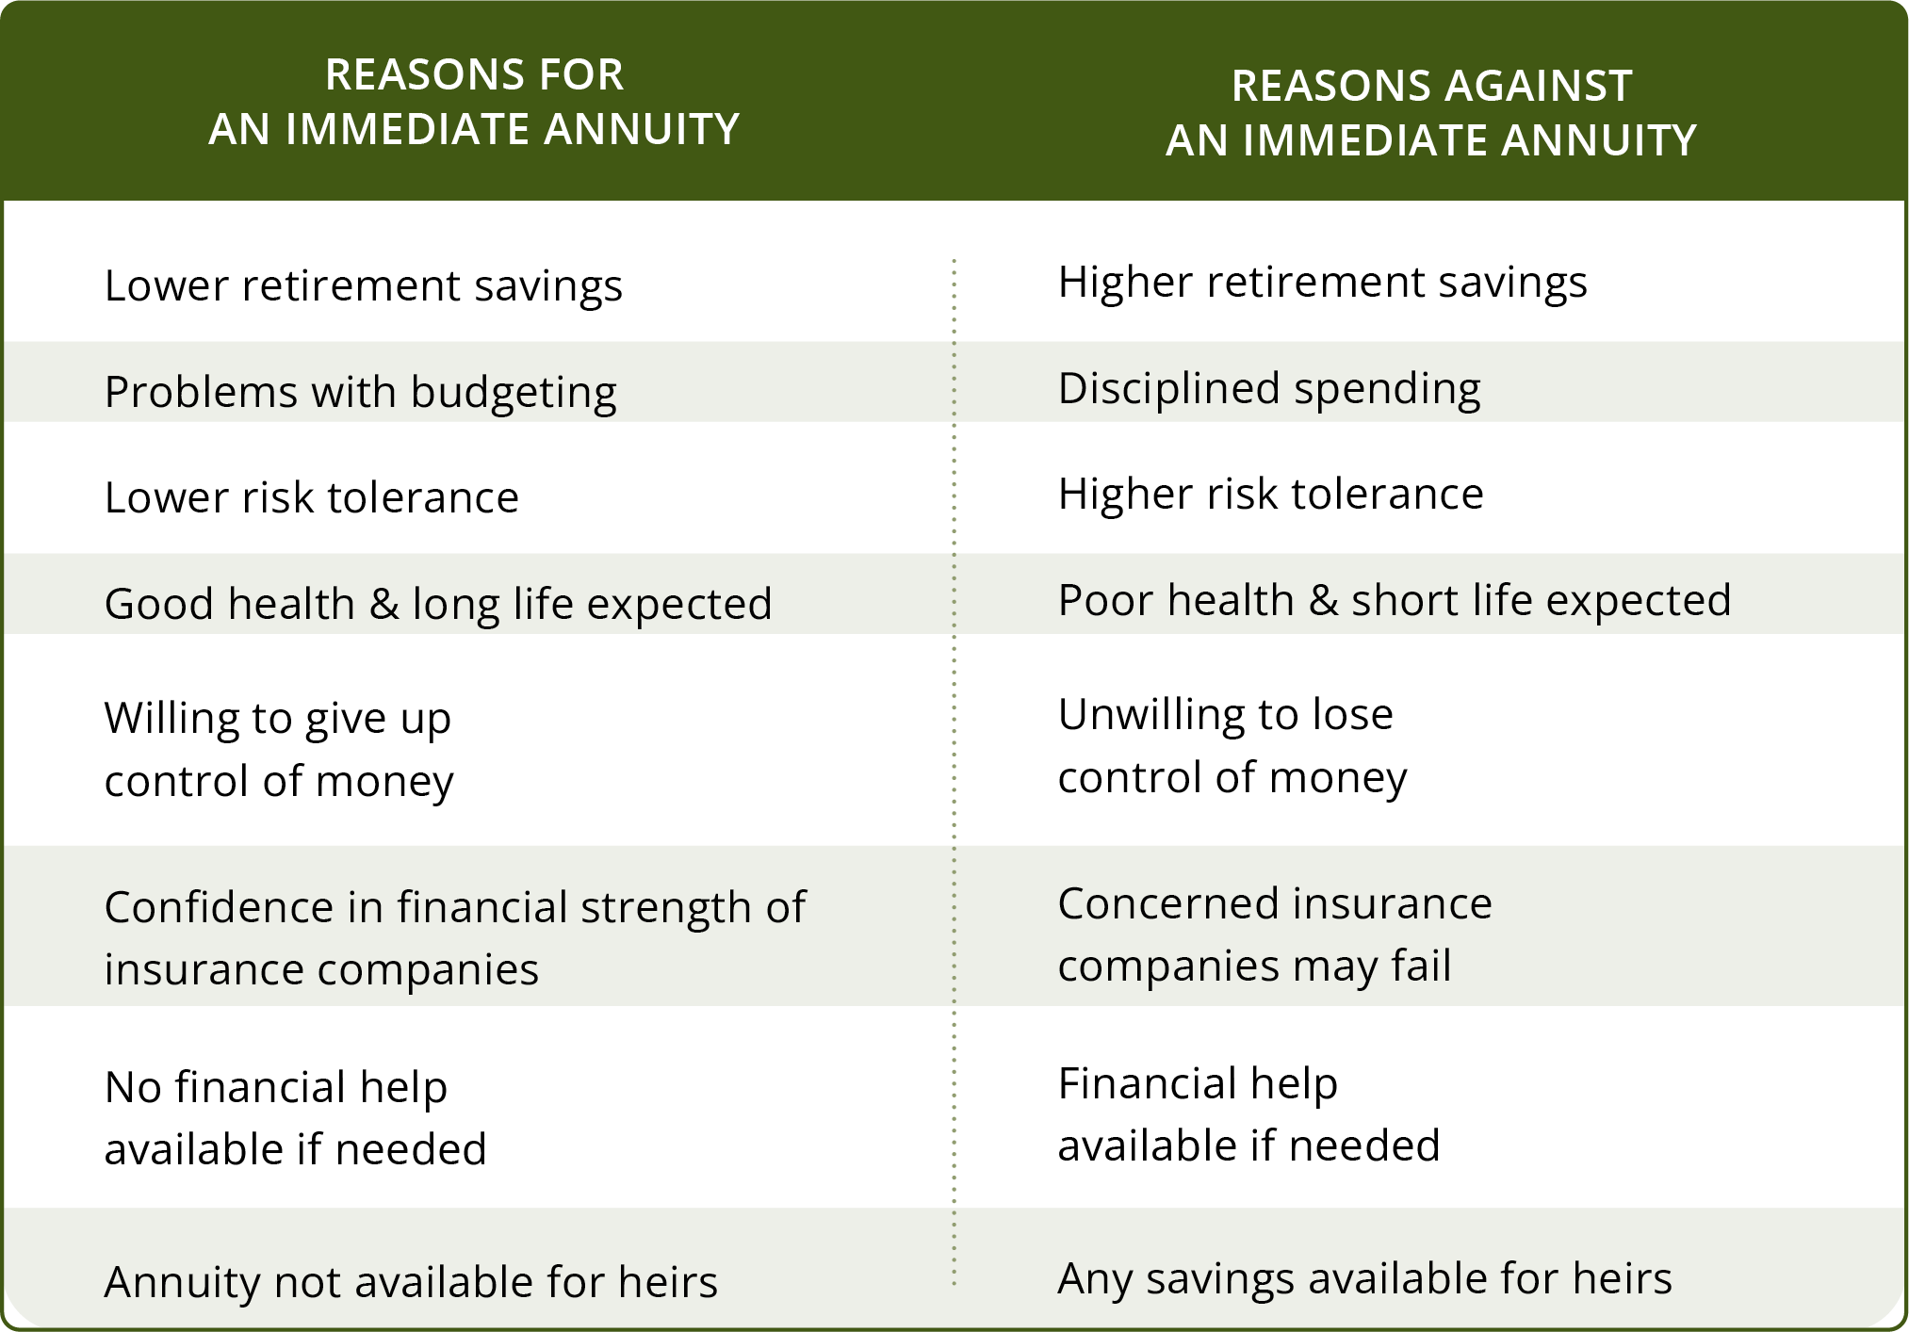
Retirement Income Concerns
Page 1-14
Transferring Longevity Risk

Slide 24
Retirement Income Concerns
Page 1-15
Why Are Seniors at Higher Risk?
As a senior, it can sometimes feel like you have a target on your back
Scammers are always looking for easy marks
Common “pressure points” include loneliness, grief or loss, medical
issues and personal affinities
Notes:
As a senior, it can sometimes feel like you have a target on your back. You’ve spent a lifetime accumulating assets and preparing for retirement. Because of this, you may now have to deal with a near-daily deluge of suspicious emails, strange phone calls and other dubious offers designed to take what you’ve earned.
Scammers are always looking for easy marks. They want to push your emotional buttons, find ways to gain your trust, trigger your fear and uncertainty. They look for anything to move money from your pocket into theirs.
Common “pressure points” that fraudsters take advantage of include:
Loneliness
Grief or loss
Medical issues, especially dementia and hearing problems
Personal affinities, such as faith, race and veteran status
Would you be more inclined to trust someone if they went to your church? How about if they were a veteran like you? Scammers know this, and many try to take advantage of a senior’s faith, race and other personal affinities or attributes to create a relationship that can be exploited for financial gain.

Slide 25
Retirement Income Concerns
Page 1-16
Elder Fraud Prevention
Don’t take logos, seals or job titles at face value
Stop and think before sending funds
Caller ID can be faked!
Don’t send funds without consulting family, attorney or financial professional
Listen to your financial institution!
Discuss with your financial professional before making a big financial decision
Notes:
Here are a few tips to prevent mail, phone and internet fraud:
Don’t take official-looking logos, seals or job titles at face value. Verify!
Stop and think before wiring funds or mailing any pre-paid cards. There’s rarely any way of getting your money back once sent.
Did you call using a phone number found in the phone book or an official web page? Or did someone call you?
Keep in mind that you can always just hang up the phone and that Caller ID can be faked!
Don’t succumb to pressure to hand over funds without first consulting a trusted family member, attorney or financial professional.
Listen to your financial institution! If they warn you a transaction may be fraudulent, think twice before sending money. Financial institutions have trained staff, special technology and often work in conjunction with law enforcement to protect their customers.
Always discuss with your financial professional before making a big financial decision.

Slide 26
Retirement Income Concerns
Page 1-17
Identity Theft Prevention
Keep your Social Security card out of your wallet
Secure personal documents
Get funds delivered by direct deposit
Protect your mail
Order a credit report annually
Use a hard-to-guess password
Review all your incoming bills and statements
Don’t let anyone watch you input your bank PIN passcode
Notes:
Identity theft used to mean simply opening up bank accounts or credit cards; now it can even include stealing your Medicare benefits or IRS tax refund. How can identity theft be better prevented? Don’t make it easy for thieves to get your information!
Keep your Social Security card out of your wallet or purse and use the numbers only when absolutely necessary. Don’t carry around more identification or cards than you need for your outing.
Secure personal documents in a safe place
Get funds delivered by direct deposit rather than by mailed physical checks
Protect your mail, both incoming and what you throw away. Lock your letterbox and shred your mail when you’re finished with it, especially bank statements and credit card offers.
Keep a careful eye on your finances and order a credit report annually
Use a hard-to-guess password complete with uppercase, lowercase, numbers and symbols
Review all your incoming bills and statements
Don’t let anyone watch you input your bank PIN passcode when you’re at a register or ATM

Slide 27


Slide 28
How Long Will My Money Last?
Page 2-1
Introduction
What are your retirement income goals? What will it take to meet them?
Estimate your annual retirement withdrawal expenses
Estimate the income you will receive from Social Security, pensions, investments, and other sources
Determine your estimated annual withdrawals
Understand the effects of taxes and inflation
Understand the risks of market timing and investing into a declining market
Notes:
What are your retirement income goals, and what will it take to meet them? This section will include information on how to:
Estimate your annual retirement withdrawal expenses
Estimate the income you will receive from sources such as Social Security, your pension, investments and other sources
Determine your estimated annual withdrawals
Understand the effects of taxes and inflation
Understand the risks of market timing and the effects of investing into a declining market

Slide 29
How Long Will My Money Last?
Page 2-2
Retirement Income Withdrawal Exercise
Estimate annual withdrawals
Identify income sources
Estimate investment assets
Calculate annual withdrawal rate
Notes:
Estimating the annual withdrawal percentage that is needed to meet your retirement expenses will provide valuable insights and help you to develop your retirement income plan.
Estimate Annual Withdrawal: Example
In our example, Mike and Sue are both 65 years old and recently retired. To determine their annual withdrawal percentage rate needed to meet expenses, we will need to calculate four totals:
Estimate annual withdrawals
Identify income sources
Estimate investment assets
Calculate annual withdrawal rate
Retirement expenses need to be calculated:
On a monthly basis (and multiply by 12 for annual expenses)
On an annual basis

Slide 30
How Long Will My Money Last?
Page 2-3
Step 1: Estimate Annual Expenses
Necessary Expenses:
Housing $_________
Transportation $_________
Income taxes $_________
Healthcare $_________
Food $_________
Clothing $_________
Misc. $_________
Discretionary Expenses:
Entertainment $_________
Travel $_________
Gifts $_________
Misc. $_________
Necessary annual expenses $_______
+ Discretionary annual expenses $_______
Total annual expenses ($68,550)
Notes:
Necessary Expenses:
Housing (mortgage/rent, property tax, insurance, repairs, furniture/appliances, utilities)
Transportation (loan payments, insurance, repairs, gasoline)
Income taxes (federal, state, local, payroll)
Healthcare (insurance, doctor/dental expenses, prescriptions, long-term care)
Food
Clothing
Misc. (other insurance, other loans)
Discretionary Expenses:
Entertainment (dining out, hobbies, movies, membership dues)
Travel (vacations, family visits)
Gifts (holiday, charitable, family)
Misc. (personal items)
Necessary annual expenses + Elective annual expenses = Total annual expenses (income needed) = $68,550

Slide 31
How Long Will My Money Last?
Page 2-4
Step 2: Identify Income Sources
Income Sources:
Social Security $_________
Pension $_________
Employment $_________
Rental income $_________
Farm income $_________
Royalties $_________
Trust income $_________
Other sources $_________
Each income source needs to be calculated:
On a monthly basis
On an annual basis
Annual income sources = $45,120
Notes:
To estimate retirement income, each income source needs to be calculated:
On a monthly basis
On an annual basis
Income Sources:
Social Security
Pension
Employment
Rental income
Farm income
Royalties
Trust income
Other income sources
Income sources (annual total) = $45,120

Slide 32
How Long Will My Money Last?
Page 2-5
Step 3: Estimate Investment Assets
Investment Assets
Savings accounts & CDs
401(k), 403(b), SEP-IRA, SIMPLE, 457 Plans
IRAs
Stocks & bonds
Mutual funds & ETFs
Deferred annuities
Other
Total investment assets = $585,750
Notes:
Add up the market value of investment assets that may generate retirement income.
Investment Assets:
Savings accounts
Certificates of Deposit
401(k), 403(b), SEP-IRA, SIMPLE, 457 Plans
IRAs (Traditional, Roth, Inherited)
Stocks and bonds
Mutual funds and exchange traded funds
Deferred annuities
Other
Total investment assets = $585,750

Slide 33
How Long Will My Money Last?
Page 2-6
Step 4: Calculate Annual Withdrawal Rate
Total annual expenses or income needed: $68,550
- Income sources (annual total): ($45,120)
= Annual income required from assets: $23,430
Annual income required from assets: $23,430
÷ Total investment assets: $585,750
= Percentage annual withdrawal rate: 4%
Notes:
Total annual expenses or income needed: $68,550
- Income sources (annual total): ($45,120)
= Annual income required from assets: $23,430
Annual income required from assets: $23,430
÷ Total investment assets: $585,750
= Percentage annual withdrawal rate: 4%
Mike and Sue need a withdrawal rate of 4% to meet their current annual retirement shortfall. Without calculating future inflation, investment returns and taxes, we can see that their annual income shortfall of $23,430 over 25 years totals $585,750, which is the total of all of their investment assets. In 25 years, our 65-year-old couple would be 90. One or both of them may still be living and have income needs.
If they are not comfortable with how long their money may last, they may need to:
Reduce their elective (optional) expenses
Continue to work part-time in retirement
Invest somewhat aggressively
Mike and Sue are not too far off, so minor adjustments should hopefully allow them to reach their retirement goals.

Slide 34
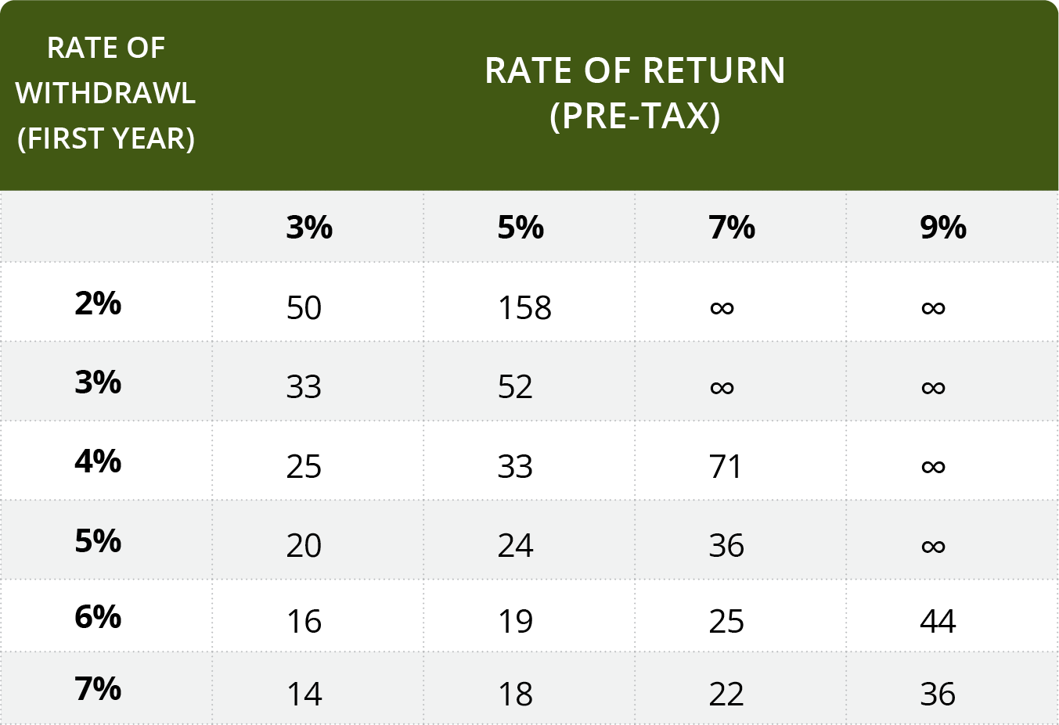
How Long Will My Money Last?
Page 2-7
Retirement Income Withdrawals¹
¹ Withdrawals are taken at the beginning of each year. After the first year, annual withdrawals increase by 3% each year to compensate for future inflation. Results do not include any fees or expenses that would be incurred with an actual investment. Hypothetical investment results do not represent any specific product and are for illustrative purposes only.
Notes:
This table shows how many years your money may last. In this chart, annual withdrawals increase by 3% each year to estimate the effects of inflation.
Assumptions:
Withdrawals are taken at the beginning of each year
After the first year, annual withdrawals increase by 3% each year to compensate for future inflation
Results do not include any fees or expenses that would be incurred with an actual investment
Hypothetical investment results do not represent any specific product and are for illustrative purposes only

Slide 35
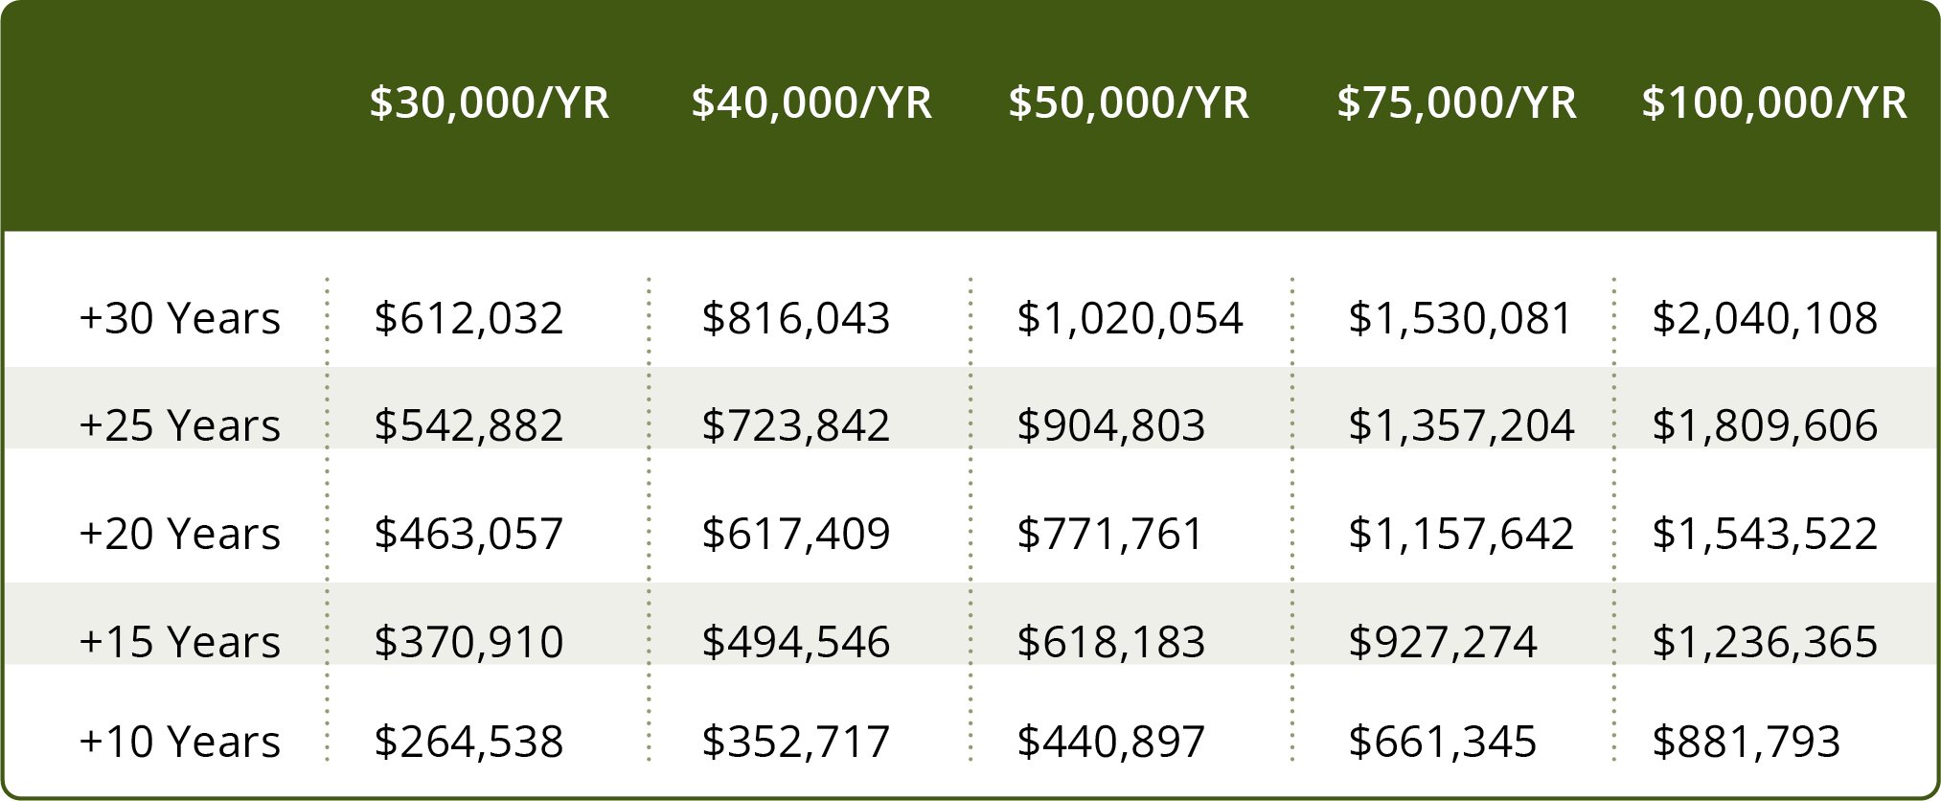
How Long Will My Money Last?
Page 2-8
Withdrawing Investment
Income from your Portfolio¹
¹ Please note that this chart comes with a few assumptions, including 6% average annual yield on balance (hypothetical and does not represent any specific investment or strategy), 3% annual inflation rate, all savings are fully invested and the principal is $0 at the end of the stated term
Notes:
While we may not know how long our lives will last, we often have more control over how much we spend in a given year. This chart is a good example of what it might take to live off your investments for 10, 20, even 30 years.
Please note that this chart comes with a few assumptions, including the following:
6% average annual yield on balance (hypothetical and does not represent any specific investment or strategy)
3% annual inflation rate
All savings are fully invested
The principal is $0 at the end of the stated term

Slide 36
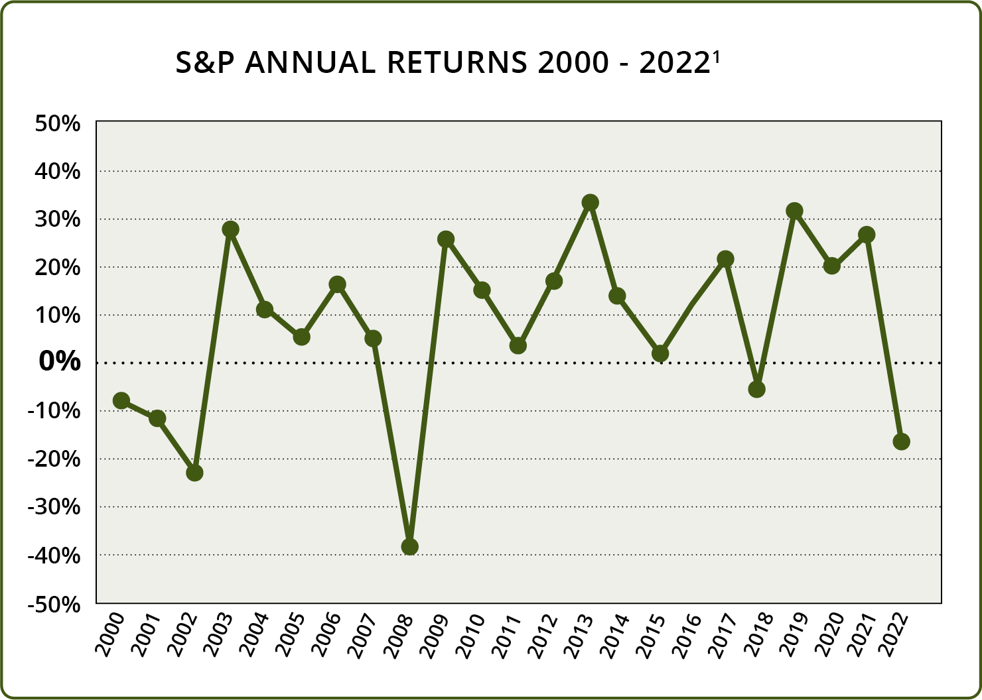
How Long Will My Money Last?
Page 2-9
Investing in a Declining Market
¹ S&P Dow Jones Indices, S&P 500. Retrieved January, 2023.
All information for an index prior to its Launch Date is hypothetical back-tested, not actual performance, based on the index methodology in effect on the Launch Date. Actual returns may differ significantly from, and be lower than, back-tested returns. Past performance is not an indication or guarantee of future results.

Slide 37
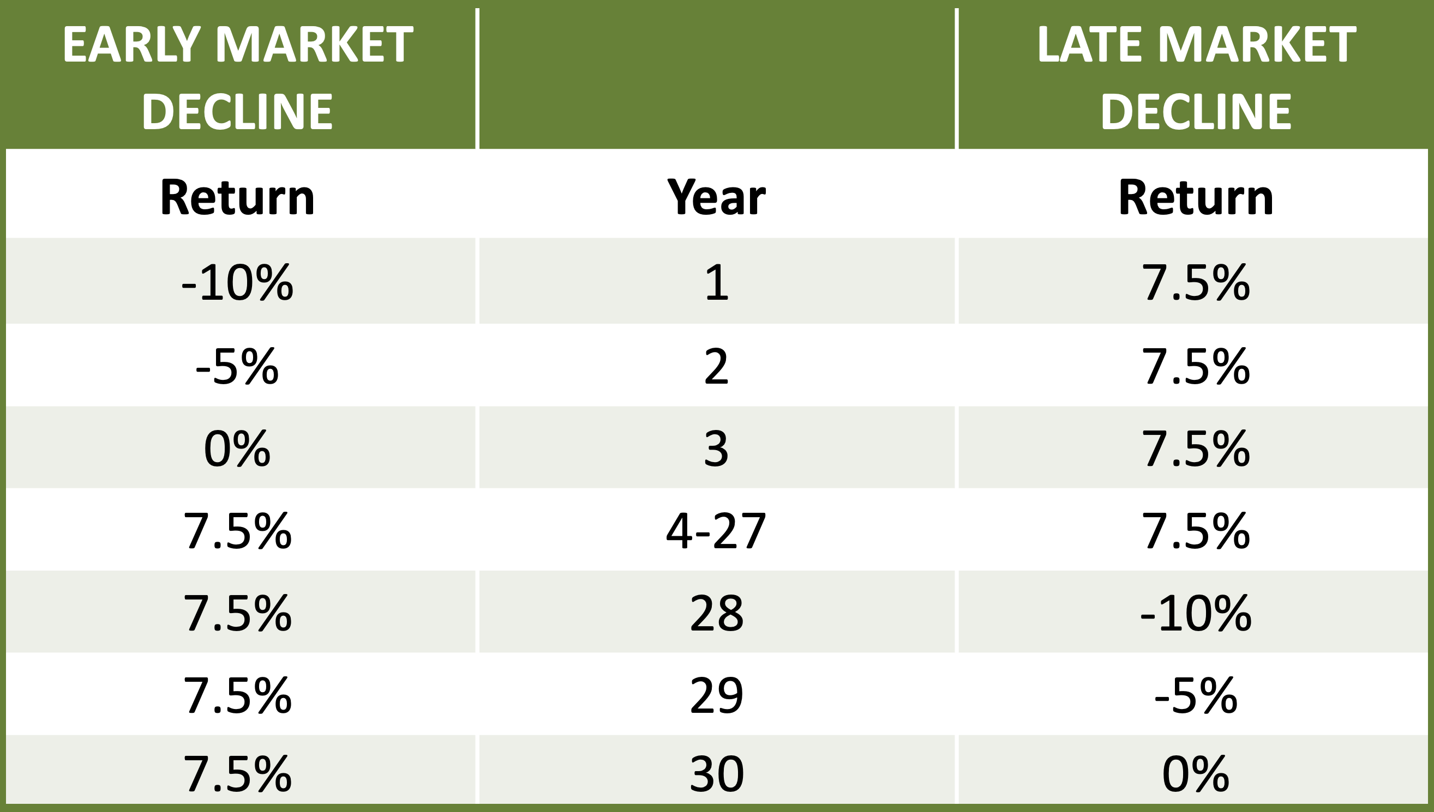
How Long Will My Money Last?
Page 2-9
Impact of Down Markets¹
Systematic withdrawals are subject to market fluctuations
It can make a significant difference when a down market occurs
Example
$1,000,000 nest egg
$50,000 annual withdrawal (5%) over 30 years
3% annual adjustment for inflation
¹ Return is annualized percentage. Inflation adjustment compounded annually. Withdrawals taken at the beginning of the year. Sales charges and taxes are not considered. Hypothetical illustration, not typical of actual returns or representative of any specific investment.
Notes:
When seniors rely on systematic withdrawals from accounts that are subject to market fluctuations, it can make a significant difference when they experience a down market.
In the following example, we’ll take a look at the purposefully oversimplified difference between a hypothetical market decline late into retirement compared to a hypothetical decline early in retirement.
Let’s begin with the following assumptions:
$1,000,000 nest egg
$50,000 annual withdrawal (5%) over 30 years
3% annual adjustment for inflation

Slide 38
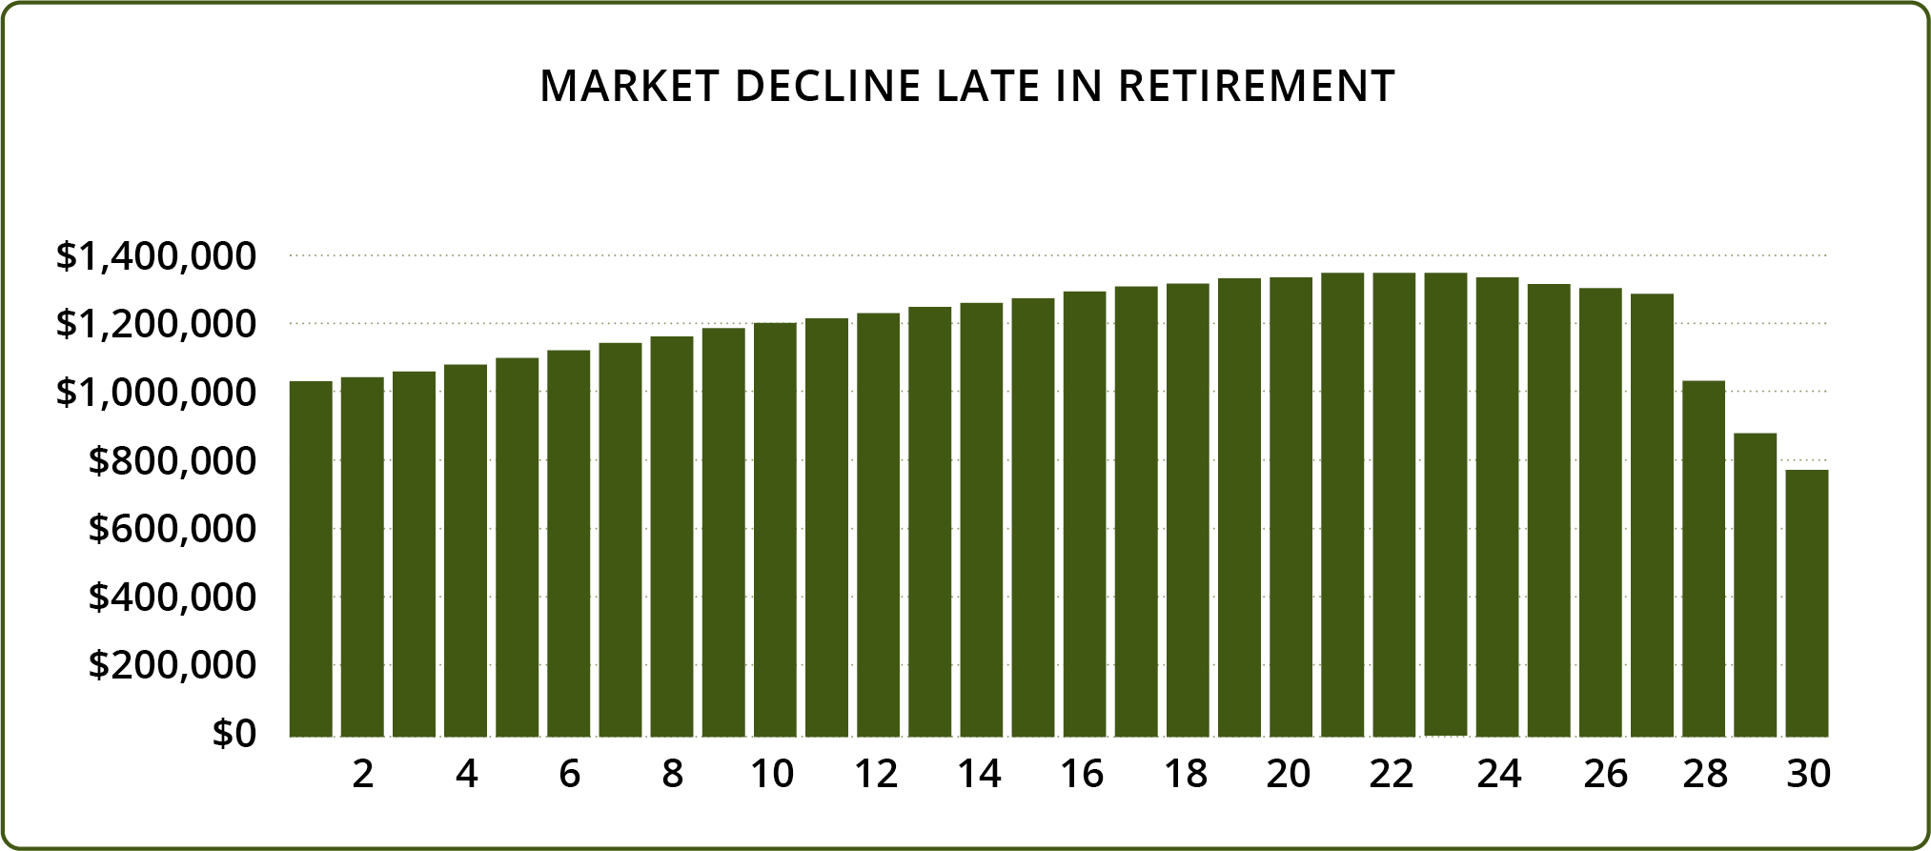
How Long Will My Money Last?
Page 2-10
Investing in a Declining Market
Notes:
Scenario 1: Market decline late in retirement
Years 1-27: 7.5% annual return
Year 28: 10% market decline
Year 29: 5% market decline
Year 30: 0% market change
$50,000 annual withdrawal, adjusted yearly for 3% inflation
As you can see from this hypothetical example, there is still nearly $800,000 left in the account despite withdrawals and market decline in the final three years. The account was allowed to grow as the annual withdrawal was smaller than the rate of growth.
Return is annualized percentage. Inflation compounded annually. Withdrawals taken at the beginning of the year. Sales charges/taxes not considered. Hypothetical illustration, not typical of actual returns or representative of any specific investment.

Slide 39
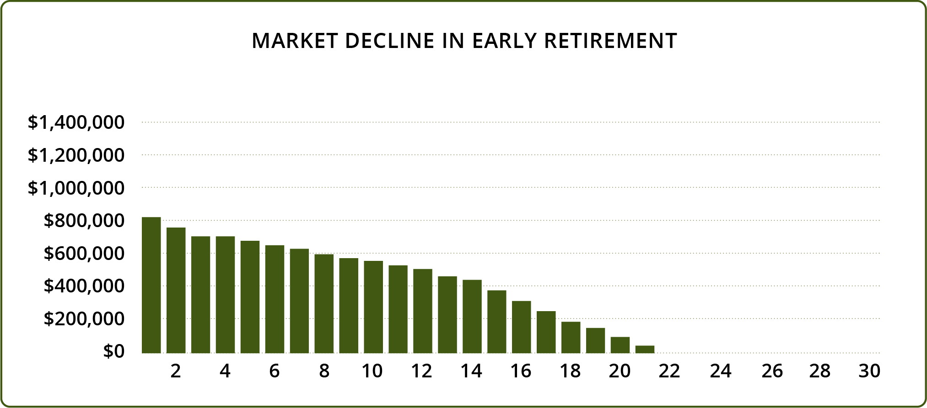
How Long Will My Money Last?
Page 2-11
Investing in a Declining Market
Notes:
Scenario 2: Market decline in early retirement
Year 1: 10% market decline
Year 2: 5% market decline
Year 3: 0% market change
Year 4-30: 7.5% annual return
$50,000 annual withdrawal, adjusted yearly for 3% inflation
The same decline early in the withdrawal period has a significant effect. The initial decline resulted in a situation where the annual withdrawals were larger than the rate of growth, meaning the balance declined each subsequent year and in this example was completely depleted after 21 years.
Return is annualized percentage. Inflation compounded annually. Withdrawals taken at the beginning of the year. Sales charges/taxes not considered. Hypothetical illustration, not typical of actual returns or representative of any specific investment.

Slide 40
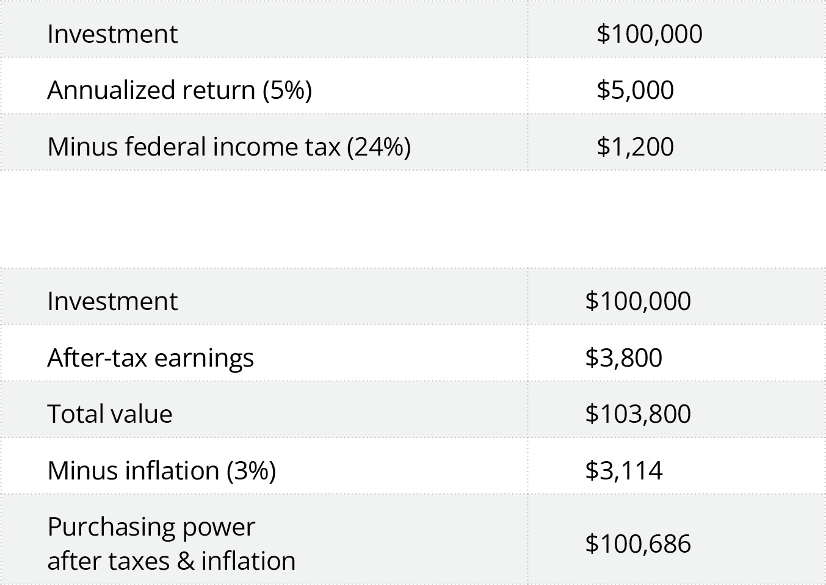
How Long Will My Money Last?
Page 2-12
Taxes & Inflation¹
¹ This illustration is hypothetical and does not represent the performance of any investment product.
Notes:
This chart shows how income taxes and inflation can impact investment returns and purchasing power.
Let’s assume that a retiree has $100,000 earning 5%, or $5,000 per year. Assuming they will owe ordinary income tax on that $5,000 and assuming a 24% federal income tax bracket, it will reduce their earnings by $1,200 to $3,800. There is also inflation to consider. If inflation is 3% on average, they will lose $3,114 in purchasing power. If you subtract income taxes and inflation, instead of earning $5,000, they end up gaining only $686 in purchasing power. If the return were lower or inflation higher, they could actually lose purchasing power.

Slide 41
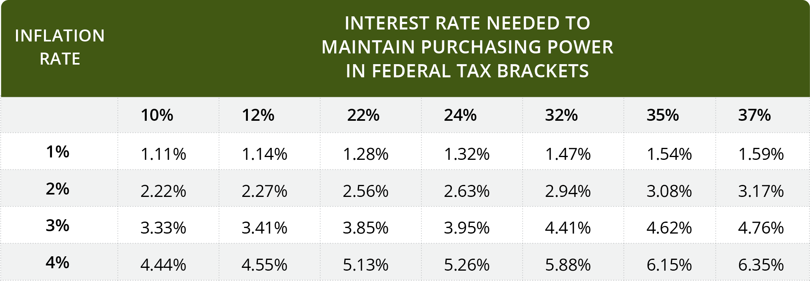
How Long Will My Money Last?
Page 2-12
Income Taxes & Inflation
Notes:
To calculate what interest rates are needed to break even (in terms of purchasing power) depends upon the inflation rate and your federal tax bracket.
Inflation rate divided by (1 minus federal tax rate) equals the interest rate needed to maintain purchasing power.
For example, at a 3% inflation rate, someone in the 24% tax bracket would have to earn 3.95% on a taxable investment to maintain purchasing power.

Slide 42
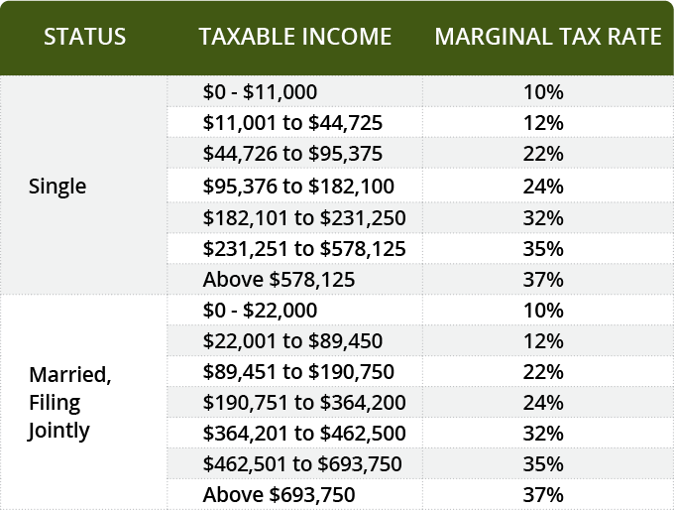
How Long Will My Money Last?
Page 2-13
2023 Federal Tax Brackets
Source: Internal Revenue Service

Slide 43
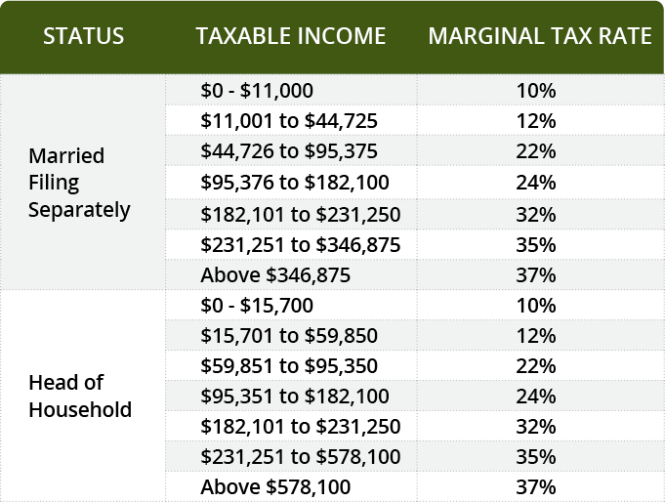
How Long Will My Money Last?
Page 2-13
2023 Federal Tax Brackets
Source: Internal Revenue Service

Slide 44
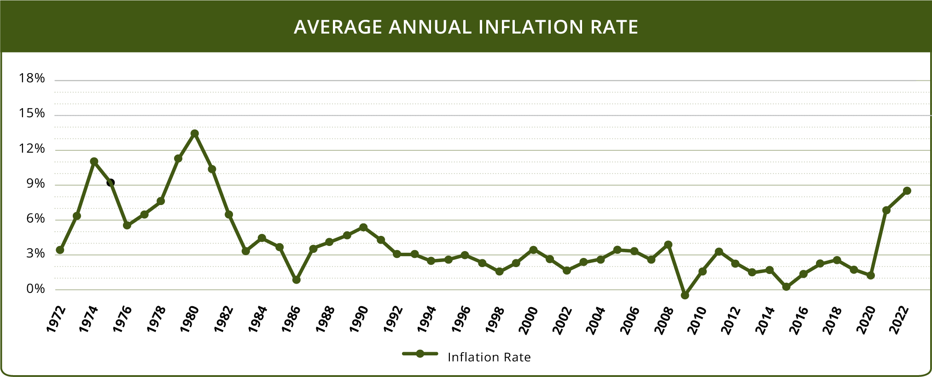
How Long Will My Money Last?
Page 2-14
Understanding Inflation¹
¹ Consumer Price Index, 1970 – 2022. For illustrative purposes only.
Notes:
Over time, inflation erodes the purchasing power of your dollars. Historical statistics show that inflation can be volatile and unpredictable. A low inflation rate today doesn’t guarantee a low or even moderate inflation rate over the next 20 - 30 years.

Slide 45
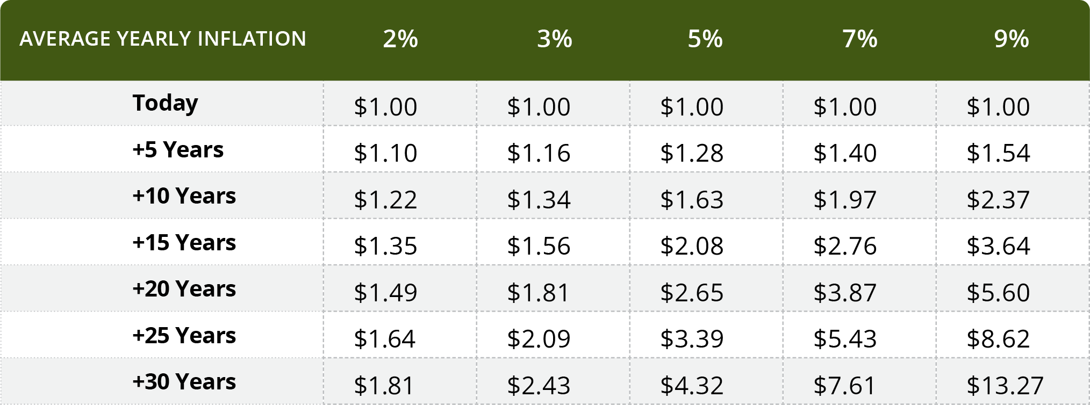
How Long Will My Money Last?
Page 2-14
Understanding Inflation¹
¹ Calculations and amounts are approximate due to rounding. Inflation has been compounded annually. This table is not intended to predict or represent any actual historical period.
Notes:
Like any rate, inflation is compounding. This is an important planning consideration, especially for anyone retiring on a fixed income. The following table shows how much money would be required to equal one dollar of today’s purchasing power under a number of hypothetical annual inflation scenarios.

Slide 46
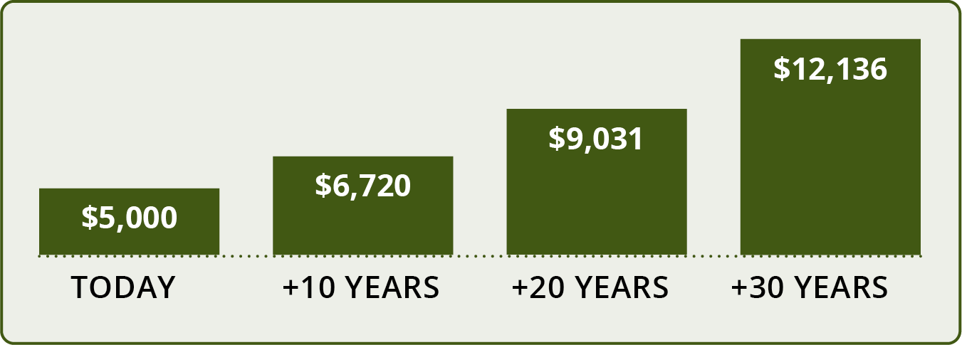
How Long Will My Money Last?
Page 2-15
Understanding Inflation
At a hypothetical 3% annual inflation rate, approximately how much income
would be required to create the equivalent of $5,000 in today’s dollars?¹
¹ Chart is for illustrative purposes only.
Notes:
At a hypothetical 3% annual inflation rate, approximately how much income would be required to create the equivalent of $5,000 in today’s dollars?

Slide 47
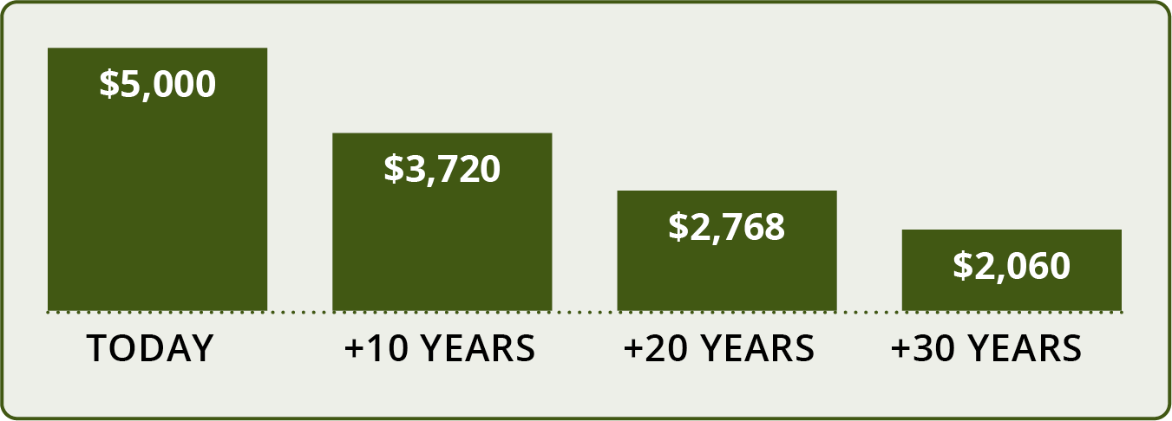
How Long Will My Money Last?
Page 2-15
Understanding Inflation
At a hypothetical 3% annual inflation rate, what might be the approximate future purchasing power of $5,000?²
² Chart is for illustrative purposes only.
Notes:
At a hypothetical 3% annual inflation rate, what might be the approximate future purchasing power of $5,000?

