Slide 1
Presented by:
[ Name of Instructor ]

Slide 2
[Broker-Dealer Disclosure]
This material is intended to provide general financial education and is not written or intended as tax or legal advice and may not be relied on for purposes of avoiding any Federal tax penalties. Individuals are encouraged to seek advice from their own tax or legal counsel. Individuals involved in the estate planning process should work with an estate planning team, including their own personal legal or tax counsel. This material is for informational purposes only and is not an offer to sell or a solicitation of any offer to buy any securities.
Course instructors are not employees or agents of Financial Educators Network®. Financial Educators Network® prohibits instructors from making specific recommendations and endorsing or selling products during the course. Once the course has ended, instructors may offer financial advice, products, or other services as an agent for insurance companies and/or broker-dealer firms. These services are not offered on behalf of Financial Educators Network®. Financial Educators Network® does not sell or endorse any insurance or investment products.

Slide 3
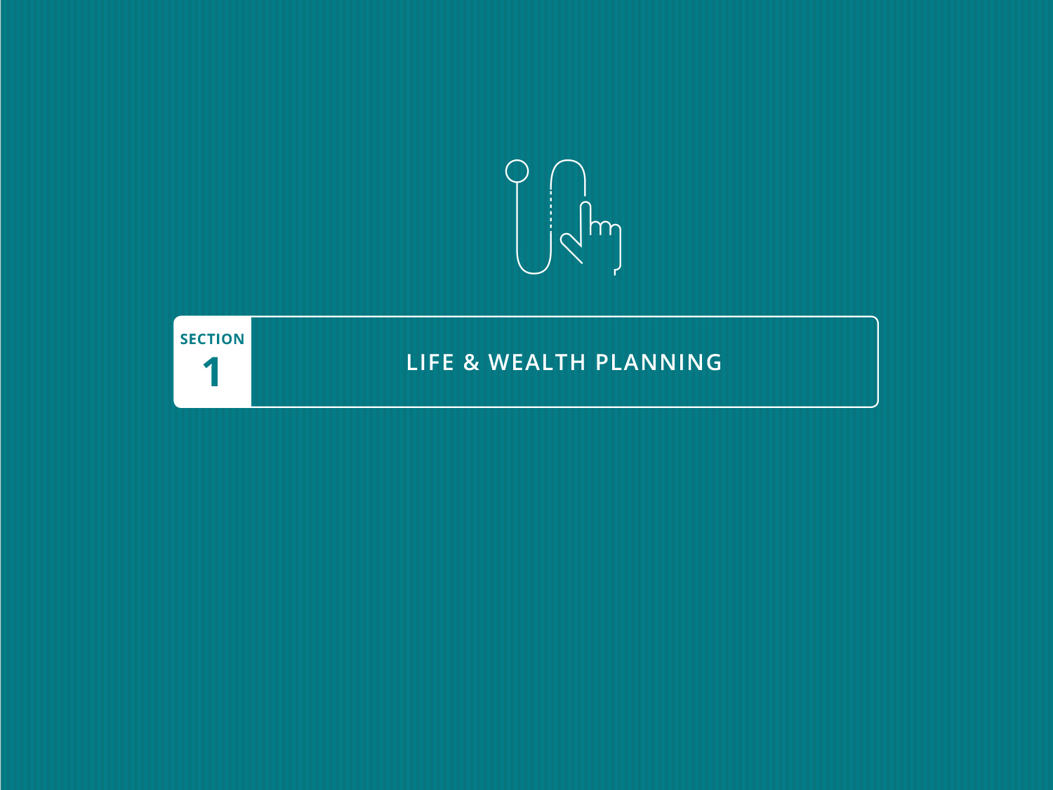

Slide 4
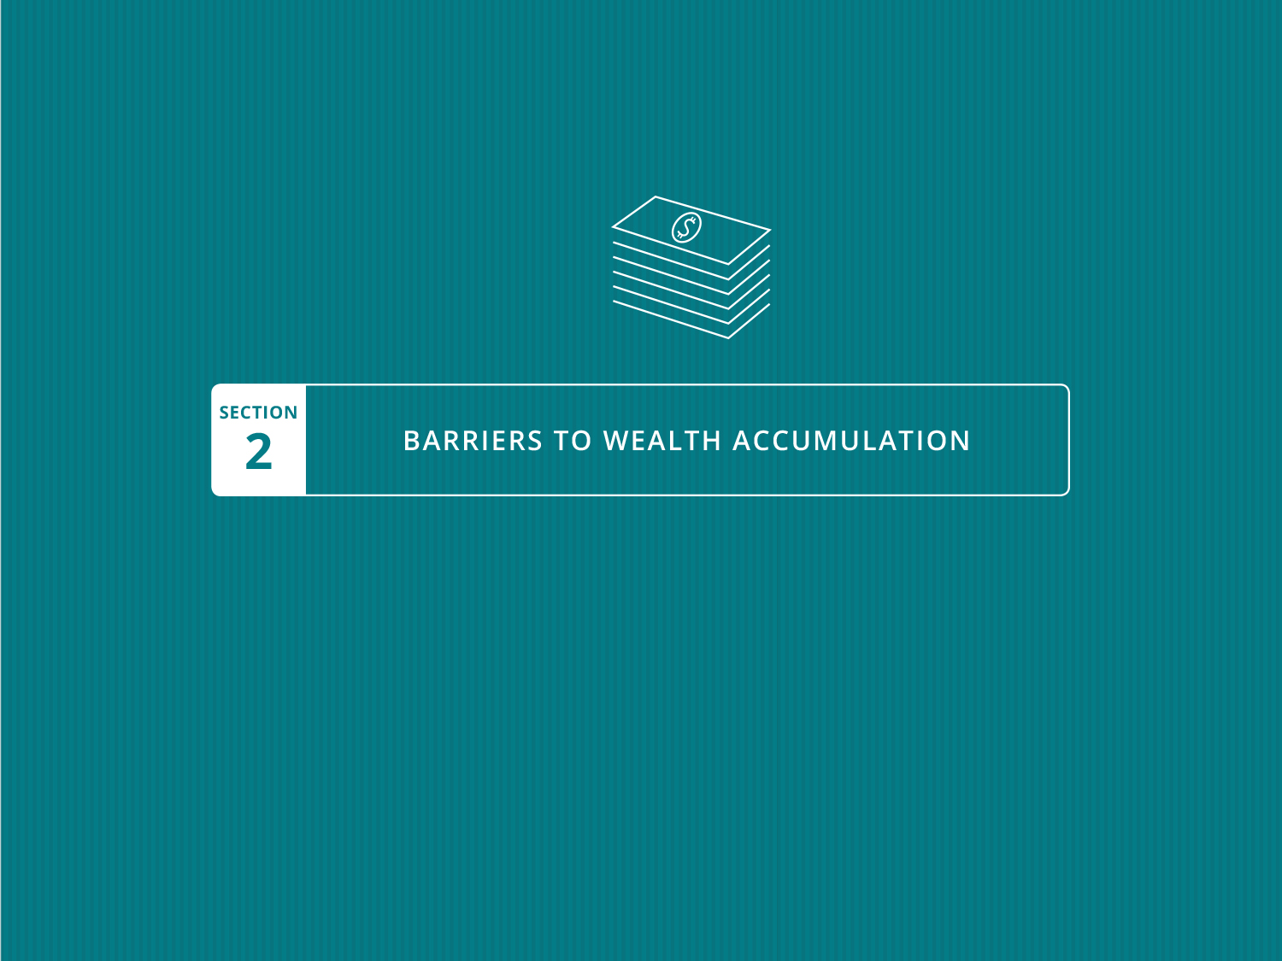

Slide 5

What’s Your Wealth Accumulation Formula?
Barriers to Wealth Accumulation
2-1
Notes:
There are many wealth accumulation options and strategies
All depend on assumptions about the future
Strategies are highly dependent on an individual’s time horizon and risk capacity
Some strategies are highly active; others are passive
Many investors choose knowledge area-specific strategies, such as tech or real estate
Your Wealth Formula May Depend on the Following:
Effective wealth planning and budgeting
Debt reduction
Tax efficiency
Risk mitigation
Return on investment greater than:
Inflation and losses
Distributions
Fees

Slide 6
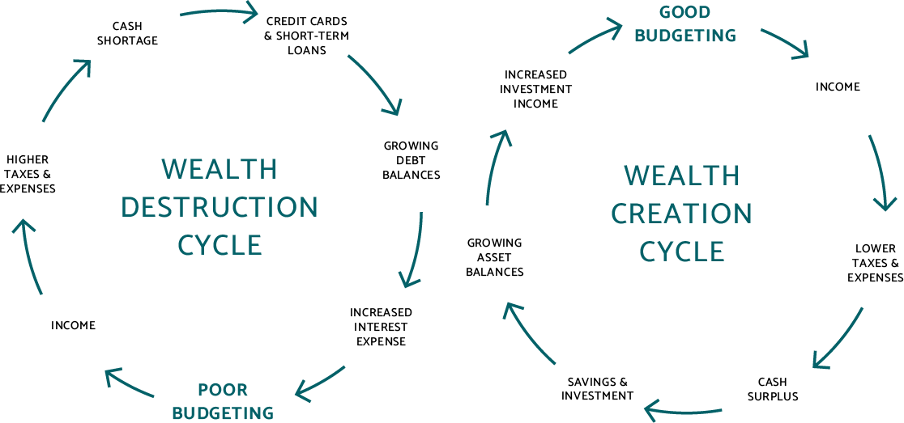
Wealth Creation & Destruction Cycles
Barriers to Wealth Accumulation
2-2

Slide 7
Barriers to Wealth Accumulation
2-3
The Top 14 Wealth Planning Mistakes
  Didn’t define lifestyle goals
  Won’t set financial goals that meet lifestyle goals
  Can’t make a commitment to financial success
  Never sought financial education
  Wouldn’t take a personal financial inventory
  Failed to effectively manage credit
  Skipped opportunities to seek financial advice and assistance
Notes:
Didn’t define lifestyle goals for the future
Won’t set financial goals that meet lifestyle goals
Can’t make a commitment to personal financial success
Never sought personal finance education
Wouldn’t regularly take a personal financial inventory
Failed to effectively manage credit
Skipped opportunities to seek financial advice and assistance

Slide 8
Barriers to Wealth Accumulation
2-3
The Top 14 Wealth Planning Mistakes
  Wouldn’t invest early or regularly
  Failed to use tax laws
  Can’t allocate assets properly
  Failed to plan for the unexpected or insure risks
  Won’t take advantage of employer benefit plans
  Never chose best way to take money out
  Didn’t plan for the estate
Notes:
8. Wouldn’t invest early or on a regular basis
9. Failed to use tax laws to full advantage
10. Can’t allocate assets properly or adjust as needed
11. Failed to plan for the unexpected or insure risks
12. Won’t take full advantage of employer benefit plans
13. Never chose best way to take money out of retirement plan
14. Didn’t plan for the estate

Slide 9
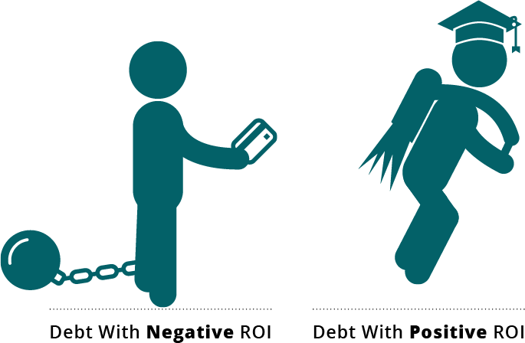
Is Your Debt Working For or Against You?
Barriers to Wealth Accumulation
2-4
Notes:
Wealth Sustaining Debt
Student or career retraining loans
Home mortgage with deductible interest
A small business loan to purchase a company or commercial real estate
Consolidating home equity loan
Wealth-Destroying Debt
High-interest credit cards or other credit lines¹
Revolving personal loans
Loan against 401(k) or other retirement plan
Financing luxury goods
Unfunded/unneeded discretionary purchases
1 Loans through credit cards and similar arrangements are prohibited per the SECURE Act of 2019

Slide 10
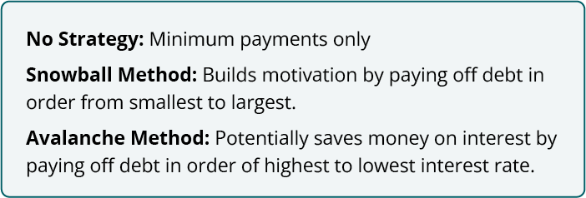
Debt Reduction Strategies
Barriers to Wealth Accumulation
2-5
Notes:
What is your debt reduction strategy? Both of the following strategies involve choosing what order you pay down debt. Sequential debt ordering means one debt is paid off at a time while minimum payments are made on all others.
No Strategy: Minimum payments only.
Snowball Method: Builds motivation by paying off debt in order from smallest to largest.
Avalanche Method: Pay off debt in order of highest to lowest interest rate.

Slide 11
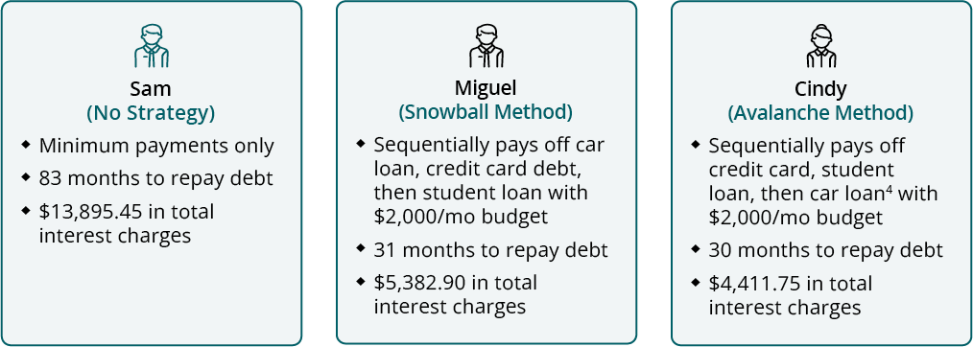
Debt Reduction Strategies
Barriers to Wealth Accumulation
2-5
  Sam, Miguel and Cindy all have $15,000 on credit cards at 15.99%¹ APR, a
  $10,000 car loan at 3.5%² APR, and a $30,000 in student loans at 4.5%³ APR
¹ $300 hypothetical minimum payment maintained or exceeded.
² $400 hypothetical minimum payment maintained or exceeded.
³ $550 hypothetical minimum payment maintained or exceeded.
⁴ Despite sequencing, car loan will be paid off before the student loan due to loan term and resulting minimum payments.
Notes:
am will pay minimum payments only. Miguel and Cindy have a budget of $2,000 a month that they plan to put towards this debt.
$15,000 credit card debt at 15.99%
$10,000 car loan at 3.5%
$30,000 student loan at 4.5%

Slide 12

Examples of “Good” & “Bad” Debt
Barriers to Wealth Accumulation
2-6
¹ Not all real estate investments generate a positive return on investment. Example only for illustrative purposes.

Slide 13
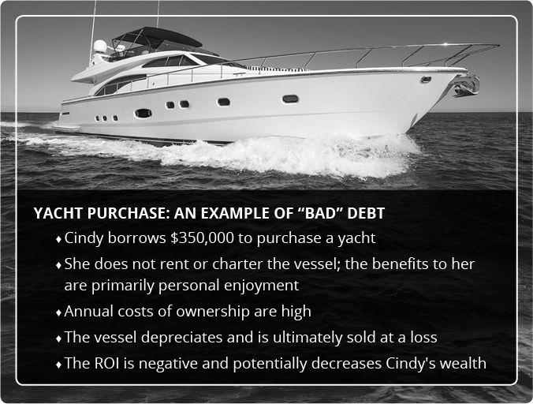
Examples of “Good” & “Bad” Debt
Barriers to Wealth Accumulation
2-6

Slide 14
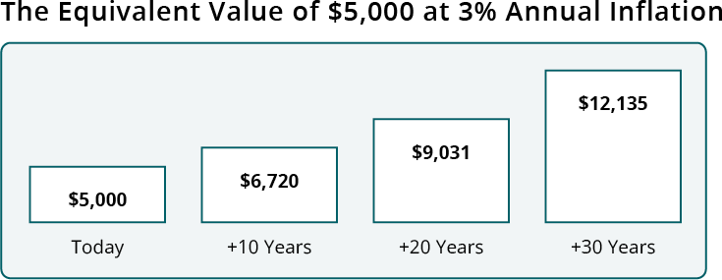
Barriers to Wealth Accumulation
2-7
How Compounding Inflation Destroys Wealth¹
¹ Charts are for illustrative purposes only.
Notes:
For the following exercise, let’s pretend you have a fixed monthly income of $5,000. What is the relationship between a fixed income and inflation?
Purchasing Power, Equivalent Value, and the Power of Inflation
Here are other ways of looking at inflation
These charts reflect a hypothetical 3% annual inflation rate
What would these charts look like at 5% annual inflation? What about 8%?

Slide 15
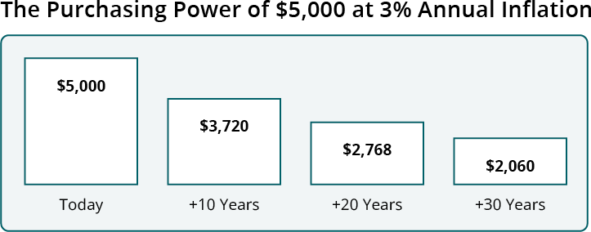
Barriers to Wealth Accumulation
2-7
How Compounding Inflation Destroys Wealth¹
¹ Charts are for illustrative purposes only.
Notes:
For the following exercise, let’s pretend you have a fixed monthly income of $5,000. What is the relationship between a fixed income and inflation?
Purchasing Power, Equivalent Value, and the Power of Inflation
Here are other ways of looking at inflation
These charts reflect a hypothetical 3% annual inflation rate
What would these charts look like at 5% annual inflation? What about 8%?

Slide 16
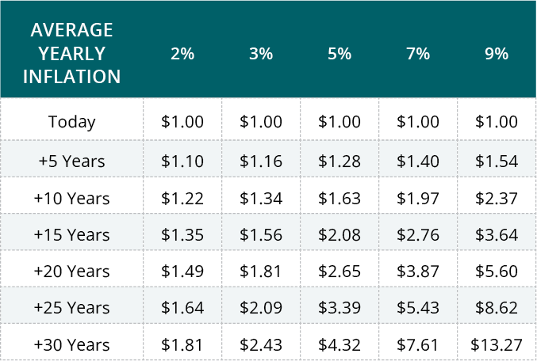
How Inflation Compounds¹
Barriers to Wealth Accumulation
2-8
¹ For illustrative purposes only. Calculations and amounts are approximate due to rounding. Inflation has been compounded annually. This table is not intended to predict or represent any actual historical period.
Notes:
Inflation compounds. This is an important planning consideration to take into account, especially for anyone retiring on a fixed income. The following table shows how much money would be required to equal one dollar of today’s purchasing power under a number of hypothetical annual inflation scenarios.
Considering Hypothetical Future Inflation Scenarios
How does the chart illustrate inflation under varying scenarios?
Inflation erodes purchasing power
Inflation is an important consideration for financial planning

Slide 17
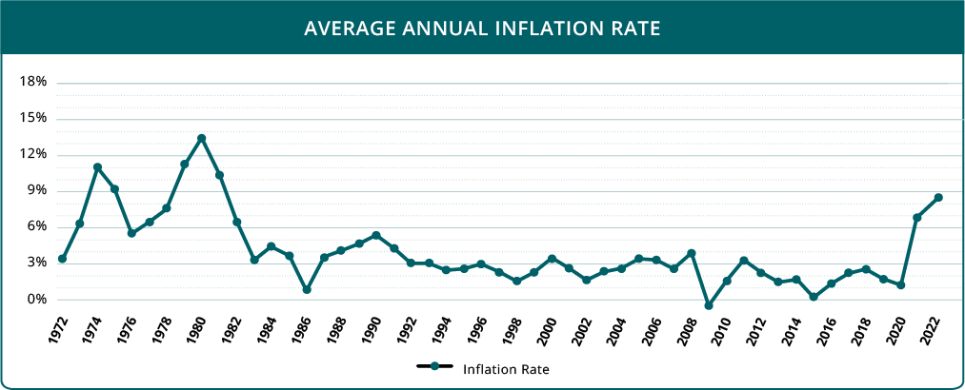
The Impact of Inflation
Barriers to Wealth Accumulation
2-9
Average Annual Inflation Rate¹
¹ Consumer Price Index, 1995 – 2022.
Notes:
Over time, inflation erodes the purchasing power of your dollars. Historical statistics show that inflation can be volatile and unpredictable. As we age, the types of good and services we consume change as well, meaning that one’s individual spending will rarely track inflation as an overall measure.
Today’s low inflation doesn’t guarantee a low or even moderate future inflation
Medical, housing, energy, and personal spending may not inflate uniformly
The rate of inflation will not mirror your personal spending or finances

Slide 18
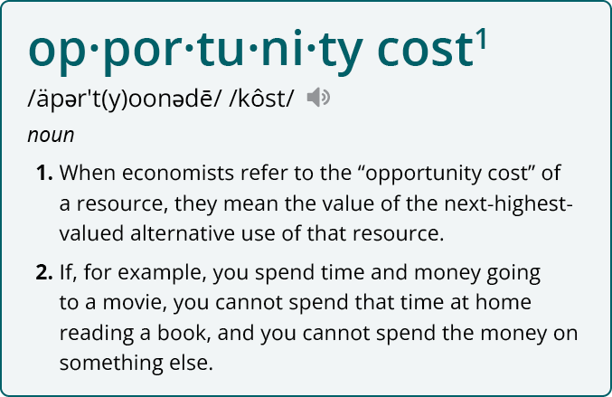
Understanding Opportunity Cost¹
Barriers to Wealth Accumulation
2-10
¹ Henderson, David R. "Opportunity Cost", The Concise Encyclopedia of Economics.

Slide 19
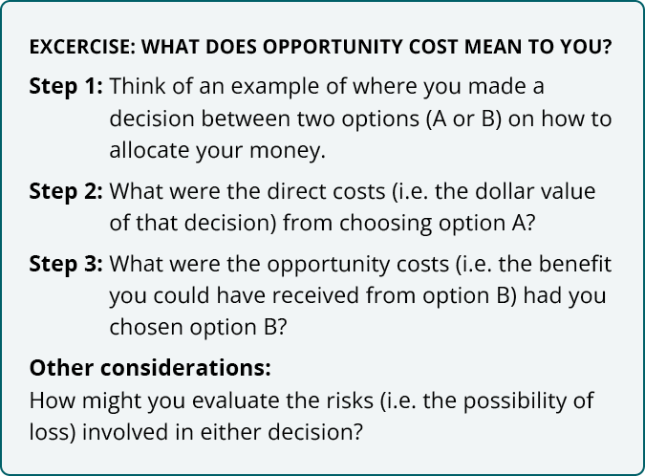
Understanding Opportunity Cost
Barriers to Wealth Accumulation
2-10

Slide 20
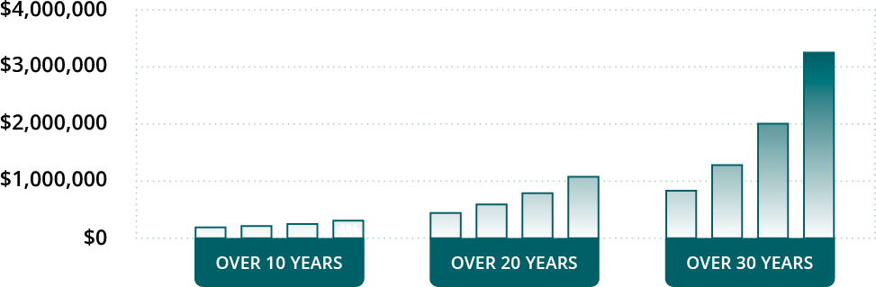
Investing Early & Regularly
Barriers to Wealth Accumulation
2-11
Bob’s Hypothetical $50,000 Initial Investment, $1,000 Monthly Contribution¹
  Compounding interest uses the power of time and reinvested interest to make an investment grow more quickly
¹ Each investor’s results will vary from these shown as investing involves risk, fluctuating returns, and the possibility of loss. Investment results are hypothetical and are for illustrative purposes only. Calculations do not consider taxes or inflation. Figures do not represent any actual investment or strategy.
Notes:
One roadblock faced by many investors is the failure to invest early enough, or on a regular basis. While it is often best to begin as early as possible, it’s never too late to get started.
Time is money. This axiom holds especially true when it comes to leveraging compound interest when investing. Compounding interest uses the power of time and the reinvestment of interest and/or dividends to make an investment grow more quickly. The graphs show the power of compound interest at work.

Slide 21
Barriers to Wealth Accumulation
2-12
Overcoming Common Investment Fears
“I’m afraid of losing my principal investment”
“What if I don’t have enough liquidity and lose my job or
face a medical issue or other unplanned emergency?”
“I’ve heard stories about financial scams and fraud”
Notes:
“I’m afraid of losing my principal investment”
Your risk capacity is a critical consideration for any investment
While all investments carry some risk, certain types put your investment principal at less risk than others
“What if I don’t have enough liquidity and lose my job or face a medical issue or other unplanned emergency?”
Does your financial plan set aside enough funds to cover an emergency?
Is your portfolio properly diversified to include shorter-term liquid investments that are less vulnerable to market downturns?
“I’ve heard stories about financial scams and fraud”
Through devastating, financial fraud accounts for a very small portion of the overall financial system
You may consider conventional investments with audited financial statements, disclosure obligations, and strong regulatory oversight

Slide 22
Barriers to Wealth Accumulation
2-13
Overcoming Common Investment Fears
“I feel overwhelmed by all the financial
terminology and available strategies”
“What if I time the market wrong?”
“I don’t trust financial professionals”
Notes:
“I feel overwhelmed by all the financial terminology and available strategies”
Start with your objectives, time horizon, and risk profile
This course can help you identify unknowns for future research and create a foundation for financial decision-making
“What if I time the market wrong?”
Making one lump investment, even diversified, may not be the most effective strategy if you have market timing concerns
Many investors choose to invest in regular installments, potentially mitigating some timing risks
“I don’t trust financial professionals”
Not all financial professionals are the same! Make sure you do your due diligence before working with one.
You can check their background with FINRA’s BrokerCheck
Do you understand their business model? Do they receive fees, commissions, do they take a portion of assets under management?

Slide 23
Barriers to Wealth Accumulation
2-14
Tax Deferral Example
Tax Deductible/Deferred vs. Taxable Accumulation
  $6,000 initial investment and $6,000/year over 15 years
  24% federal income tax bracket
  Net after-tax annual contribution of $4,560
  15% tax on qualified dividends and capital gains
  Pre-tax return of 8%
  Net after-tax return of 6.8%
  State/local taxes not considered
Notes:
Tax Deductible/Deferred vs. Taxable Accumulation
Due to the effect of compounding interest, tax-deferred investments may grow more quickly. Let’s examine the benefits of investing with an IRA with the following example:
$6,000 initial investment and $6,000 per year over 15 years
24% federal income tax bracket
Net after-tax annual contribution of $4,560 (for taxable account)
15% tax on qualified dividends and capital gains
Pre-tax return of 8%
Net after-tax return of 6.8% for taxable account
State/local taxes not considered
In a taxable account, realized capital losses may potentially be used to offset realized capital gains, offset earned income, reduce your taxable income, or offset realized gains in future years (all subject to restrictions). This may provide a relative advantage of the taxable versus the tax-deferred account. Lower capital gains or dividend tax rates would make the return for the taxable account more favorable. Withdrawals from a tax-deferred account funded with tax-deductible contributions are subject to ordinary income tax rates on contributions and earnings. Withdrawals from a tax-deferred account funded with nondeductible contributions are only subject to ordinary income tax rates on the earnings. Withdrawals from a tax-deferred account prior to age 59 ½ may incur a 10% penalty.

Slide 24
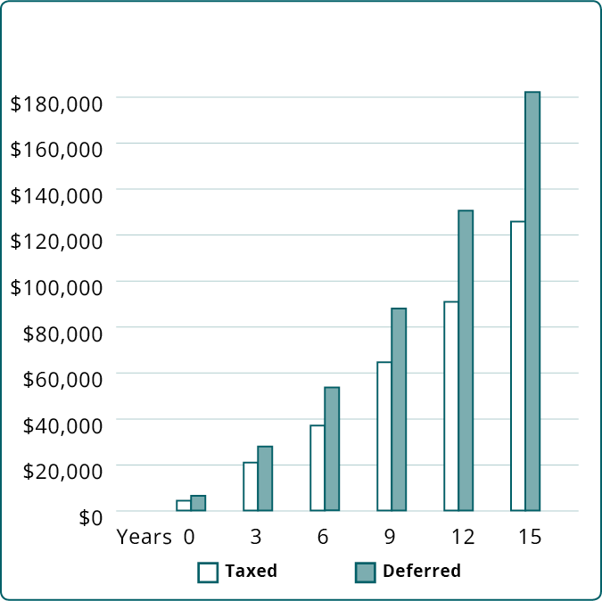
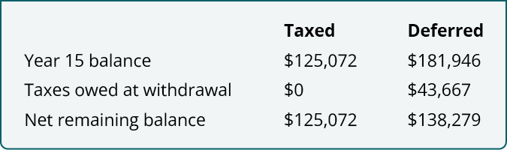
Benefits of Tax Deferral
Barriers to Wealth Accumulation
2-15
Notes:
The hypothetical example on the previous page is provided for illustrative purposes only and is not a guarantee of future performance. Changes in tax rates and tax treatment of investment earnings may impact the comparative results. You should consider your personal investment horizon and income tax bracket, both current and anticipated when making an investment decision as these may further impact the results of the comparison.

Slide 25
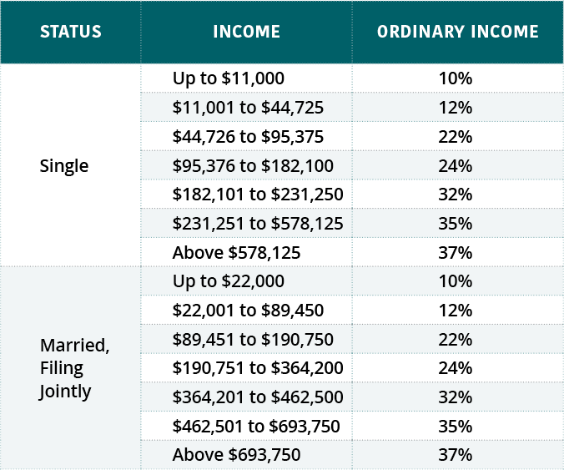
2023 Ordinary Income Federal Tax Brackets
Barriers to Wealth Accumulation
2-16
Source: Internal Revenue Service.

Slide 26
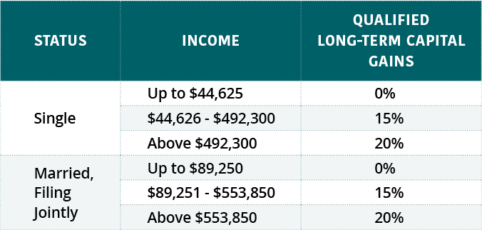
2023 Qualified Long-Term Capital Gains Tax Brackets
Barriers to Wealth Accumulation
2-16
Source: Internal Revenue Service.

Slide 27
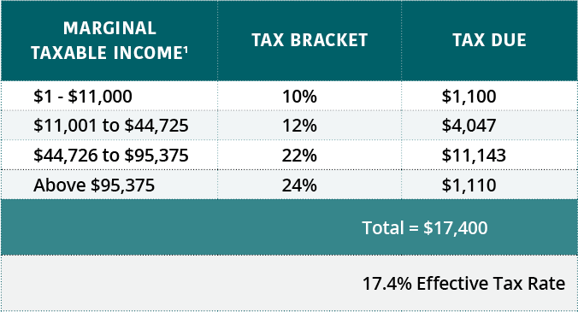
Barriers to Wealth Accumulation
2-17
Understanding Marginal Tax Rates
¹ Example does not include any other variables such as deductions, tax credits, etc.
Notes:
Marginal tax rates can be a confusing concept. As a result, many people assume their tax bracket applies to the whole of their income. Let’s take a moment to look beyond your tax bracket and think about how much money you’re actually paying in taxes.
Maria earned $100,000 in 2023 and files as single and takes the $13,850 standard deduction. She's in the 24% tax bracket. How would she estimate her marginal tax rate?

Slide 28
Barriers to Wealth Accumulation
2-18
Top 12 Strategies to Minimize Wealth-Destroying Taxes
Participate in your ESRP
    Contributions to ESRPs can reduce taxable income
    Long-term benefits of tax-deferred principal and earnings growth
Use capital loss rules
    Use up to $3,000 in losses to offset earned income or qualified dividends¹
    Losses above $3,000 can be carried forward to offset future gains
¹ Topic No. 409 Capital Gains and Losses. Internal Revenue Service, January 2023.
Notes:
Participate in your Employer-Sponsored Retirement Plan
Contributions to many ESRPs are pre-tax and reduce your taxable income
Long-term tax benefits of tax-deferred principal and earnings growth
Use capital loss rules to your advantage
If capital losses exceed capital gains in a tax year, use up to $3,000 in losses to offset earned income or qualified dividends
Losses above $3,000 can be carried forward to offset gains in future years

Slide 29
Barriers to Wealth Accumulation
2-18/19
Top 12 Strategies to Minimize Wealth-Destroying Taxes
Contribute to a Traditional IRA
    Long-term tax benefits of tax-deferred principal and earnings growth¹
Contribute to Flexible Spending Accounts
    Set aside pre-tax dollars for qualified health care expenses
    Plan carefully; some funds may have contribution and carryover limits²
¹ Topic No. 451 Individual Retirement Arrangements (IRAs). Internal Revenue Service, February 2023.
² Internal Revenue Service . Health Savings Accounts and Other Tax-Favored Health Plans (Publication 969). September 2022.
Notes:
Contribute to a Traditional IRA
Long-term tax benefits of tax-deferred principal and earnings growth
Contribute to Flexible Spending Accounts
Set aside pre-tax dollars for qualified health care expenses
Plan carefully; some funds may have contribution and carryover limits

Slide 30
Barriers to Wealth Accumulation
2-19
Top 12 Strategies to Minimize Wealth-Destroying Taxes
Adjustments, deferrals, and credits
      Earned Income Tax Credit: Up to $7,430
      Child and Dependent Care Credit: Up to $6,000
      Adoption Credit: Up to $15,950
      American Opportunity Tax Credit: Up to $2,500
      Lifetime Learning Credit: Up to $2,000
      Student Loan Interest Deduction: Up to $2,500
      Transportation and Parking Benefits: Up to $300 per month
      Medical Savings Accounts
      Business meal and beverage expenses
Updated for 2023. Please refer to your workbook for footnotes. Consult your tax advisor about your specific situation.
Notes:
Take advantage of adjustments, deferrals, and credits
May include student loan interest, child/dependent care expenses, adoption, foreign taxes and more.²
Earned Income Tax Credit (EITC): Up to $7,430
Child and Dependent Care Credit: Up to $6,000³
Adoption Credit: Up to $15,950
American Opportunity Tax Credit: Up to $2,500⁴
Lifetime Learning Credit: Up to $2,000⁴
Student Loan Interest Deduction: Up to $2,500⁵
Transportation and Parking Benefits: Up to $300/mo
Medical Savings Accounts
Business meal and beverage expenses
² 2023 amounts
³ $3,000 per qualifying child or individual. The amount of the credit is a percentage of the amount of work-related expenses paid to a provider for care and depends on your adjusted gross income. Source: Topic No. 602 Child and Dependent Care Credit, Internal Revenue Service
⁴ The American Opportunity Tax Credit (AOTC) benefit is per eligible student and the Lifetime Learning Credit (LLC) is per return. You may not claim the AOTC and LLC based on the same qualified education expenses or for the same student. Benefits may be phased out based on adjusted gross income. Consult your tax advisor about your specific situation.
⁵ The $2,500 maximum deduction for interest paid on qualified education for taxpayers is gradually reduced and eventually eliminated by phaseout when your modified adjusted gross income amount reached the annual limit for your filing status. Source: Topic No. 456 Student Loan Interest Deduction, Internal Revenue Service.

Slide 31
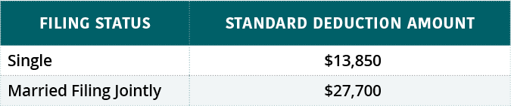
Barriers to Wealth Accumulation
2-20
Top 12 Strategies to Minimize Wealth-Destroying Taxes
Itemize Tax Deductions
    Consider tracking spending and itemizing deductions instead of
    taking the standard deduction¹
    Itemizable expenses may include mortgage interest, property taxes, state/local income taxes, sales taxes², medical/dental expenses, charitable contributions, losses, and others
¹ For some higher income taxpayers, itemized deductions are phased out.
² State and local tax deductions limited to $10,000 (2018-2025).
Notes:
Itemize Tax Deductions
Consider tracking spending and itemizing deductions instead of taking the standard deduction
Itemizable expenses may include mortgage interest, property taxes, state/local income taxes, sales taxes, medical/dental expenses, charitable contributions, losses, and others

Slide 32
Barriers to Wealth Accumulation
2-20
Top 12 Strategies to Minimize Wealth-Destroying Taxes
Consolidate deductible expenses
    Consider tax liability in 2-year cycles
    Perform non-essential medical or dental work in same year
    Give next years’ charitable contribution at end of the current year
    Make mortgage payment for January in prior year
    Prepay estimated state income tax balance instead of April¹
¹ Please consult your tax advisor regarding your specific situation.
Notes:
Consolidate deductible expenses
Consider tax liability in 2-year cycles
Perform non-essential medical or dental work for the same calendar year
Give next years’ charitable contribution at the end of the current year
Make your mortgage payment for January in the prior year
Prepay estimated state income tax balance instead of waiting for April

Slide 33
Barriers to Wealth Accumulation
2-21
Top 12 Strategies to Minimize Wealth-Destroying Taxes
Know when to convert your IRA
    Converting an IRA to a Roth IRA can save on taxes:
      More itemized deductions than you can use
      A “low-earning” year due to job, sabbatical or other reason
      “Top off” an advantageous tax rate¹
¹ Please consult your tax advisor regarding your specific situation.
Notes:
Know when to convert your IRA
Converting some or all of an IRA to a Roth IRA at the right time can save on taxes in the following circumstances:
More itemized deductions than you can use to lower your liability
You’re in a “low-earning” year due to job, sabbatical or other reason
You have the opportunity to “top off ” an advantageous tax rate

Slide 34
Barriers to Wealth Accumulation
2-21/22
Top 12 Strategies to Minimize Wealth-Destroying Taxes
Use tax-advantaged accounts for active trading¹
    401(k), IRA and tax-advantaged accounts can reduce impact of
    capital gains from actively-traded securities
    Returns may be re-invested tax-deferred, growth may be tax-exempt
    Avoids higher income categorization
Time purchase/sale of mutual funds (in non-advantaged accounts)
    Purchase a mutual fund after distribution to avoid taxation¹
¹ Please consult your tax advisor regarding your specific situation.
Notes:
Use tax-advantaged accounts for active trading
401(k), IRA and other tax-advantaged accounts can reduce impact of capital gains from actively-traded securities
Returns may be re-invested tax-deferred or growth may be tax-exempt
Avoids higher ordinary income tax categorization
Time purchase/sale of mutual funds (in non-advantaged accounts)
Purchase a mutual fund after distribution to avoid taxation on distribution

Slide 35
Barriers to Wealth Accumulation
2-22
Top 12 Strategies to Minimize Wealth-Destroying Taxes
Pay estimated tax payments
    Estimated taxes due quarterly
    Failure to pay may result in a penalty
    Penalty waived under specific circumstances ¹
Purchase instead of renting
    Real estate tax and home mortgage interest deductions
    Up to $500,000 in tax-free capital gains¹
¹ Please consult your tax advisor regarding your specific situation.
Notes:
Withhold or pay estimated tax payments
Estimated taxes (or withholdings) are due quarterly
Failure to pay quarterly taxes on time may result in a penalty on owed funds
This penalty may be waived under specific circumstances
Purchase a home instead of renting
Take advantage of real estate tax and home mortgage interest deductions
Potential of up to $500,000 in tax-free capital gains

Slide 36
Tax Exclusion from Home Sale Gain
Barriers to Wealth Accumulation
2-23
Did You Sell Your Home for a Profit?
  Exclude up to $500,000 in gains for married filing jointly¹
  Must pass the following tests:²
    Ownership test
    Use test
    Previous sale test
    Joint-filer test
¹ Internal Revenue Service, October 2022.
² You may not be eligible for this exemption if your home was acquired through a like-kind exchange (also known as a 1031 exchange) during the past five years.
Notes:
If you sell your home for a profit, you may be able to exclude the following from federal income tax:
Up to $250,000 of gains
Or up to $500,000 of gains for a married couple filing jointly
However, you must pass several tests to be eligible:
Ownership test: During the five-year period ending on the date of the sale, you must have owned the home for at least two years.
Use test: During the same five-year period, you must have used the property as your primary residence for at least two years.
Previous sale test: During the two-year period ending on the date of the sale, you did not exclude gains from the sale of another home.
Joint-filer test: To be eligible for the $500,000 joint-filer exclusion, at least one spouse must pass the ownership test and both spouses must pass the use test.
If you don’t meet all the qualification rules, a reduced gain exclusion may be available when you sell your home due to specific reasons, as specified by the IRS.

Slide 37
Understanding the Alternative Minimum Tax
Barriers to Wealth Accumulation
2-24
Do You Currently Pay the AMT?
  Deductions are designed to reduce your tax liability
  AMT laws are targeted at high-income persons with many deductions/exemptions
  AMT eliminates many deductions and establishes a minimum taxation rate
  The AMT was not indexed to inflation until 2012
Notes:
The Alternative Minimum Tax (AMT) Is Almost an Entirely Separate Tax System. Do You Currently Pay the AMT?
Deductions are designed to reduce your tax liability. But what if it reduces that liability “too much,” at least from the perspective of the government? This was the question that lead to the minimum tax, or Alternative Minimum Tax (AMT) laws of 1969 and 1982, which were targeted at high-income persons who were able to employ a large number of deductions and exemptions to reduce (or in some cases, even eliminate) their federal income tax burden. In a highly simplified sense, the AMT eliminates many popular deductions and establishes a relatively flat minimum taxation rate for higher-income taxpayers and for those who would otherwise pay a lower tax rate under our standard taxation system.
But if the AMT was designed to capture wealthy individuals with many deductions, why should you care? The AMT was not indexed to inflation until 2012, meaning that this supplemental income tax captured more taxpayers each year, including an increasing number of upper middle-class individuals.

Slide 38
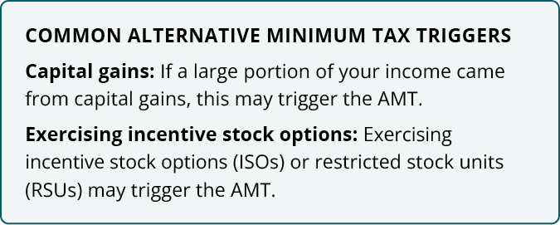
Understanding the Alternative Minimum Tax
Barriers to Wealth Accumulation
2-24

Slide 39
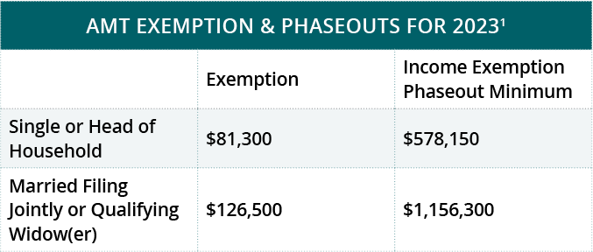
Alternative Minimum Tax Basics
Barriers to Wealth Accumulation
2-25
¹Internal Revenue Service, October 2022.
Notes:
The Alternative Minimum Tax is almost like an entirely separate tax system, whoever prepares your taxes—whether it is you or a tax professional—must calculate your tax liability under both standard taxation laws and AMT and then pay the higher of the two.
This secondary tax system is a highly complex and often misunderstood topic. Though popular off-the-shelf tax preparation software programs typically calculate AMT tax liability automatically, a tax professional may be able to best help you navigate these waters and plan ahead.

Slide 40
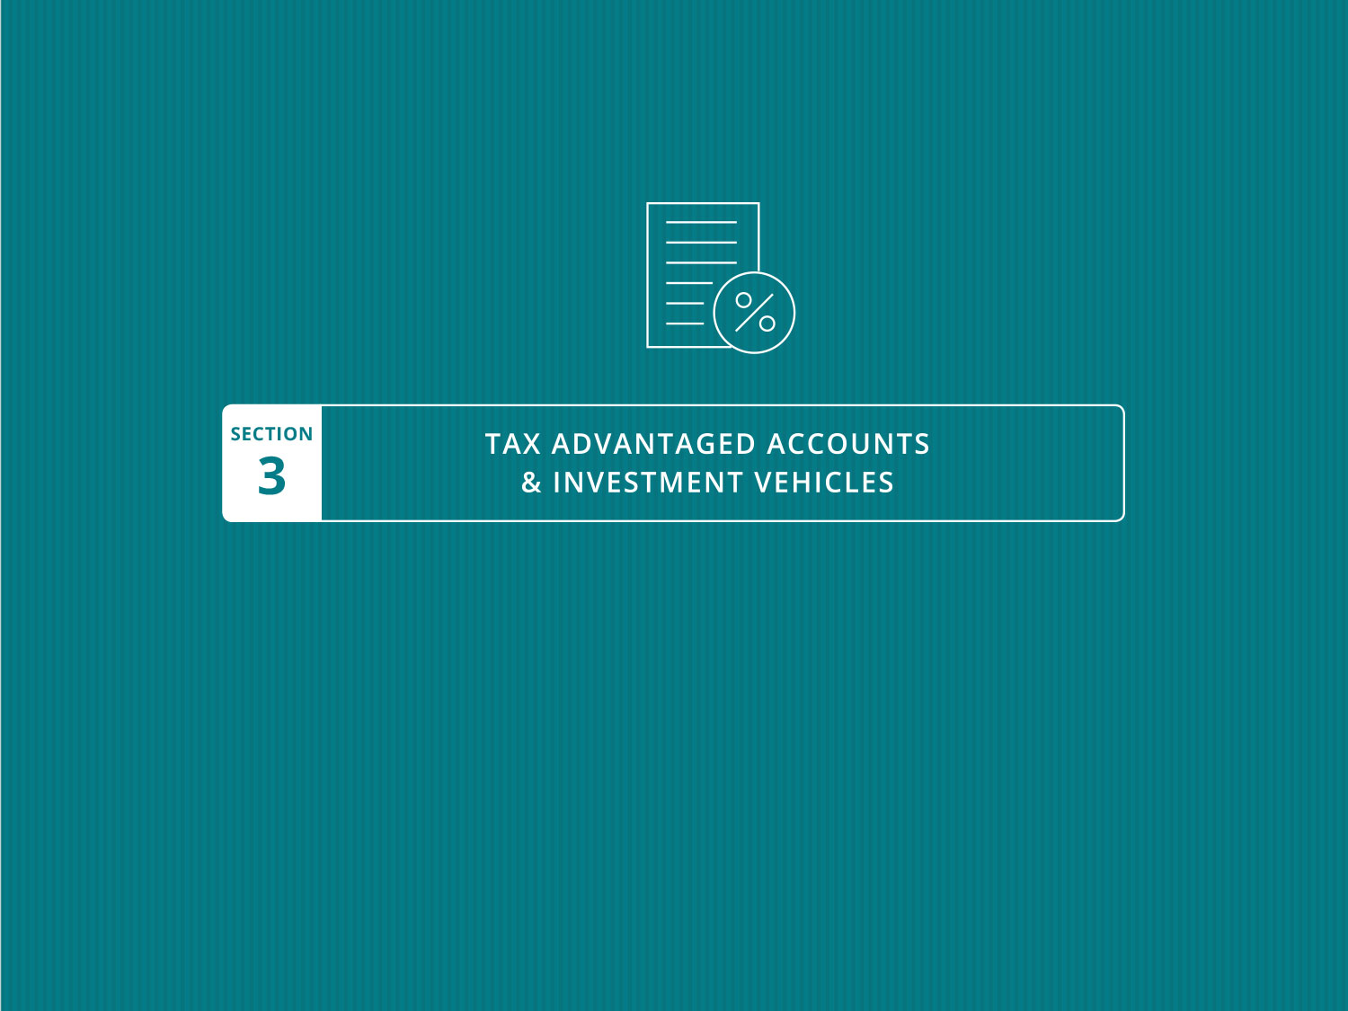

Slide 41
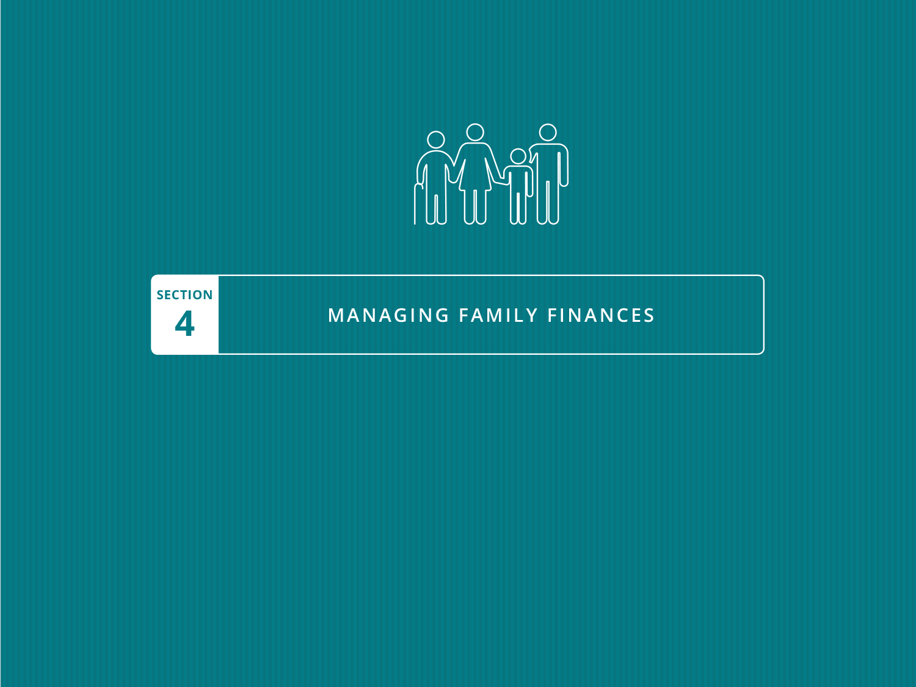

Slide 42

Disclaimer
Investors should consider the investment objectives, risks, charges, and expenses of any investment carefully before investing. The prospectus contains this and other information about the investment company or investment vehicle. You can obtain a prospectus from your financial representative or financial product. Read the prospectus carefully before investing.
Investing in any investment vehicle carries risk, including the possible loss of principal, and there can be no assurance that any investment strategy will provide positive performance over a period of time. The following information is for general educational purposes only. The asset classes and/or investment strategies described in this publication may not be suitable for all investors.

Slide 43


Slide 44


