Slide 1
Presented by:
[ Name of Instructor ]
Notes:
Before You Begin:
Welcome attendees
Introduce self and course
Read any required disclosures
Introduce course format and any other important logistical topics, such as scheduled breaks and the location of the bathrooms

Slide 2
[Broker-Dealer Disclosure]
This material is intended to provide general financial education and is not written or intended as tax or legal advice and may not be relied on for purposes of avoiding any Federal tax penalties. Individuals are encouraged to seek advice from their own tax or legal counsel. Individuals involved in the estate planning process should work with an estate planning team, including their own personal legal or tax counsel. This material is for informational purposes only and is not an offer to sell or a solicitation of any offer to buy any securities.
Course instructors are not employees or agents of Financial Educators Network®. Financial Educators Network® prohibits instructors from making specific recommendations and endorsing or selling products during the course. Once the course has ended, instructors may offer financial advice, products, or other services as an agent for insurance companies and/or broker-dealer firms. These services are not offered on behalf of Financial Educators Network®. Financial Educators Network® does not sell or endorse any insurance or investment products.

Slide 3
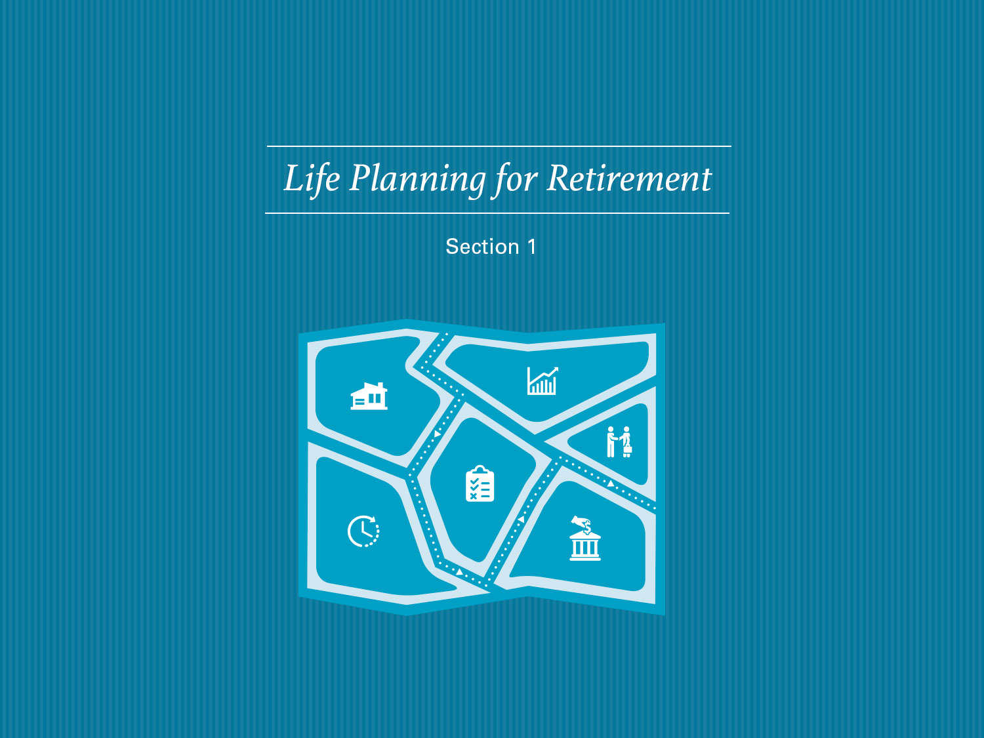

Slide 4
Life Planning for Retirement
Page 1-1
Introduction
Many of us are so busy that we’ve never really taken the time
to plan out how we’ll live during our retirement years
Without a clear vision of your retirement goals, it’s difficult
to prepare financially for the next chapter of your life
You have a unique vision for your retirement, one that is
yours and yours alone
Perhaps that vision is of an extended, leisurely vacation; or maybe
you’d prefer an active lifestyle filled with work and play
Notes:
Before You Begin: Note to attendees that page numbers on the slides correspond to page numbers in the course workbook
It wasn’t easy to make your way to this course. You likely had to set aside hard-to-find time from your busy schedule, sit in traffic, hunt for the classroom or figure out a new set of videoconferencing instructions.
Many of us are so busy that we’ve never really taken the time to plan out how we’ll live during our retirement years. Without a clear vision of your retirement goals, it’s difficult to prepare financially for the next chapter of your life.
Whether you are at home or in the classroom, take a moment to get comfortable in your chair. Let go of your day at work, the car ride here and all the other things on your mind. You have a unique vision for your retirement, one that is yours and yours alone. Perhaps that vision is of an extended, leisurely vacation; or maybe you’d prefer an active lifestyle filled with work and play.
Focus on that vision. Do you have it in your mind?
Good—you’re ready to begin. Together let’s start the process of designing an individual plan for living a meaningful, fulfilling and secure retirement.

Slide 5
Life Planning for Retirement
Page 1-2
The Retirement Landscape has Changed
In this section, we will:
Review the “traditional” view of retirement
Look ahead and examine the “new” view of retirement,
a retirement full of exciting new opportunities
Perform brief exercises to explore and understand your
unique vision of retirement
Examine how the retirement planning process has changed
Briefly discuss the financial topics we’ll cover over the two course sessions
Notes:
THE RETIREMENT LANDSCAPE HAS CHANGED
In this section, we will:
Review the “traditional” view of retirement
Look ahead and examine the “new” view of retirement, a retirement full of exciting new opportunities—but also one of great change and additional responsibilities
Perform brief exercises to explore and understand your unique vision of retirement
Examine how the retirement planning process has changed
Briefly discuss the financial topics we’ll cover over the two course sessions

Slide 6
Life Planning for Retirement
Page 1-3
Looking to the Past & Future
2021: Many median-aged Baby Boomers will retire at 65
50th anniversary of the first spacecraft to orbit another planet
2024: Copyright for early Mickey Mouse cartoons expire
2027: Spain’s Sagrada Familia Basilica scheduled for completion
2029: “A Message from Earth” reaches Gliese 581
2030: The UN projects world population of 8.5 billion
2034: The last wave of Baby Boomers take late retirement at age 70
Notes:
LOOKING TO THE PAST & FUTURE
You’ve lived through amazing times. Growing up, did you ever imagine you’d see self-driving cars, high-powered computers that fit into your pocket, high-definition 3-D television, thought-controlled prosthetics and bionic eyes? The pace of change won’t slow. You’ll soon live in a world very different than the one you retired into, one full of both progress and opportunity.

Slide 7
Life Planning for Retirement
Page 1-4
Retirement Doesn’t Stop the Clock
By the time you retire at about age 65 or so, you may have spent
more than 100,000 hours on the job!
The average Baby Boomer began saving for retirement in their mid-thirties
You’ve likely spent tens of thousands of hours during your best working
years carefully saving a portion of your earnings for retirement
Once retired, you’ll likely stay retired for many years. But how much time
have you spent actually mapping out and planning for your retirement?
Notes:
RETIREMENT DOESN’T STOP THE CLOCK
By the time you retire at about age 65 or so, you may have spent more than 100,000 hours on the job!
The average Baby Boomer began saving for retirement in their mid-thirties
Whether you started early or late, you’ve likely spent tens of thousands of hours during your best working years carefully saving a portion of your earnings for retirement
No matter what happens in your life, one thing is very clear—once retired, you’ll likely stay retired for many years. But how much time have you spent actually mapping out and planning for your retirement?

Slide 8
Life Planning for Retirement
Page 1-5
A Traditional View of Retirement
Your parents likely:
Worked for many years at the same company
Retired at about age 65 and received a comfortable pension
Relied upon Social Security for supplemental retirement income
Focused primarily on money during their retirement planning process
Generally lived their retirement years as an extended vacation
Didn’t always know how to fill their time without work
Thought end-of-life planning was relatively simple
Notes:
A TRADITIONAL VIEW OF RETIREMENT
Your parents likely:
Worked for many years at the same company
Retired at about age 65 and received a comfortable pension
Relied upon Social Security for supplemental retirement income
Focused primarily on money during their retirement planning process
Generally lived their retirement years as an extended vacation
Didn’t always know how to fill their time without work
Thought end-of-life planning was relatively simple

Slide 9
Life Planning for Retirement
Page 1-5
A New View of Retirement
Many of us have worked for several companies during our careers;
others have been self-employed for some or all of our working lives
This sense of self-reliance will help you enormously as you prepare
for a largely self-directed retirement
These changes have created both new opportunities
and additional responsibilities
Notes:
A NEW VIEW OF RETIREMENT
Many of us have worked for several companies during our careers; others have been self-employed for some or all of our working lives
This sense of self-reliance developed over the course of your career will help you enormously as you prepare for a largely self-directed retirement. After all, the way people perceive retirement and how they plan for it has changed substantially
These changes have created both new opportunities and additional responsibilities

Slide 10
Life Planning for Retirement
Page 1-6
New Retirement Opportunities
Many of today’s retirees:
Retire at a younger age
Enjoy a longer period of good health and increased lifespan
Look forward to spending more than a quarter of their life in retirement
Prioritize an active, independent, purposeful lifestyle
View retirement as a new, fulfilling chapter of life
Notes:
NEW RETIREMENT OPPORTUNITIES
Many of today’s retirees:
Retire at a younger age
Enjoy a longer period of good health and increased lifespan
Look forward to spending more than a quarter of their life in retirement
Prioritize an active, independent, purposeful lifestyle
View retirement as a new, fulfilling chapter of life
Since so many people enter their retirement years in good health, many decide to continue working in some capacity. Others pursue opportunities to accomplish things they never had time for during their careers. These pursuits enable today’s retirees to stay creative, involved and active. After all, happiness in retirement depends on much more than just financial security.

Slide 11
Life Planning for Retirement
Page 1-6
New Retirement Opportunities
New retirees may:
Continue working on a full- or part-time basis
Open a business, consult within their field or even start a new career
Volunteer with church, charities or the community
Go back to school
Get involved with clubs
Pursue recreational activities or hobbies
Travel
Notes:
NEW RETIREMENT OPPORTUNITIES
New retirees may:
Continue working on a full- or part-time basis
Open a business, consult within their field or even start a new career
Volunteer with church, charities or the community
Go back to school
Get involved with clubs
Pursue recreational activities or hobbies
Travel

Slide 12
Life Planning for Retirement
Page 1-7
Life Planning for Retirement
Values & Objectives
Retirement planning should not be focused solely on money
Financial security and success alone does not guarantee
a rich or fulfilling life
Financial freedom does provide more choices throughout life,
including your retirement years
Notes:
LIFE PLANNING FOR RETIREMENT
The increasing number of lifestyle choices and years in retirement have created additional personal responsibilities, especially in light of the ever-changing (and oftentimes uncertain) financial markets.
Values & Objectives
To help you prepare for the type of retirement you really want, you’ll need proper financial and lifestyle planning. It’s important to remember that:
Retirement planning should not be focused solely on money
Financial security and success alone does not guarantee a rich or fulfilling life
Financial freedom does provide more choices throughout life, including your retirement years

Slide 13
Life Planning for Retirement
Page 1-8
Questions to Consider
What will be our primary source of income during retirement?
Will I work post-retirement? Will my partner?
What age do I want to retire? Does my partner know this?
Who should my partner speak to about financial advice if I am incapacitated?
Notes:
QUESTIONS TO CONSIDER
It’s more critical now than ever that you take a few moments to think about what’s most important about your upcoming retirement. If you’re here today with a partner, this is an opportunity to set aside assumptions and have an open conversation about the future.
What will be our primary source of income during retirement?
Will I work post-retirement? Will my partner?
What age do I want to retire? Does my partner know this?
Who should my partner speak to about financial advice if I am incapacitated?
These are just a handful of questions you’ll need to think about and discuss. In fact, you should give serious consideration to every facet of your retirement.

Slide 14
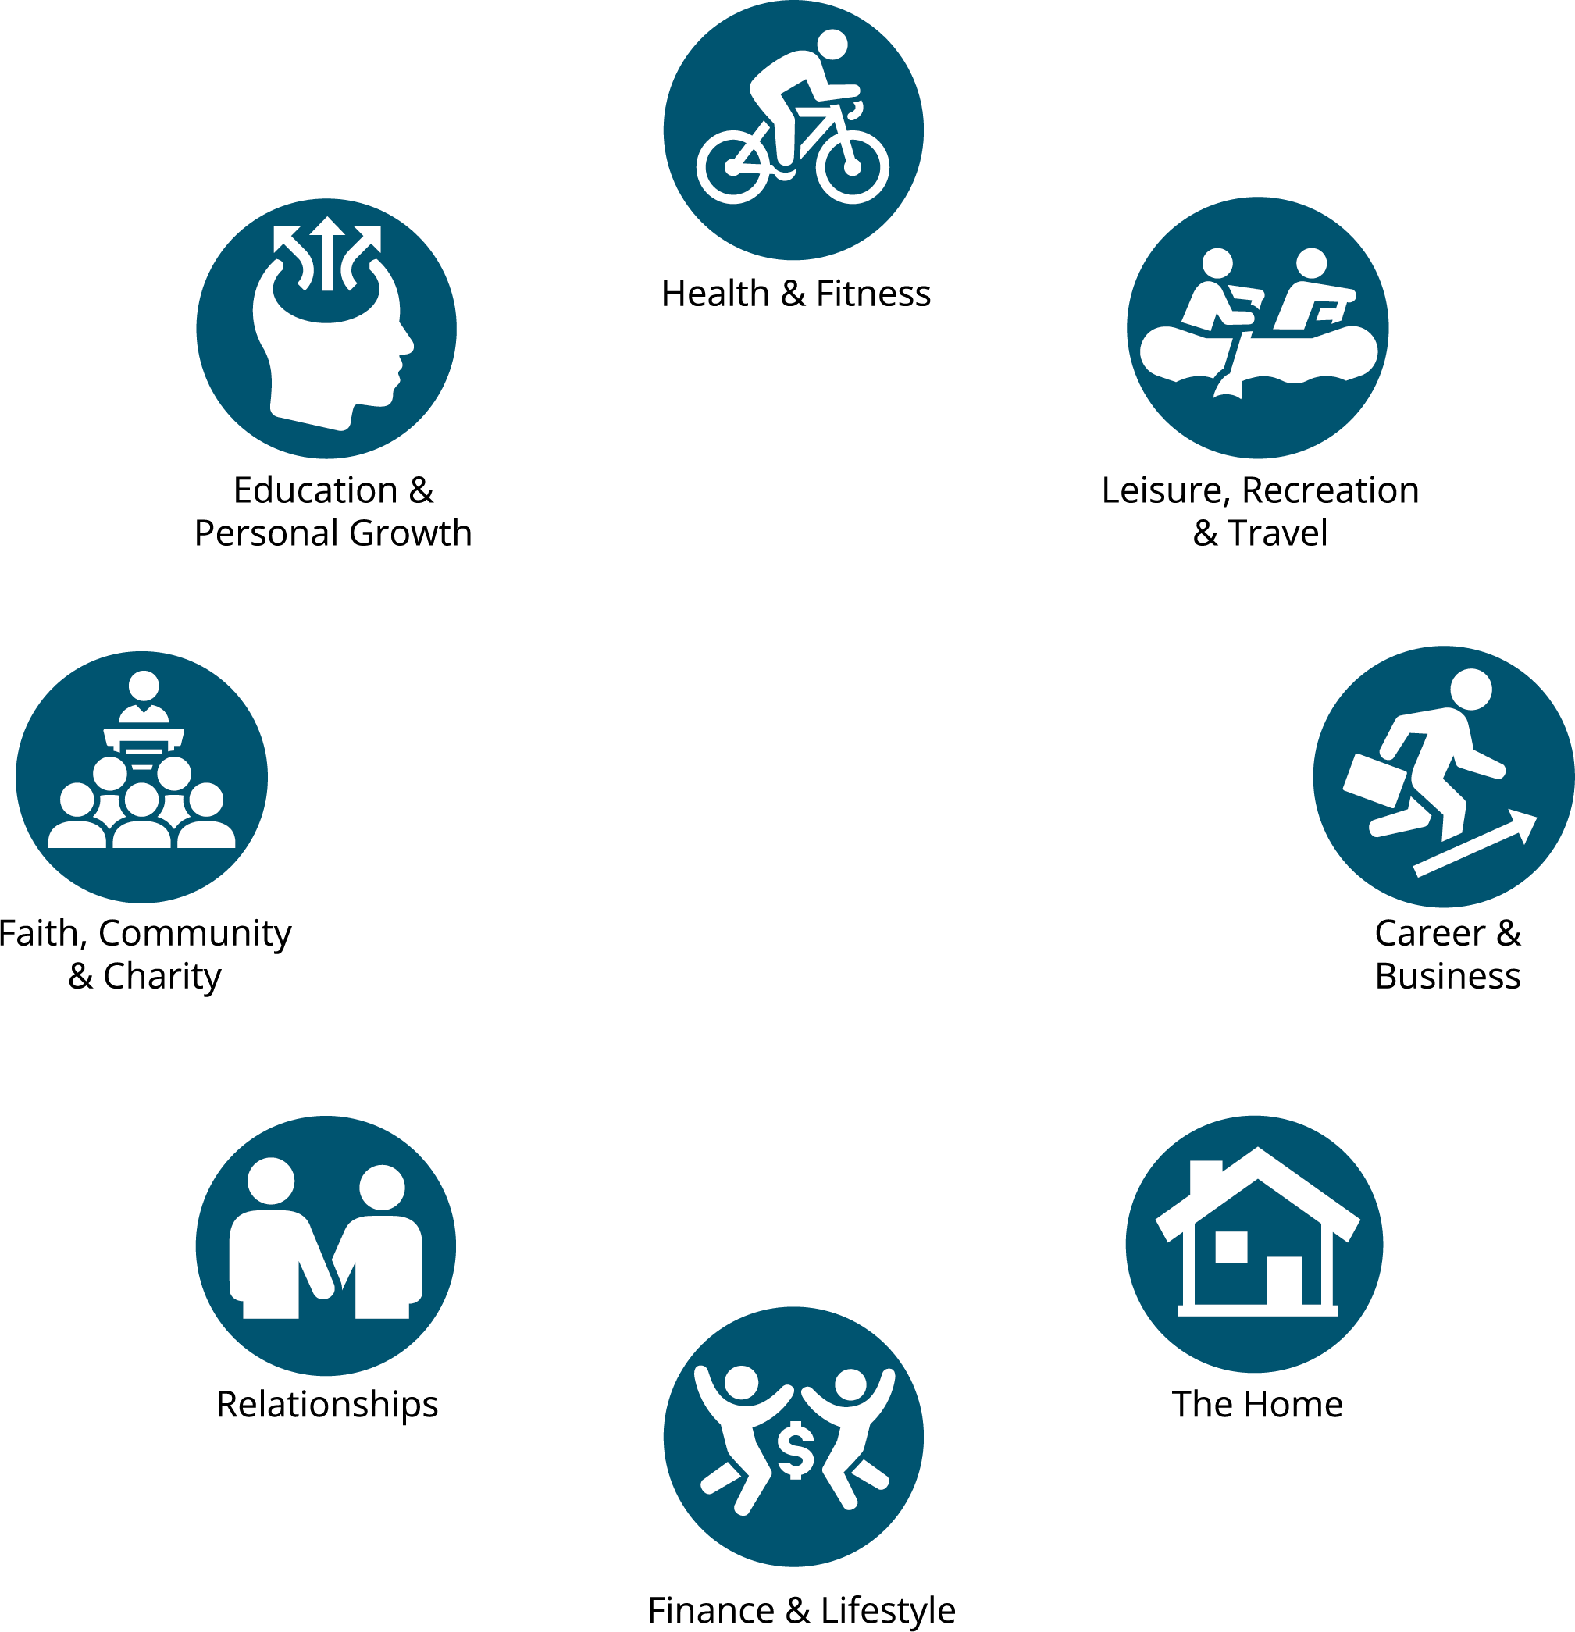
Life Planning for Retirement
Page 1-9
The Facets of Retirement

Slide 15
Life Planning for Retirement
Page 1-10/11
Personal & Partner Exercise
Take a pen and a few moments to go through the statements
on Page 1-10/11.
What did you circle?
If you’re here with a partner, what did they circle?
What will it take to fulfill their dreams and goals? How about yours?
Are there any potential misunderstandings or conflicts you’ll
need to discuss in greater depth?
Notes:
PERSONAL & PARTNER EXERCISE
Take a pen and a few moments to go through the following statements. Don’t think about any single one too hard, just circle whatever you feel best represents your beliefs and intentions for retirement.
Take a look at your results:
What did you circle?
If you’re here with a partner, what did they circle?
What will it take to fulfill their dreams and goals? How about yours?
Are there any potential misunderstandings or conflicts you’ll need to discuss in greater depth?

Slide 16
Life Planning for Retirement
Page 1-12
Retirement Considerations
You may have come today with a number of questions about retirement.
Can I begin my new retirement today and just work part-time?
Do I prefer a more traditional retirement?
Does my spouse share my view of an ideal retirement?
Notes:
RETIREMENT CONSIDERATIONS
You may have come today with a number of questions about retirement. These questions may include:
Can I begin my new retirement today and just work part-time?
Do I prefer a more traditional retirement?
Does my spouse share my view of an ideal retirement?
All of these life choices and different scenarios make retirement planning today more complex than ever. The financial world continually changes, with new tax laws, investment choices and insurance products as well as increasingly sophisticated financial strategies.

Slide 17
Life Planning for Retirement
Page 1-13
The Retirement Planning Process
The Traditional Retirement Planning Process
People once bought relatively simple financial products for retirement:
Insurance from their insurance agent
Stocks and bonds from their broker
Certificates of deposit from their bank
Notes:
THE RETIREMENT PLANNING PROCESS
Since most people view their retirement differently today, it makes
sense that the planning process has changed as well.
The Traditional Retirement Planning Process
People once bought these relatively simple financial products in
preparation for retirement:
Insurance from their insurance agent
Stocks and bonds from their broker
Certificates of deposit from their bank

Slide 18
Life Planning for Retirement
Page 1-13
The Retirement Planning Process
The New Retirement Planning Process
Determine the outcome you want to achieve
Educate yourself to make informed decisions
Analyze your current financial situation
Develop a financial plan to address scenarios like job loss, health
problems/disability, changes to Social Security, death in the family
Implement the plan, selecting the financial products necessary for a coordinated portfolio
Review your plan and adjust over time
Notes:
THE RETIREMENT PLANNING PROCESS
The New Retirement Planning Process
Determine the outcome you want to achieve
Educate yourself to make informed decisions
Analyze your current financial situation
Develop a comprehensive financial plan to address all possible scenarios, including job loss, health problems or disability, changes to Social Security benefits, death in the family
Implement the plan, selecting the financial products necessary for a coordinated portfolio
Review your plan and adjust over time

Slide 19
Life Planning for Retirement
Page 1-14
About This Course
Section 2: Retirement Needs & Expenses
Determine how much you’ll need and when you can retire
Could you retire today and still maintain your desired lifestyle?
Section 3: Retirement Roadblocks & Mistakes
Retirement planning mistakes are common
Section three covers the most common retirement planning missteps
and legal strategies to minimize your yearly tax liability
Notes:
ABOUT THIS COURSE
Section 2: Retirement Needs & Expenses
Only 18% of workers plan to retire before age 60. But about three times as many (34%) actually do. In fact, only 6% of workers make it to 70 before retiring, a fraction of the number who once intended to work to that age. Are you prepared to stop working earlier than expected? This section will help you determine how much you’ll need and when you can retire—and if you could retire today and still maintain your desired lifestyle.
Section 3: Retirement Roadblocks & Mistakes
Retirement planning mistakes are frighteningly common, easy to make and may have an outsized impact on your financial future. Section 3 covers the most widespread retirement planning missteps, including one you may be making right now—namely failing to take full advantage of legal strategies to minimize your yearly tax liability.

Slide 20
Life Planning for Retirement
Page 1-15
About This Course
Section 4: Retirement Income Sources
Many Social Security recipients do not employ the strategies
needed to maximize their monthly earned benefits check¹
Learn to advocate for yourself and develop a personalized strategy
to maximize your earned benefits
This section will also cover employer-sponsored retirement plans,
IRAs and IRA to Roth IRA conversions
¹ The 2022 Retirement Confidence Survey. Greenwald & Associates, Employee Benefit Research Institute.
Notes:
ABOUT THIS COURSE
Section 4: Retirement Income Sources
Many Social Security recipients do not employ the strategies needed to maximize their monthly earned benefits check; in some cases leaving thousands, or even tens of thousands of dollars unclaimed. Your local Social Security Claims Specialist may even steer you towards one of these less-effective strategies! This public program has become increasingly complicated since inception, and factors like age, marital status (past or present), spousal earnings (including from a previous marriage), survivor status, disability and other considerations can make a substantial difference in the actual dollar amount on a beneficiary’s monthly check. It’s critical that you learn to advocate for yourself and develop a personalized strategy to maximize your earned benefits over the course of your retirement. This section will also cover other retirement income sources and considerations, including employer-sponsored retirement plans, IRAs and IRA to Roth IRA conversions.

Slide 21
Life Planning for Retirement
Page 1-15/16
About This Course
Section 5: Retirement Plan Distributions
How do you take money out of your retirement accounts while
maintaining financial flexibility?
This section will compare retirement plan distribution choices and options
Once made, many of these decisions cannot be reversed
Section 6: Investments
This section discusses cash accounts, bonds, markets, stocks, mutual funds, exchange-traded funds and individually managed accounts
It will also discuss pre-investment considerations such as common investment risks and portfolio risk management strategies
Notes:
ABOUT THIS COURSE
Section 5: Retirement Plan Distributions
You’ve planned. You’ve saved. You’ve invested wisely. Now how do you take money out of your retirement accounts while maintaining financial flexibility? We’ll use this section to compare retirement plan distribution choices and evaluate your options, including a look at what happens should you need emergency access to funds. It’s an important topic to carefully consider: once made, many of these decisions cannot be reversed.
Section 6: Investments
This section covers investment-related subjects and terminology, including cash accounts, bonds, markets, stocks, mutual funds, exchange-traded funds and individually managed accounts. We will also discuss a number of important pre-investment considerations such as common investment risks and portfolio risk management strategies.

Slide 22
Life Planning for Retirement
Page 1-16
About This Course
Section 7: Risk Management & Asset Protection
How do you plan to protect yourself from financial loss prior to
or during retirement?
Where should you shop for insurance coverage?
When should you start thinking about long-term health care?
This section covers health and asset risk management, including costs,
who should consider purchasing and the alternatives
It will also discuss varying types of insurance and what to look
for in coverage
Notes:
ABOUT THIS COURSE
Section 7: Risk Management & Asset Protection
How do you plan to protect yourself from financial loss prior to or during retirement? Where should you shop for insurance coverage? When should you start thinking about long-term health care? This section covers health and asset risk management, including costs, who should consider purchasing and the alternatives. We will discuss varying types of insurance and what to look for in coverage so you can know your options and make smart, informed decisions.

Slide 23
Life Planning for Retirement
Page 1-16
About This Course
Section 8: Estate Planning
Too few recognize what they might put their families through if they haven’t completed a living will or planned for their estate
Survivors may face complicated tax laws, probate fees, expensive delays, legal challenges, frozen assets and unexpected financial liabilities
This section will cover the strategies and techniques used to reduce overall income, gift and estate tax liabilities
Notes:
ABOUT THIS COURSE
Section 8: Estate Planning
While estate planning is a deeply personal process, too few recognize what they might put their families through if they haven’t completed a living will or planned for their estate. Survivors may be left to contend with complicated, constantly changing tax laws, probate fees, expensive delays, legal challenges, frozen assets and unexpected financial liabilities. Perhaps worst of all, the probate process is conducted and documented using publicly available court records. Retirement Planning Today will cover the strategies and techniques used to ease the often punishingly difficult estate transition and reduce overall income, gift and estate tax liabilities.

Slide 24
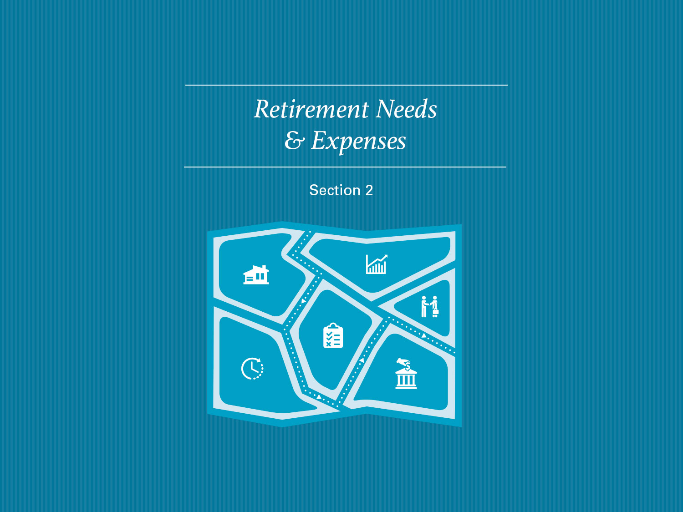

Slide 25
Retirement Needs & Expenses
Page 2-1
Introduction
Inflation can have a big impact on fixed incomes
You can plan and prepare for inflation
How can you estimate the cost of goods and services in the future?
How does inflation erode your purchasing power over time?
Notes:
INTRODUCTION
In general, people are retiring earlier and living longer. Although this trend presents many opportunities for retirees, it requires more financial planning and resources to ensure that they don’t outlive their money.
Since many retirees live on a fixed income, inflation can have a big impact on their financial situations. While you can’t control inflation, you can plan for it. In this section, we will examine how inflation can:
Help you estimate the cost of goods and services in the future
Erode your purchasing power over time
Pre-retirees have varying levels of confidence about their ability to meet their financial needs and goals during retirement. You may be surprised to discover that less than half have tried to determine how much they will need to save!

Slide 26
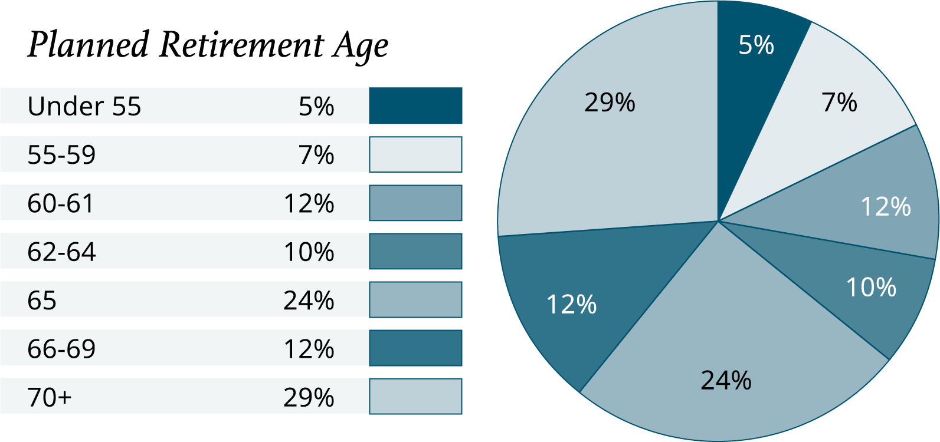
Retirement Needs & Expenses
Page 2-2
Americans Retire Earlier Than Expected
Source: The 2022 Retirement Confidence Survey. Greenwald & Associates, Employee Benefit Research Institute
Notes:
AMERICANS RETIRE EARLY
Are you financially prepared to weather an unexpectedly early retirement? It’s an important topic to consider, especially given new research suggests that many Americans stop working earlier than planned. Are you one of the 65% of workers who plan to work to age 65 or beyond?

Slide 27
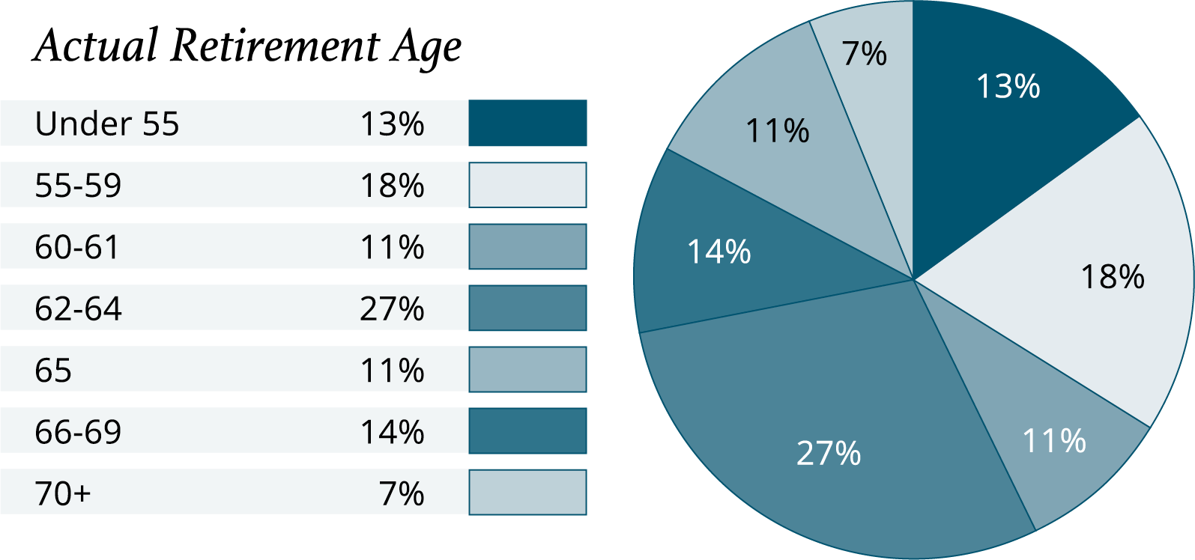
Retirement Needs & Expenses
Page 2-2
Americans Retire Earlier Than Expected
Source: The 2022 Retirement Confidence Survey. Greenwald & Associates, Employee Benefit Research Institute
Notes:
AMERICANS RETIRE EARLY
Would it surprise you to know that 69% of surveyed Americans didn’t even make it to 65? In fact, 31% of those surveyed stopped working before age 60!

Slide 28
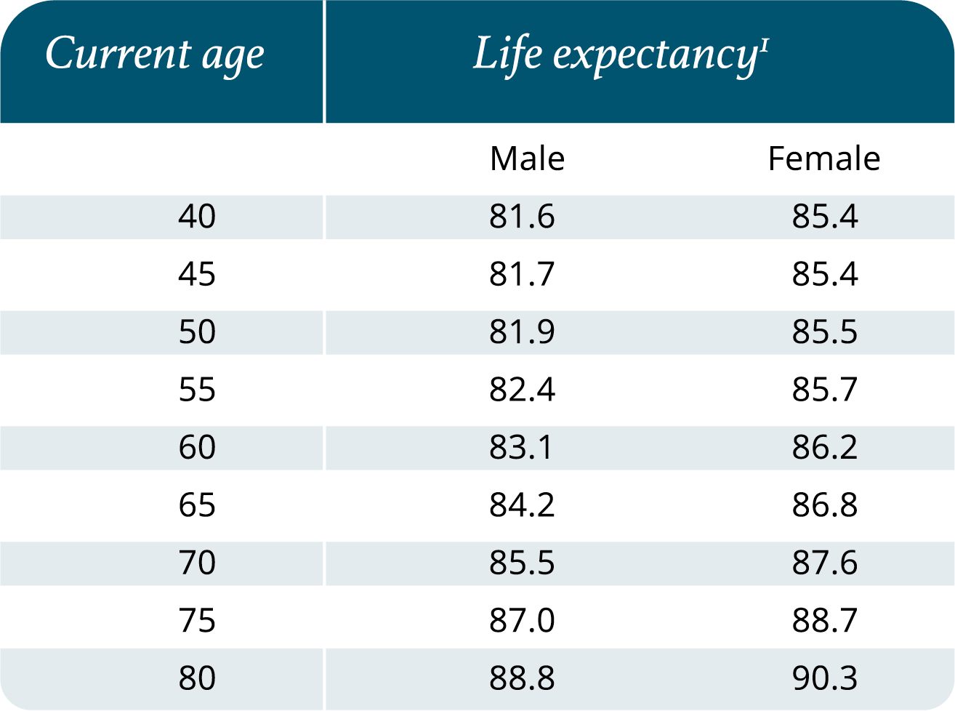
Retirement Needs & Expenses
Page 2-3
How Long Must Your Money Last?
Source: Social Security Administration, 2022 Retirement & Survivors Benefits: Life Expectancy Calculator.
As calculated on November 1, 2022.
Notes:
HOW LONG MUST YOUR MONEY LAST?
The average life expectancy of Americans continues to rise. This may be due to a combination of factors including medical advances, better nutrition and healthier lifestyles.
When planning for your retirement, it is important to consider that you may live to be 80… 90… 100… or more. Your retirement plan should be designed to help you maintain independence and preserve your lifestyle throughout retirement.
The chart shows the life expectancy of Americans between the ages of 40 and 80. This chart illustrates that each year you age, your life expectancy increases.

Slide 29
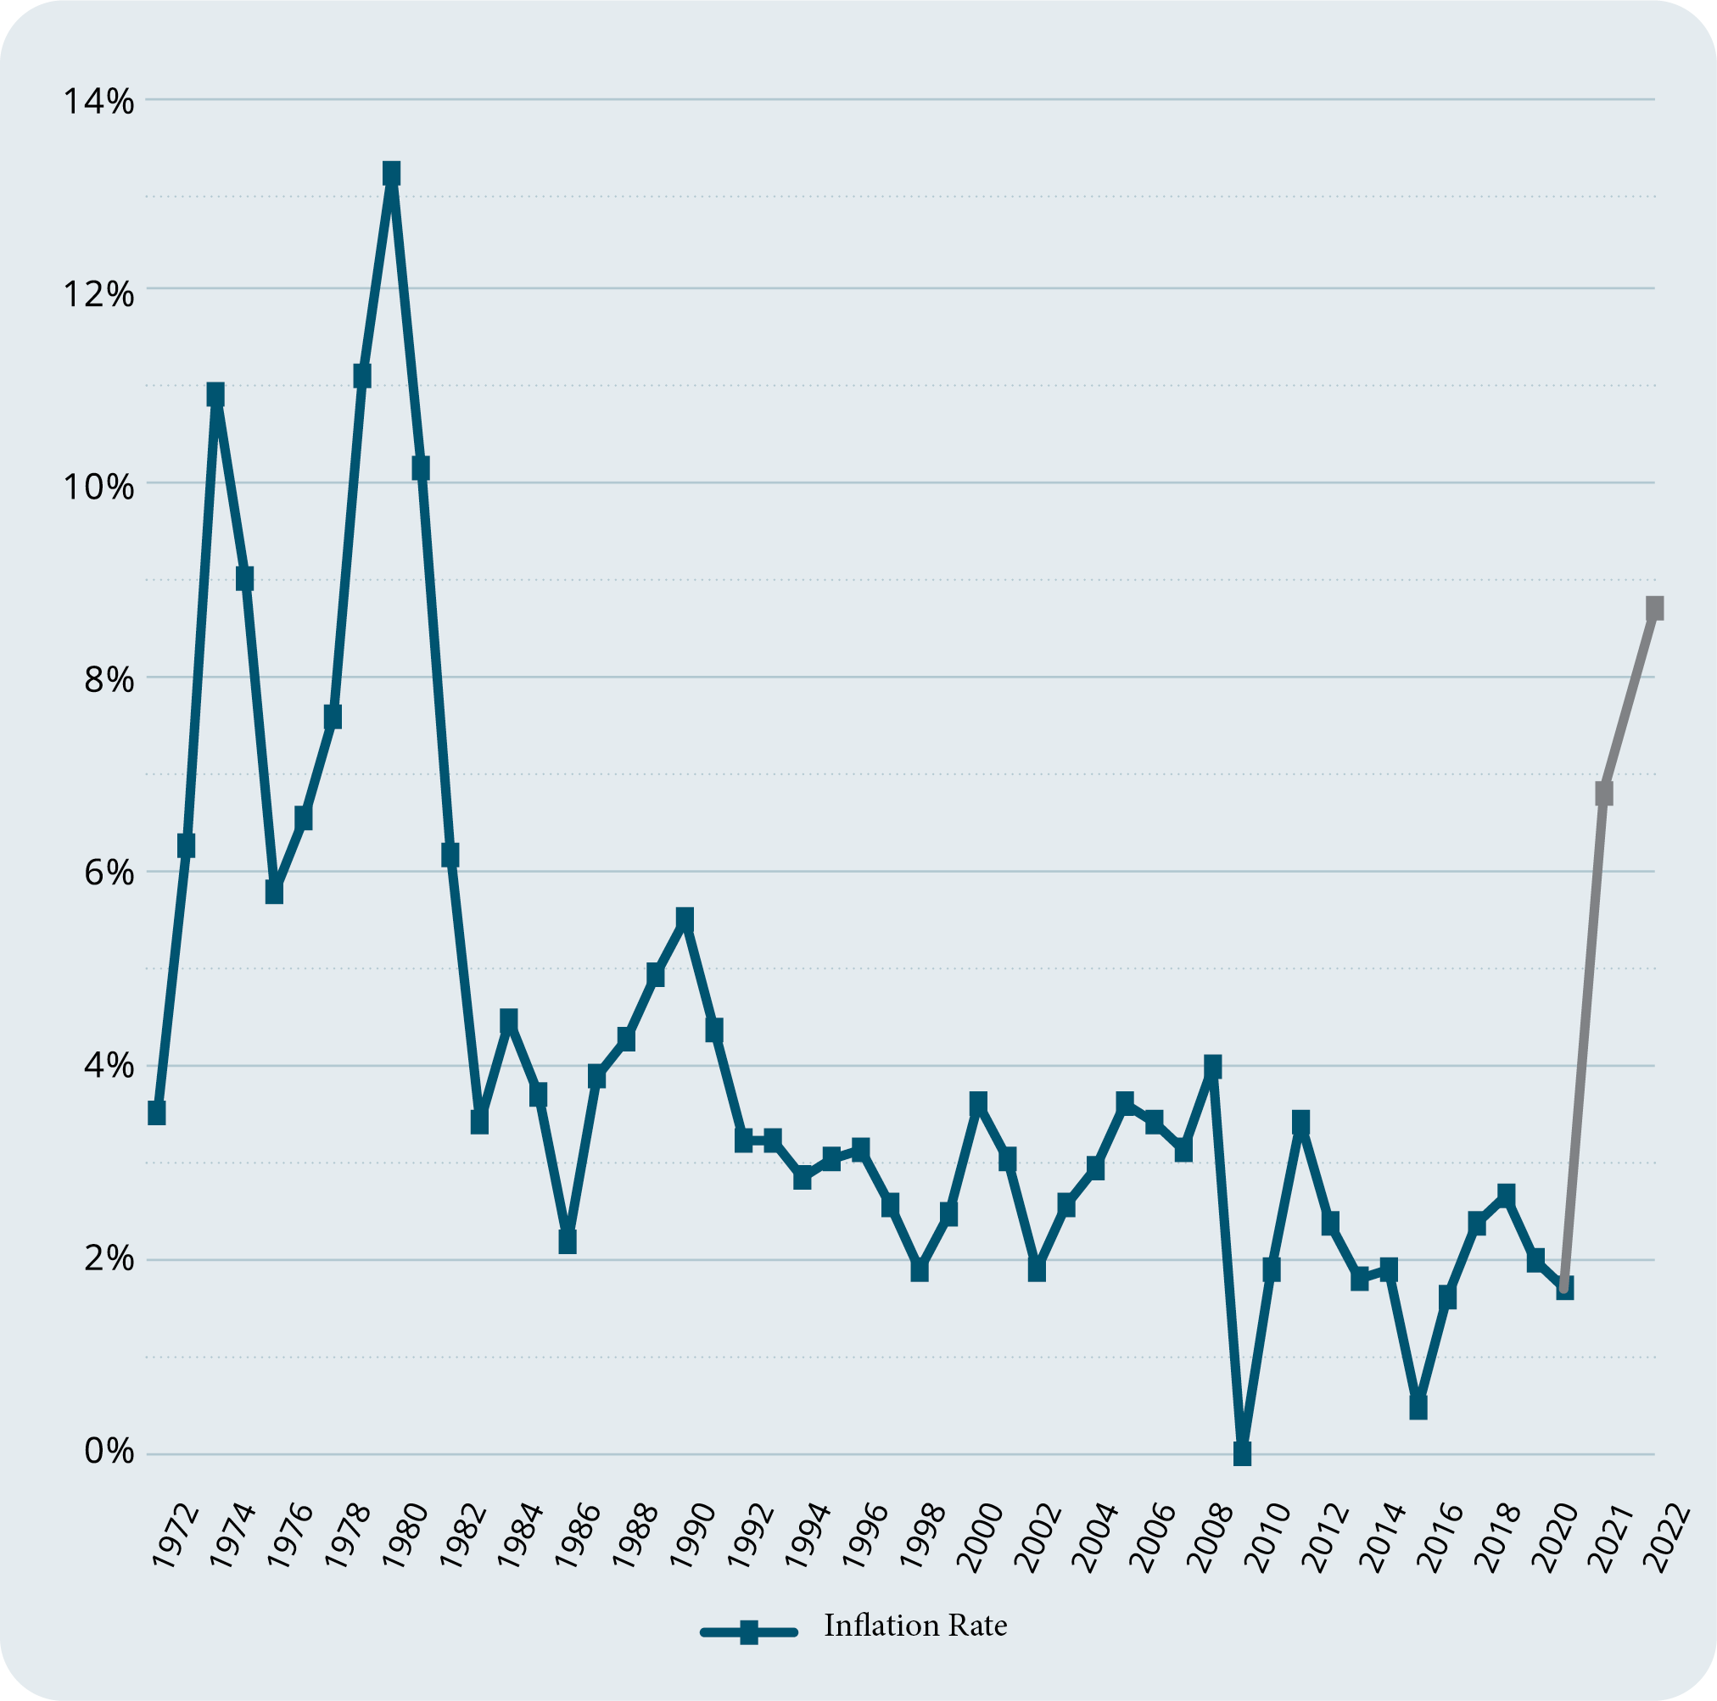
Retirement Needs & Expenses
Page 2-4
Historical Rates of Inflation
Source: https://cpiinflationcalculator.com/2022-cpi-and-inflation-rate-for-the-united-states/. For illustrative purposes only.
Notes:
HISTORICAL RATES OF INFLATION
Over time, inflation erodes the purchasing power of your dollars. Historical statistics show that inflation can be volatile and unpredictable. A low inflation rate today doesn’t guarantee a low or even moderate inflation rate over the next 20–30 years.

Slide 30
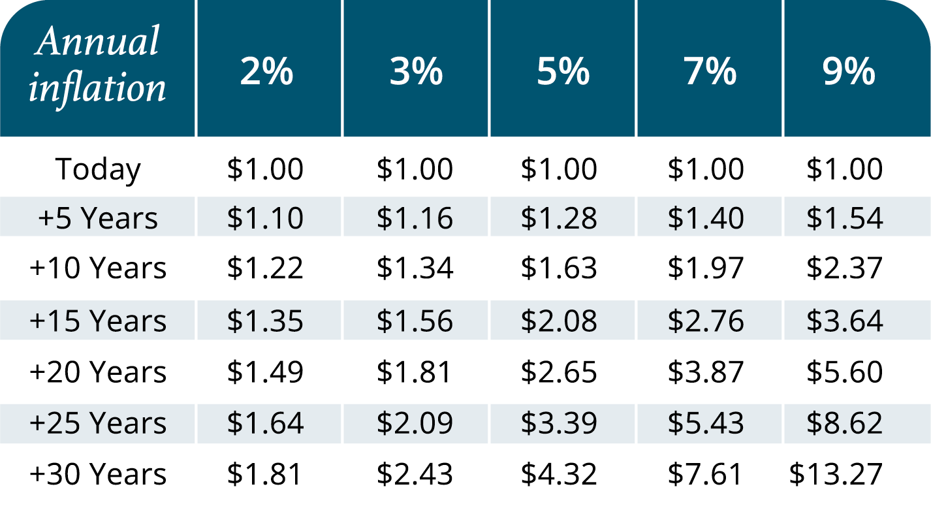
Retirement Needs & Expenses
Page 2-5
Inflation & Purchasing Power
Note: For illustrative purposes only. Calculations and amounts are approximate due to rounding. Inflation has
been compounded annually. This table is not intended to predict or represent any actual historical period.
Notes:
INFLATION & PURCHASING POWER
Inflation erodes the purchasing power of dollars in the future and compounds in a negative direction. This is an important planning consideration, especially for anyone retiring on a fixed income. This table shows how much money would be required to equal one dollar of today’s purchasing power under a number of hypothetical annual inflation scenarios.

Slide 31
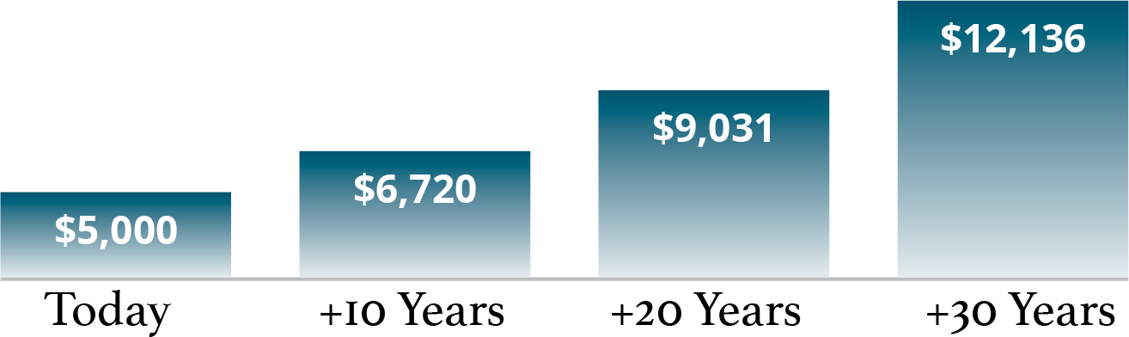
Retirement Needs & Expenses
Page 2-5
Inflation & Purchasing Power
At a 3% inflation rate, approximately how much income would be required to create the equivalent of $5,000 in today’s dollars?
Notes:
INFLATION & PURCHASING POWER
At a 3% inflation rate, approximately how much income would be required to create the equivalent of $5,000 in today’s dollars?

Slide 32
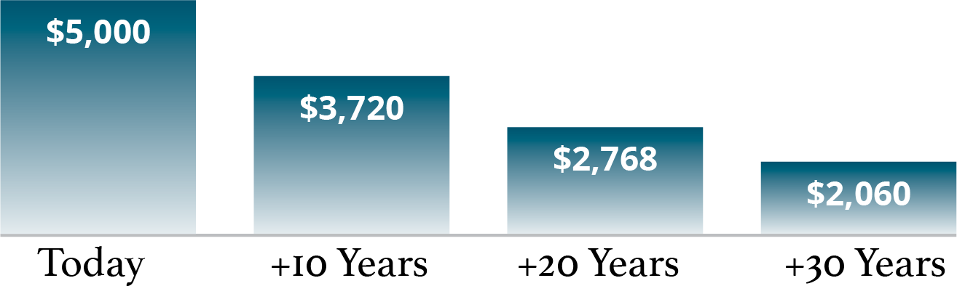
Retirement Needs & Expenses
Page 2-5
Inflation & Purchasing Power
At a 3% inflation rate, what is the approximate future purchasing power of $5,000?
Notes:
INFLATION & PURCHASING POWER
At a 3% inflation rate, what is the approximate future purchasing power of $5,000?

Slide 33
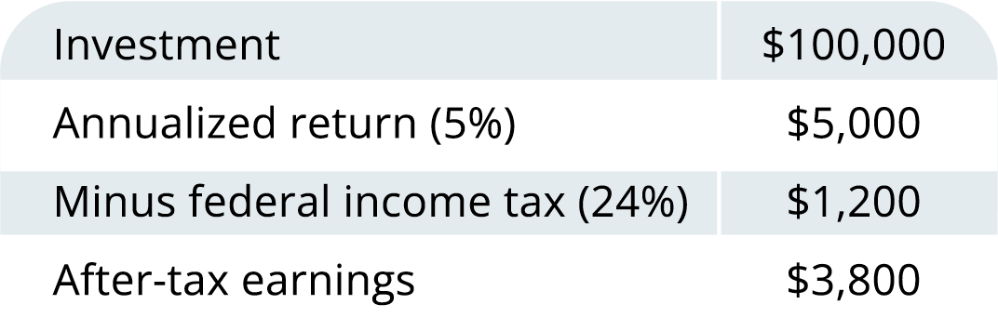
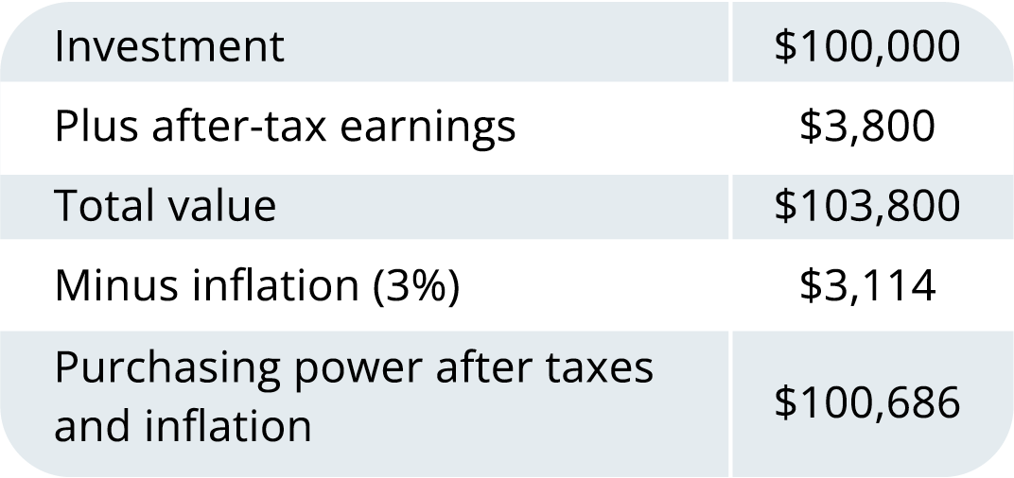
Retirement Needs & Expenses
Page 2-6
Inflation & Income Taxes
Many become more conservative in retirement
It is important not to become too conservative too early
Inflation and taxes impact returns and purchasing power
Note: This illustration is hypothetical and does not represent the performance of any investment product.
Notes:
INFLATION & INCOME TAXES
As people approach retirement and eventually retire, they tend to become more conservative with their investment selections. As a rule of thumb, this makes good sense. However, it is important not to become too conservative too early.
This chart illustrates how inflation and income taxes can impact investment returns and purchasing power.
Assumptions:
Annualized return of 5%
Federal income tax bracket of 24%
Inflation rate of 3%

Slide 34
Retirement Needs & Expenses
Page 2-7
Retirement Expectations
73% of workers are very or somewhat confident they will have
enough money to live comfortably throughout retirement
A third of workers and half of retirees who feel less confident cite inflation and the cost of living as the reason for their declining retirement confidence.
70% of workers plan to work for pay in retirement.
Close to half of workers say debt has negatively impacted their ability to save for retirement.
Source: The 2022 Retirement Confidence Survey. Greenwald & Associates, Employee Benefit Research Institute.
Notes:
RETIREMENT EXPECTATIONS
In a recent survey conducted by the Employee Benefit Research Institute:
73% of workers are very or somewhat confident they will have enough money to live comfortably throughout retirement
A third of workers and half of retirees who feel less confident cite inflation and the cost of living as the reason for their declining retirement confidence.
70% of workers plan to work for pay in retirement.
Close to half of workers say debt has negatively impacted their ability to save for retirement.

Slide 35
Retirement Needs & Expenses
Page 2-8
How Much Will You Need to Retire?
Many retirement experts estimate that your yearly expenses in retirement will be 80% of your annual pre-retirement expenses
Others estimate your expenses will be 100% of your pre-retirement expenses or more as you’ll have more uncommitted time to spend money
Some of your monthly expenses may increase while others will decrease
How much you will need to retire will depend on your individual situation¹
¹Note: All following calculations and amounts are approximate due to rounding.
Notes:
HOW MUCH WILL YOU NEED TO RETIRE?
Many retirement experts estimate that your yearly expenses in retirement will be 80% of your annual pre-retirement expenses. Others estimate your expenses will be 100% of your pre-retirement expenses or more as you’ll have more uncommitted time to spend money. Generally speaking, some of your monthly expenses will increase while others will decrease. How much you will need to retire will depend on your individual situation.

Slide 36
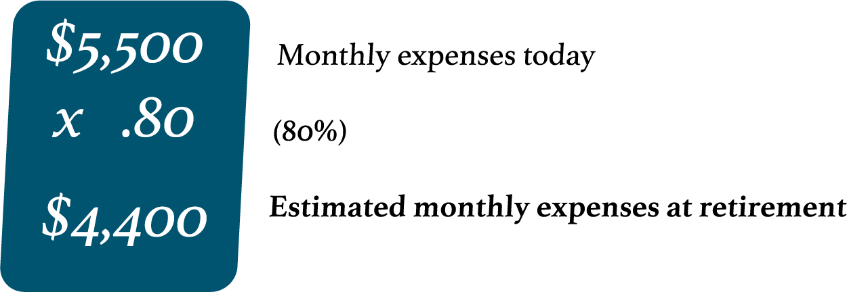
Retirement Needs & Expenses
Page 2-8
How Much Will You Need to Retire?
Step 1: Determine Your Monthly Expenses
Robert and Sophia plan to retire in fifteen years
Neither intends to work during retirement
They plan to live on about 80% of current lifestyle costs
Notes:
HOW MUCH WILL YOU NEED TO RETIRE?
Step 1: Determine Your Monthly Expenses
Let’s take a look at the example of Robert and Sophia. This married couple plans to retire in fifteen years and neither intends to work during retirement. They think they can cut back on their expenses in retirement and live on about 80% of what their lifestyle costs today.

Slide 37
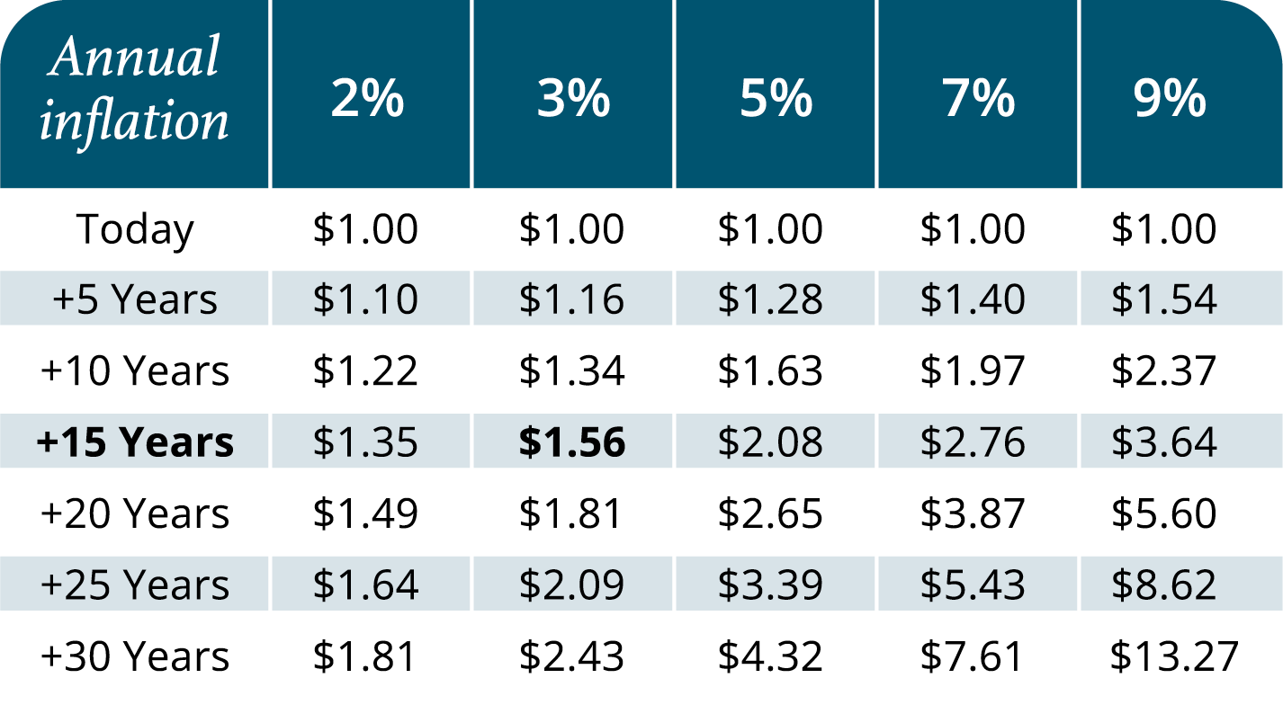
Retirement Needs & Expenses
Page 2-9
How Much Will You Need to Retire?
Step 2: Adjust for Inflation
We will assume a hypothetical average inflation rate of 3% over the 15-year period between now and their retirement date
Notes:
HOW MUCH WILL YOU NEED TO RETIRE?
Step 2: Adjust for Inflation
As we discussed earlier, $4,400 in 15 years won’t have the same buying power as it does today. We’ll need to estimate how inflation could affect Robert and Sophia’s monthly expenses. For the sake of this hypothetical scenario we’ll assume an average inflation rate of 3% over the 15-year period between now and their retirement date.

Slide 38
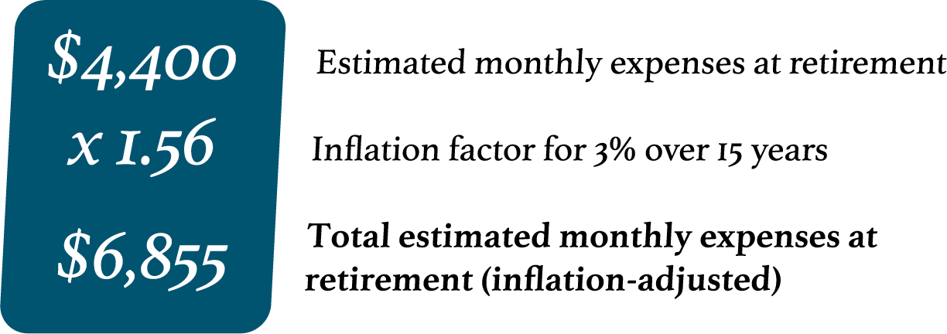
Retirement Needs & Expenses
Page 2-9
How Much Will You Need to Retire?
Step 2: Adjust for Inflation
We will assume a hypothetical average inflation rate of 3% over the 15-year period between now and their retirement date
Notes:
HOW MUCH WILL YOU NEED TO RETIRE?
Step 2: Adjust for Inflation
As we discussed earlier, $4,400 in 15 years won’t have the same buying power as it does today. We’ll need to estimate how inflation could affect Robert and Sophia’s monthly expenses. For the sake of this hypothetical scenario we’ll assume an average inflation rate of 3% over the 15-year period between now and their retirement date.

Slide 39
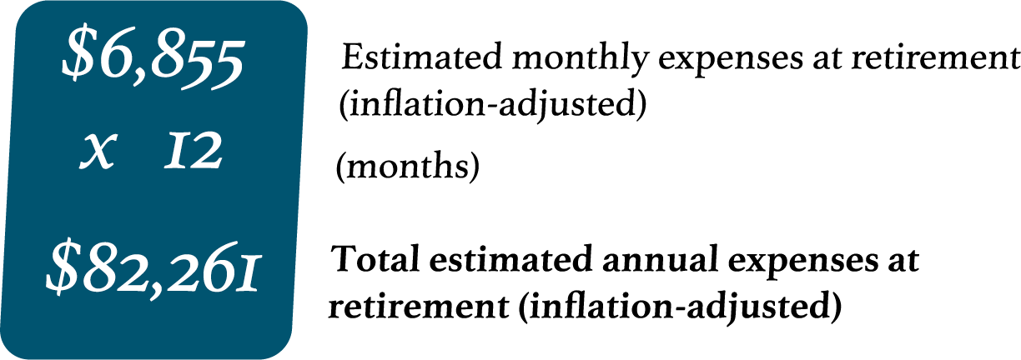
Retirement Needs & Expenses
Page 2-10
How Much Will You Need to Retire?
Step 3: Turning a Monthly Estimate Into a Yearly Estimate
Robert and Sophia’s estimated monthly expenses will be approximately $6,855 at retirement
Multiply the monthly estimate by 12 in order to estimate their yearly expenses at retirement
Notes:
HOW MUCH WILL YOU NEED TO RETIRE?
Step 3: Turning a Monthly Estimate into a Yearly Estimate
Robert and Sophia’s inflation-adjusted estimated monthly expenses will be approximately $6,855 at retirement. Multiply the monthly estimate by 12 in order to estimate their yearly expenses at retirement.

Slide 40
Retirement Needs & Expenses
Page 2-10
How Much Will You Need to Retire?
Step 4: Inflation in Retirement
Assume Robert and Sophia are the same age, expect to retire at age 65 and expect to spend 20 years in retirement
Assume the inflation rate continues at a steady 3% annually over their 20-year retirement but living expenses stay the same
How much money will they need over this 20 years?
Notes:
HOW MUCH WILL YOU NEED TO RETIRE?
Step 4: Inflation in Retirement
For the sake of simplicity, let’s assume Robert and Sophia are the same age, both expect to retire at age 65 and expect to spend 20 years in retirement.
Let’s assume the inflation rate continues at a steady 3% annually over their 20-year retirement but their living expenses stay the same. How much money will they need over this 20 years? As you can see from the next chart, their expenses today of $5,500 a month (or $66,000 a year) may grow to more than two million dollars over the course of their 20-year retirement.

Slide 41
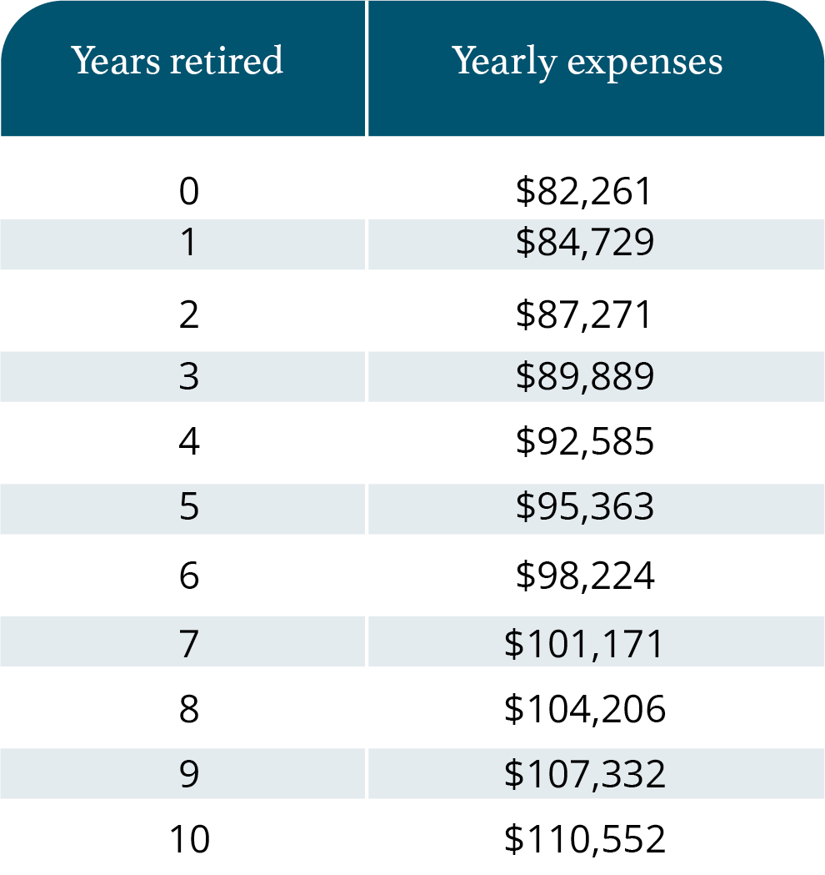
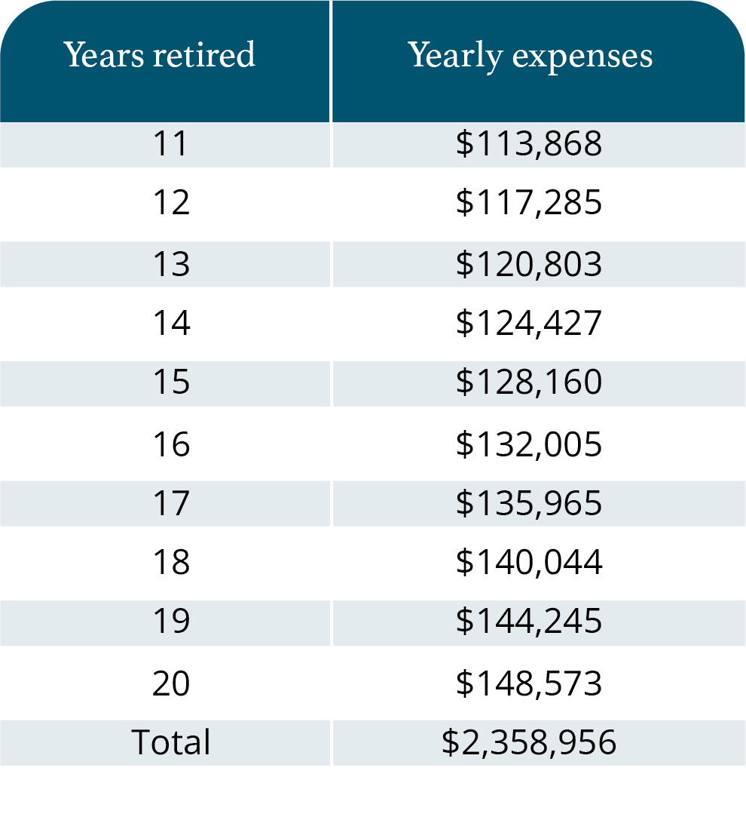
Retirement Needs & Expenses
Page 2-11
How Much Will You Need to Retire?
Yearly Living Expenses During Retirement
Expenses today of $5,500 a month may grow to over two million dollars
Notes:
HOW MUCH WILL YOU NEED TO RETIRE?
There are many factors involved in accurately estimating your retirement expenses. Many financial professionals use advanced software to compare different scenarios and calculate retirement expenses.
As you can see from the chart, their expenses today of $5,500 a month (or $66,000 a year) may grow to more than two million dollars over the course of their 20-year retirement.

Slide 42
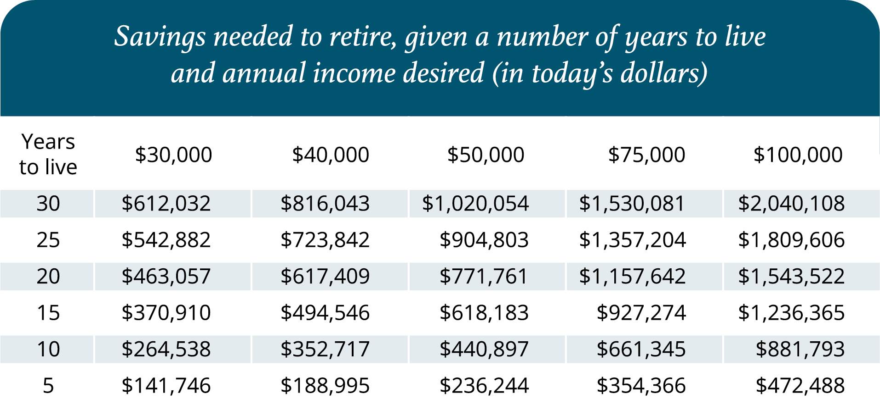
Retirement Needs & Expenses
Page 2-12
Can You Retire Today?
Assumptions: 6% annual yield on balance (average)¹, 3% inflation rate,
savings amount is fully invested, principal is $0 at end of life
¹The 6% yield is hypothetical and does not represent any particular investment.
Note: Potential pension income and/or Social Security benefits are not represented in this illustration. Each investor’s results will vary from these shown as investing involves risk, fluctuating returns and the possibility of loss.
Notes:
CAN YOU RETIRE TODAY?
Are you ready to retire today? Let’s see if you are financially prepared. This chart shows the retirement savings you need today based on your life expectancy and the amount of annual income you need during retirement.
Assumptions:
6% annual yield on balance (average)
3% inflation rate
Savings amount is fully invested
Principal is $0 at end of life

Slide 43
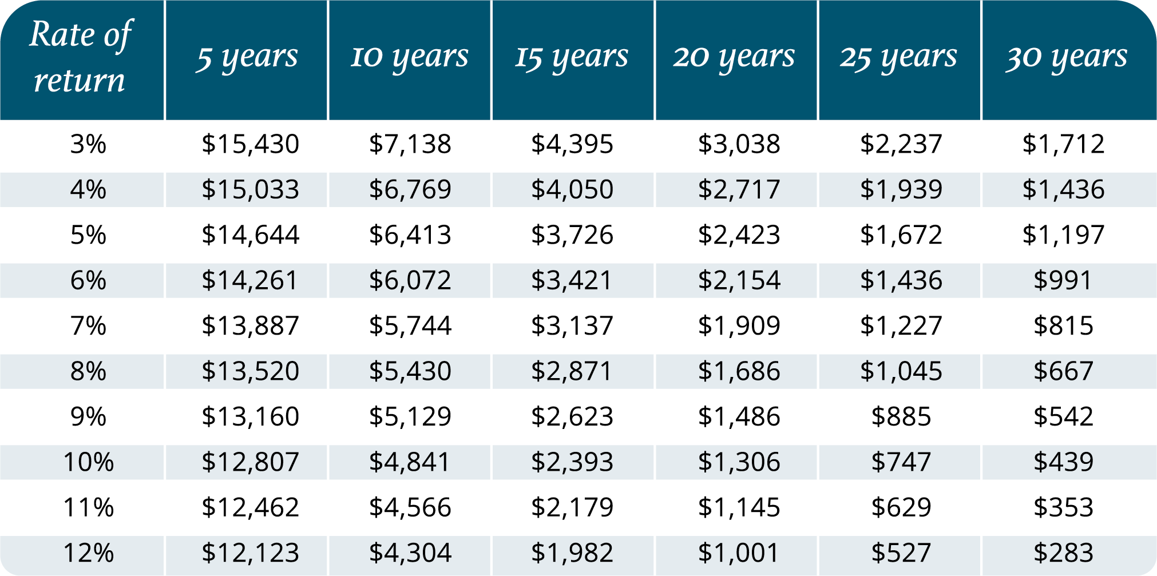
Retirement Needs & Expenses
Page 2-13
How to Save One Million Dollars
Each investor’s results will vary from these shown as investing involves risk, fluctuating returns and the possibility of loss. These figures
shown do not represent any specific product. Investments made at the beginning of time period, Returns are compounded monthly.
Notes:
HOW TO SAVE ONE MILLION DOLLARS
This chart indicates the monthly investment needed to save $1,000,000 depending on the number of years and the rate of return on your investment.
Assumptions: Investments made at the beginning of time period, Returns are compounded monthly.

