Slide 1

Modelist Market
Insights
Your Monthly Investment Review & Outlook

Slide 2


agenda
  Quick Recap
  Three Themes
  Equity Overview
  Fixed Income Overview
  Global Macro Overview
  Actionable Insights
  Modelist Overview
  Q&A
  Disclosures

Slide 3



Modelist Fills the Industry Blind Spot
Do It Yourself
Value to Clients
Your Brand
Customized
Not Your Expertise
Lacks Compliance
High Cost (Time/Staff)
Outsource
Deep Expertise
Consistent Experience
Compliance
Lacks Transparency
Limited Control
Selling Someone Else
ADVISOR USE ONLY

Slide 4

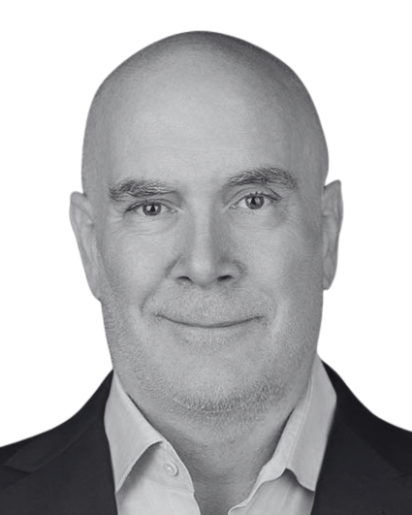
Our TEAM
Joe Mallen
CEO
Kent Peterson, PhD
CIO
MSc from London Business School
BSB from University of Minnesota
Joe has garnered a significant following among financial advisors, recognized for his insightful market analysis and expertise. He's a source for financial media, quoted by CNBC, Bloomberg, The Wall Street Journal, Barron's, Reuters, MarketWatch, and Yahoo. His thought leadership extends to appearances on prominent industry platforms, including Animal Spirits, The Sherman Show, and TD Ameritrade.
PhD from Princeton University
BA from Cornell University
Kent has spent much of his career between Wall Street and London, excelling in global macro research for some of the world's top investment firms. He started his career at Bridgewater Associates and was recently Head of Global Market Solutions at Santander. His expertise in identifying economic trends has distinguished him as a leading strategist in the finance sector.
ADVISOR USE ONLY

Slide 5
Quick recap
US stocks continued their trek higher in March, leaving the S&P 500 up in double digits year-to-date, and most other major industries not too far behind. More globally, overseas stocks also powered higher, with European bourses playing catch-up and having the best performance among major developed markets in March. Europe's broad Euro Stoxx 50 index is now up 12.43% in local currency terms year-to-date, while the Nikkei is now up 20.63% in local currency terms, though these returns are a bit lower for US$ investors because of dollar strength. By contrast, EM returns have been positive if more muted because of the drag from China's economic malaise. US Treasuries closed fairly flat for the month, with the US 2 and 10 Year now up about 35 bps from the start of the year as yield curve inversion continues. The biggest news of the month was the Fed's announcement that, barring a sudden spike in inflation, they did intend to cut rates three times this year. Good news for Treasuries. In other markets, the US$ had a strong March as US growth continues to outpace most other investible countries and make US assets attractive. The VIX remains in its muted state as there are few negatives on the horizon to send stocks falling. Crude and Gold both had a strong March, while Bitcoin traded sideways, though all three markets, like stocks, have had a strong start to 2024.
Source: Bloomberg, Modelist
Returns greater than 1-year are annualized.

Slide 6
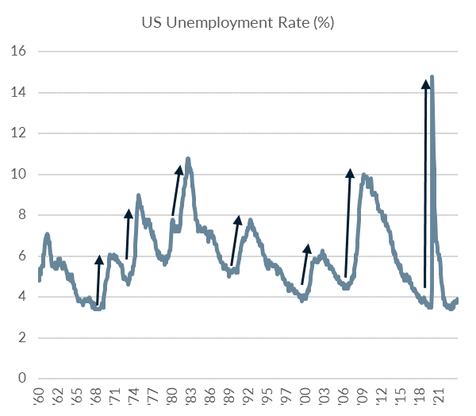
Three Themes
1
Fed’s Pivot: From Inflation Fighting to Recession Risks
For the last few years, with inflation roaring up into high single digits, all of the Fed's focus has been on taming inflation and bringing it back to their target of 2%. So how is it that with inflation currently just above 3%, a good distance from that target, the Fed is saying that they aim to cut rates three times this year? The quick answer is that the Fed is worried about higher rates leading to a spike in unemployment and a recession. That's because in a business cycle, hiring happens gradually and cautiously while firing happens fast and out of fear. As you can see in the chart to the left, the multiplier effect that works slowly when there is growth—more jobs means more demand, and so more people are hired—reverses violently when growth stalls. The Fed, with its dual mandate to keep prices stable and achieve maximum employment, has shifted their gaze from worrying completely about the balloon over-inflating to concern that all their rate hikes might suddenly let a lot of air out of the balloon.
Source: Bloomberg, Modelist

Slide 7
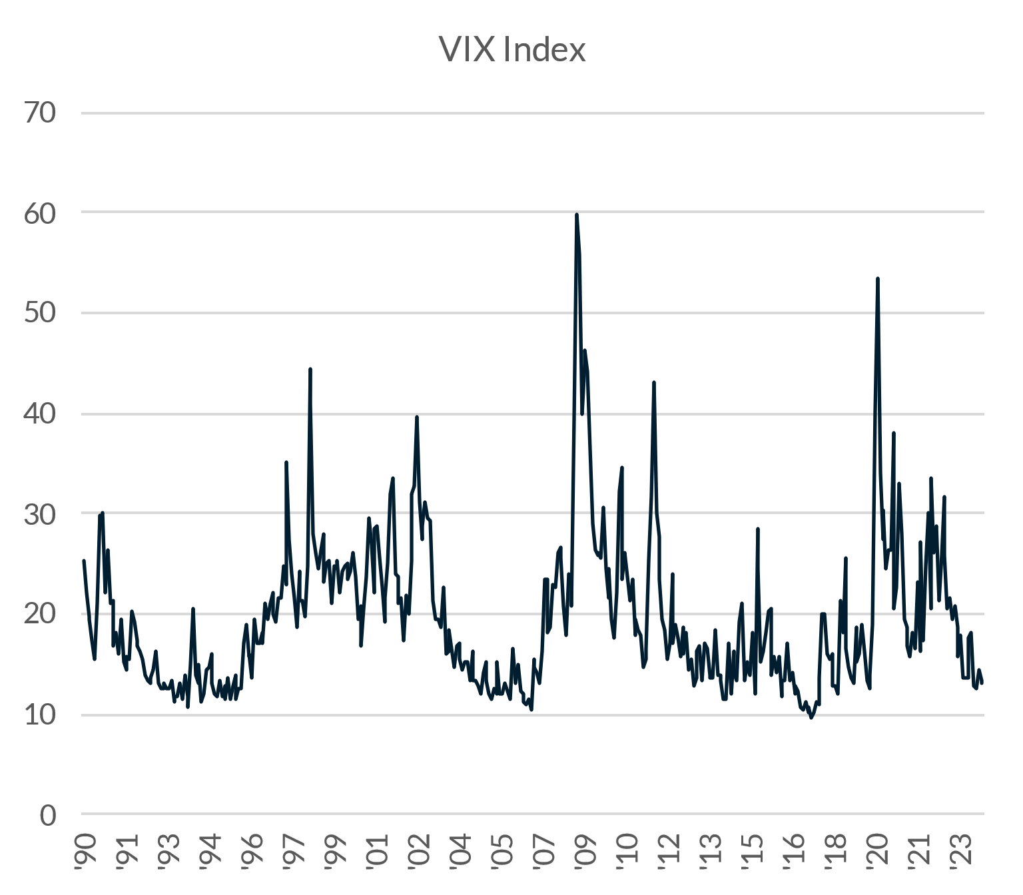
Three Themes
2
VIX Slumbers, But for How Long?
The VIX is the option market's estimate of expected future stock volatility. Currently, it sits at the low end of its range at around 13. For reference, the long-term average of the VIX is 19.63, and the realized volatility of stocks since 1990 has been 15%. On a percentile basis, it currently sits in the 15th percentile versus the last 34 years. So it's low but not extremely or worryingly low. Like unemployment, the VIX is prone to spikes that occur when the stock market starts falling, and the demand for protective insurance surges. But now, there simply isn't a lot of fear or demand for that insurance. Sellers of option premiums, perhaps seeking income, are pushing prices for options down. But there may not be much juice left in this trade: option sellers make income in part because the price of expected volatility trades at a premium over realized volatility and gradually falls as options get closer to expiration, but currently, both metrics sit close to each other at 13%, so that premium is low. At some point, volatility will return to normal higher levels, but that catalyst remains off on the horizon.
Source: Bloomberg, Modelist

Slide 8
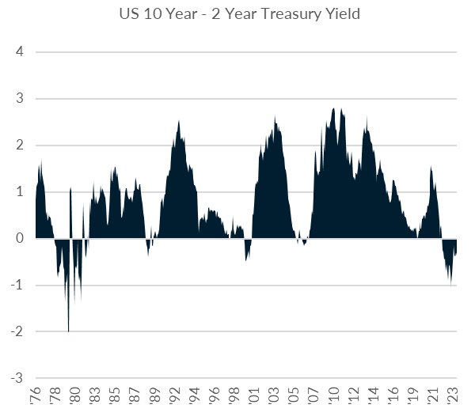
Three Themes
3
Inverted Yield Curve: An Abnormal Norm
For the last 21 months, longer-term US bond yields have traded below shorter-term yields. This is not normal. Normal is when ten-year rates are higher than two-year rates. And there is a good reason for this. The longer you hold an asset, the greater the risk of default and inflation erosion when payments are fixed. This greater risk means that investors should receive a higher yield in return for bearing that additional risk. What is especially unusual is the sheer duration of the current inversion. Since 1976, the US has only seen one other period when the yield curve was inverted for this long, and that was in 1980 for 21 months when inflation was out of control. We are likely to easily surpass that duration and set a record in the coming months. When the Yield Curve will return to normal is largely a function of the Fed lowering rates and market expectations, and how the Treasury will choose to distribute the maturities of future debt issuance. Our hope is that we don't see a repeat of the early 80s when inflation comes roaring back, and the Yield Curve stays upside down.
Source: Bloomberg, Modelist

Slide 9
Equity
Overview

Slide 10
US Equity markets
VIX Index
S&P 500 Index Trailing P/E Ratio & 10-Year Average
S&P 500 Index & 30-Day SMA (2 Standard Deviations)
S&P 500 Index Forward P/E Ratio & 10-Year Average
Source: Bloomberg, Modelist

Slide 11
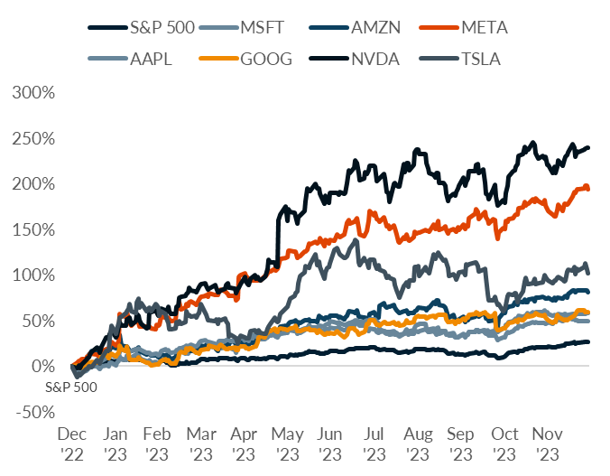
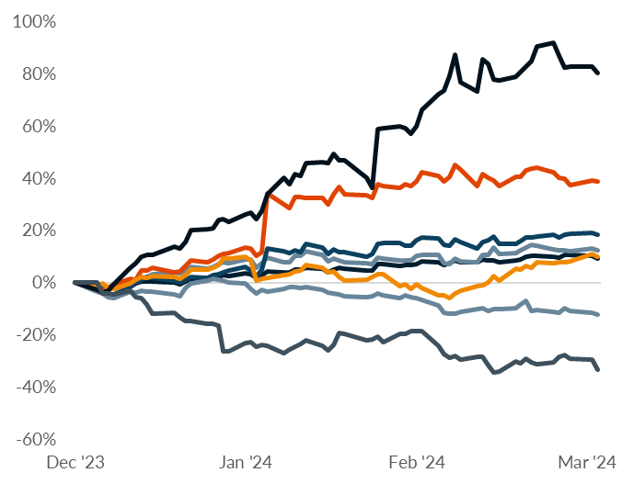
US Equity markets
S&P 500 Index and ‘Magnificent Seven” Total Returns
NVDA
NVDA
S&P 500
S&P 500
TSLA
Source: Bloomberg, Modelist

Slide 12
US Equity markets
US Style Box Total Return (%)
Source: Bloomberg, Modelist
Returns greater than 1-year are annualized.

Slide 13
US Equity markets
US Sector & Industry Total Return (%)
Source: Bloomberg, Modelist
Returns greater than 1-year are annualized.

Slide 14
international Equity markets
Developed & Emerging Markets Total Return (%)
Source: Bloomberg, Modelist
Returns greater than 1-year are annualized.

Slide 15
Fixed Income
Overview

Slide 16
Fixed Income Markets
US Federal Reserve Policy Monitor
Implied Fed Funds Rate (%)
US CPI YoY NSA & US PCE Core Price YoY SA (%)
US U-3 Unemployment Rate (%) (left) & US Initial Jobless Claims SA (1000s) (right)
Source: Bloomberg, Modelist

Slide 17
Fixed Income Markets
US 10 Year Treasury Yield (%)
Current Treasury Yield Curve & One-Year Ago (%)
US 10 Year minus 2 Year Treasury Yield (%)
High Yield Credit Spread (left) & A-Rated Credit Spread (right) (%)
Source: Bloomberg, Modelist

Slide 18
Fixed Income Markets
Fixed Income Asset Class Total Return (%)
Source: Bloomberg, Modelist
Returns greater than 1-year are annualized.

Slide 19
Global Macro
Overview

Slide 20
US Economic Data
Recent Releases
Source: YCharts, Modelist

Slide 21
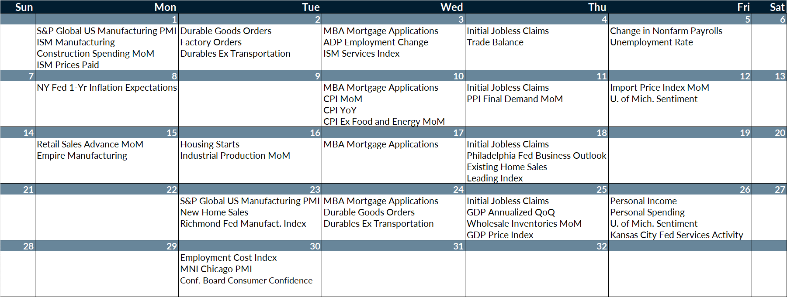
US Economic Data
Next Month’s Calendar
Source: Bloomberg, Modelist

Slide 22
Actionable
insights

Slide 23
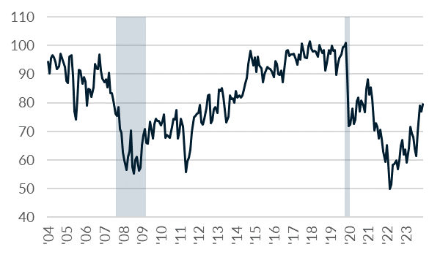
Consumer Sentiment
The University of Michigan Consumer Sentiment Index
Component Contributions
US Recessions
Consumer Sentiment
Source: Bloomberg, Modelist

Slide 24
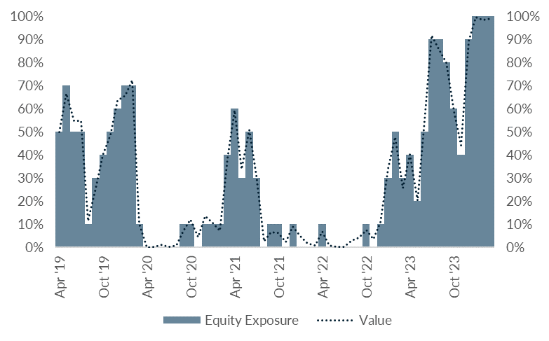
Consumer Sentiment
Consumer Sentiment Strategy
Commentary
The Consumer Sentiment Strategy’s full investment in Global Large Blend equities, at 100%, is indicative of a strong consumer sentiment reading for March at 79.4, which is considerably above the two-year average. This positioning reflects the strategy's assessment of the University of Michigan's Consumer Sentiment Index, identifying a strong trend and, therefore, favoring equities. The current sentiment levels suggest that consumer confidence is robust, leading to increased consumer spending that benefits equity markets. The allocation is consistent with the strategy’s directive to lean into global equities in times of positive consumer sentiment trends.
Source: Bloomberg, Modelist

Slide 25

Modelist
Overview
ADVISOR USE ONLY
25

Slide 26
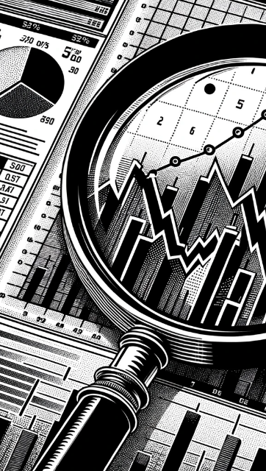
evidence-based approach
Repeatable Process
At Modelist, we build upon a strong foundation of evidence-based investing strategies rooted in robust research and market analysis
Our team conducts thorough research into global macroeconomic trends, technical indicators, and fundamental factors. We distill this data into concise, comprehensible, and actionable insights, enabling financial advisors to seamlessly integrate these valuable perspectives into their models. This approach ensures that advisors can leverage the benefits of our in-depth research in a practical and easily understandable manner.
Informed Decisions
By leveraging these proven strategies, financial advisors gain the insights needed to make well-informed decisions aligned with their clients' goals
Data-Driven Advantage
Trust in your choices and enhance client experiences through research-backed approaches that stand the test of time
ADVISOR USE ONLY

Slide 27
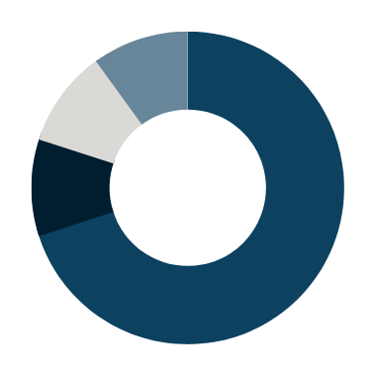

Building Investment Models
Our team recommends specific investment strategies, considering market trends and the advisor's objectives.
Macroeconomic
Fundamental
Technical
Inflation Expectations
Relative Value
Duration Management
Economic Growth Expectations
Relative Quality
Yield Spreads
Leading Economic Indicators
Alternative Assets
Asset Class Relative Strength
Coincident Economic Indicators
All Weather Adjustment
Asset Class Trend Following
Consumer Sentiment
Enhanced Yield
Equity Trend Following
News Sentiment
Cash Plus
Sector Relative Strength
ADVISOR USE ONLY

Slide 28
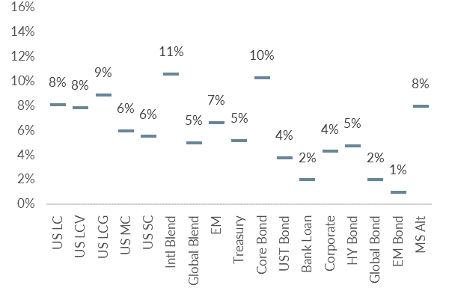
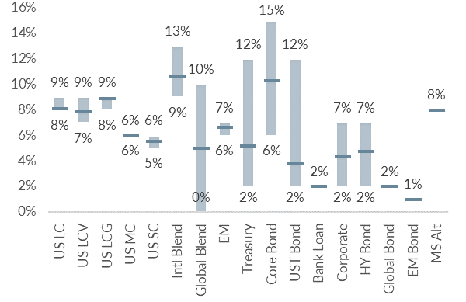
Building Investment Models
We skillfully blend various investment strategies into a unified, cohesive design that aligns with your clients' needs.
Diversified Model
Model with added Tactical Strategies
Coincident Economic Indicators
Duration Management
Asset Class Relative Strength
ADVISOR USE ONLY

Slide 29
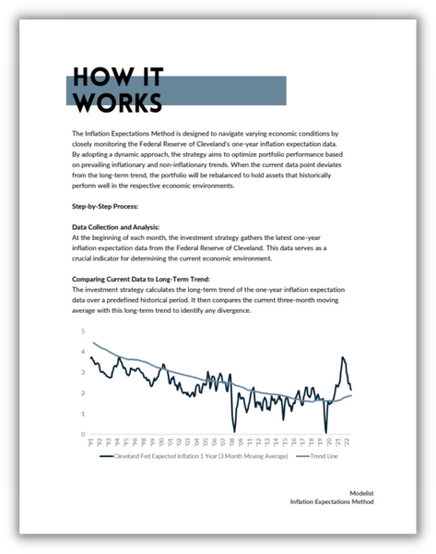
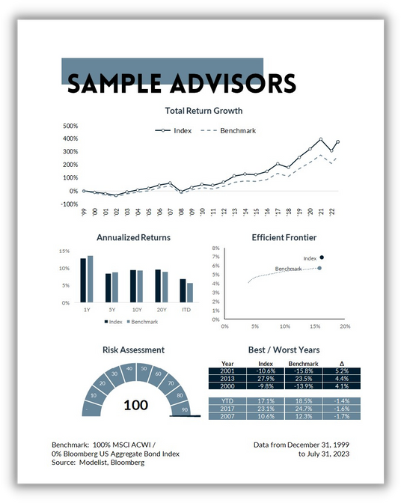
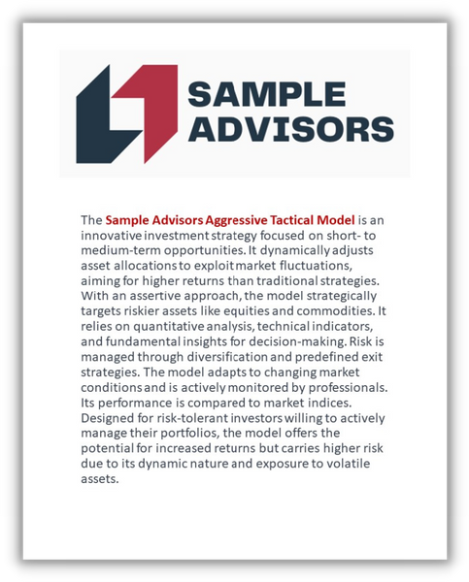
Supporting Collateral and
White-Labeled Branding
Access to Research
White-Labeled Branding
Comprehensive Collateral
Benefit from our in-depth research on investment strategies to strengthen your compliance documentation.
Access supporting collateral, including educational resources, marketing materials, and more.
Customized resources to your brand, effectively showcasing the value of your investment approach to clients.
ADVISOR USE ONLY

Slide 30
Personalized models for the fiduciary advisor
Over 30 Strategies
Modelist Resources
Fully Transparent
Frequent Content
Competence
Advisor
Model Portfolios
Fully Customized
Credibility
Narrative Continuity
Communication
Your
Brand
Brand Optics
Compliant
Process Control
Fund Preferences
ADVISOR USE ONLY

Slide 31

Questions &
And answers
ADVISOR USE ONLY
31

Slide 32

Learn More
Unlock Opportunities
Modelist empowers you with tailored investment models, evidence-based strategies, and comprehensive support.
Elevate Your Business with Modelist
Explore Further
Dive deeper into the advantages that Modelist offers and discover how it can transform your advisory approach.
Take Action
612-887-9897
Elevate your advisory business by partnering with Modelist. Join us today and experience the difference for yourself.
hello@modelist.me
www.modelist.me
ADVISOR USE ONLY

Slide 33
Disclosures
Modelist Inc. is a registered investment adviser. Information presented is for educational purposes only and does not intend to make an offer or solicitation for the sale or purchase of any specific securities, investments, or investment strategies. Investments involve risk and, unless otherwise stated, are not guaranteed. Be sure to first consult with a qualified financial adviser and/or tax professional before implementing any strategy discussed herein. Past performance is not indicative of future performance.

