Slide 1

Modelist Market
Insights
Your Monthly Investment Review & Outlook

Slide 2


agenda
  Quick Recap
  Three Themes
  Equity Overview
  Fixed Income Overview
  Global Macro Overview
  Actionable Insights
  Modelist Overview
  Q&A
  Disclosures

Slide 3



Modelist Fills the Industry Blind Spot
Do It Yourself
Value to Clients
Your Brand
Customized
Not Your Expertise
Lacks Compliance
High Cost (Time/Staff)
Outsource
Deep Expertise
Consistent Experience
Compliance
Lacks Transparency
Limited Control
Selling Someone Else
ADVISOR USE ONLY

Slide 4


Our TEAM
Joe Mallen
CEO
Kent Peterson, PhD
CIO
MSc from London Business School
BSB from University of Minnesota
Joe has garnered a significant following among financial advisors, recognized for his insightful market analysis and expertise. He's a source for financial media, quoted by CNBC, Bloomberg, The Wall Street Journal, Barron's, Reuters, MarketWatch, and Yahoo. His thought leadership extends to appearances on prominent industry platforms, including Animal Spirits, The Sherman Show, and TD Ameritrade.
PhD from Princeton University
BA from Cornell University
Kent has spent much of his career between Wall Street and London, excelling in global macro research for some of the world's top investment firms. He started his career at Bridgewater Associates and was recently Head of Global Market Solutions at Santander. His expertise in identifying economic trends has distinguished him as a leading strategist in the finance sector.
ADVISOR USE ONLY

Slide 5
Quick recap
May proved to be a positive month for stocks after a dismal April dragged equities down. Two factors drove US stocks higher: positive earnings reports from mega-caps like Nvidia and an array of economic stats pointing to moderating inflation and cooler growth, which brought the tantalizing prospect of a Fed rate cut slightly closer. Not surprisingly, US equities rallied with the Nasdaq leading the way up 6.98% for the month, while the S&P 500 rose 4.96% and the Dow was up 2.58%. Developed stocks also rallied in kind, with most of the positive price action coming from Europe and a select group of Asian countries. By contrast, Emerging Markets barely budged, closing up 59 basis points.
Economic data showing the US economy was no longer in overdrive and might even be cooling slightly helped push Treasury yields lower by 14 to 18 basis points.
Other markets were mixed. The rise in stocks helped push the VIX and demand for options protection lower. Meanwhile, Gold continued its march upward, gaining $41 on the month to close at $2,327.33, while Crude Oil dipped down to $76.99 per barrel.
Source: Bloomberg, Modelist
Returns greater than 1-year are annualized.

Slide 6
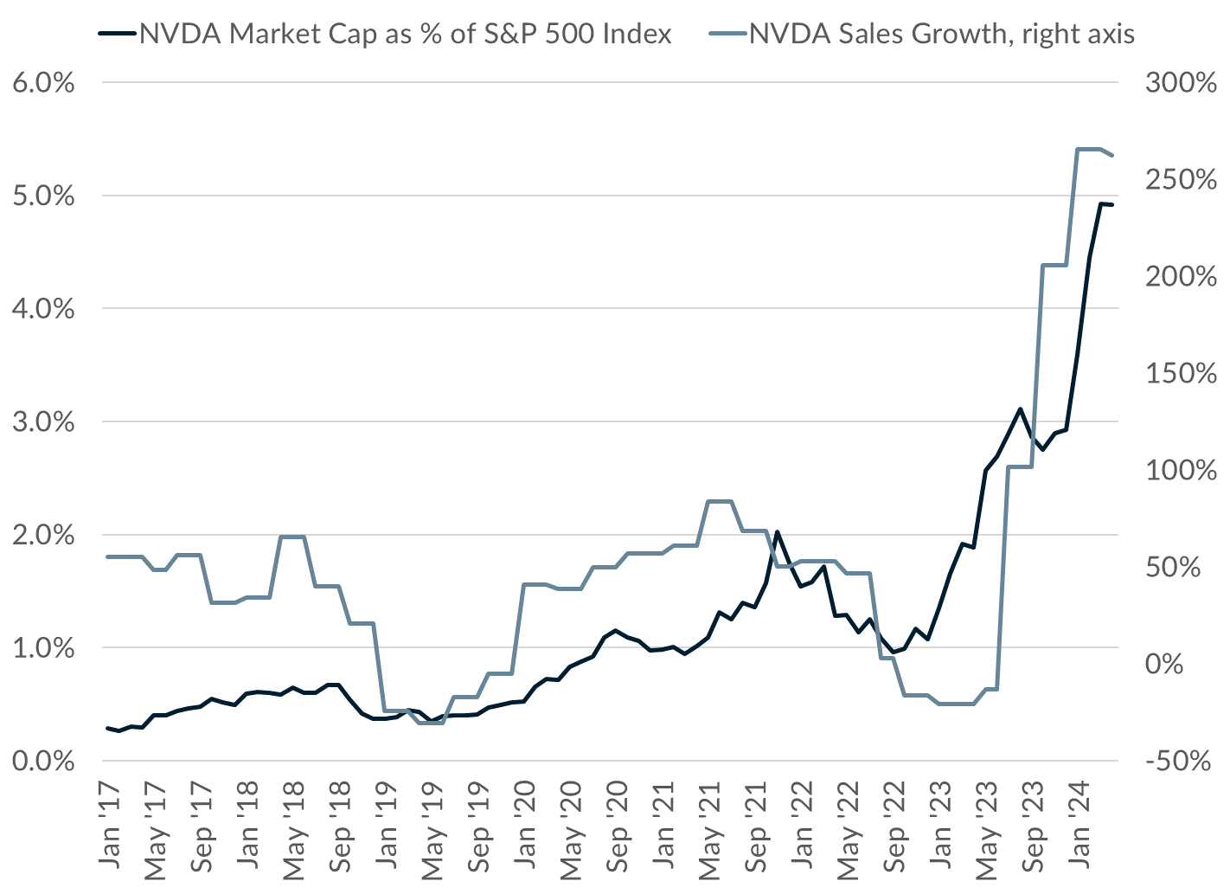
Three Themes
1
Nvidia's Chip Empire: Soaring Profits and Captive Customers
Nvidia is back. After selling off in April, its May earnings report sent the stock gapping to new historic highs above $1,000 per share. By most measures, its valuation remains stretched (its PE is 67), but unlike bubbles of the past, its growth is very real. As you can see in the chart, NVDA has grown from a market capitalization share of less than 0.5% of the S&P 500 to close to 5% today. Over the same time frame, sales growth has been astonishing, most recently reaching 260%. While competitors are trying to steal market share, building chips takes years, and many customers are locked into Nvidia's ecosystem. So, for the time being, NVDA can set prices where it likes. It enjoys a profit margin of 57%, its highest ever.
Source: Bloomberg, Modelist

Slide 7
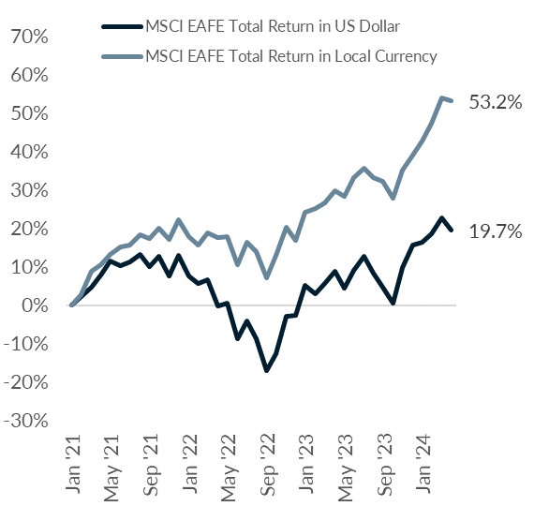
Three Themes
2
Currency Woes: The Hidden Cost of Overseas Investing
Investing outside the US to diversify has its benefits in the long term. Foreign markets can be driven by their local business cycles, and thus stock prices may rise, even when those in the US are falling, a pattern likely to accelerate with the decline in global trade. However, there have been two problems with this strategy for US investors in the last few years. Firstly, until recently, the US stock market has simply outperformed almost every other major developed market in the world, giving investors little reason to go abroad. Secondly, the strength of the US dollar has diminished overseas gains when those gains are converted back into dollars. The chart to the right shows the returns to a US investor of the MSCI EAFE index in US dollar and local currency terms since the start of 2021. The local currency index has gained 33.6% more than the US dollar version. Of course, this currency effect could easily reverse. In the event that the US dollar declines when the Fed starts cutting rates, US investors may find that what once was a headwind dragging down their international holdings suddenly becomes a tailwind boosting returns.
Source: Bloomberg, Modelist

Slide 8
Three Themes
3
Inflation's Uneven Retreat: A Tale of Two Sectors
Inflation has cooled considerably from its peak in 2022 when it was approaching 9+% due to above-average price increases in every CPI component. Today, almost all key inflation metrics remain above the longer-term trend but well below their peaks, with two exceptions that unfortunately make up the majority of the inflation stats by weight. Shelter (or housing) and transportation combined account for 61% of the weight of the CPI basket but actually contribute about 81% of current inflation. Owner's equivalent rent and housing utilities are up over 5% annually, while transportation costs remain in double digits due to skyrocketing car insurance costs (up 22.6% YoY) and vehicle repair costs (up 9.8% YoY). The good news is that housing inflation is slowly decelerating, and Food & Beverage price increases are the smallest since early 2020 and below trend (they make up 14.4% of CPI). If transportation inflation cools off, the Fed may finally feel at ease and start to lower rates, since prices of everything else are heading in the right direction.
Source: Bloomberg, Modelist

Slide 9
Equity
Overview

Slide 10
US Equity markets
VIX Index
S&P 500 Index Trailing P/E Ratio & 10-Year Average
S&P 500 Index & 30-Day SMA (2 Standard Deviations)
S&P 500 Index Forward P/E Ratio & 10-Year Average
Source: Bloomberg, Modelist

Slide 11
US Equity markets
US Earnings Monitor (Q1 2024, 2/16/24 to 05/15/24)
Sales Surprise (Positive, Inline, Negative)
Earnings Surprise (Positive, Inline, Negative)
Average Sales Surprise
Average Earnings Surprise
Source: Bloomberg, Modelist

Slide 12
US Equity markets
US Style Box Total Return (%)
Source: Bloomberg, Modelist
Returns greater than 1-year are annualized.

Slide 13
US Equity markets
US Sector & Industry Total Return (%)
Source: Bloomberg, Modelist
Returns greater than 1-year are annualized.

Slide 14
international Equity markets
Developed & Emerging Markets Total Return (%)
Source: Bloomberg, Modelist
Returns greater than 1-year are annualized.

Slide 15
Fixed Income
Overview

Slide 16
Fixed Income Markets
US Federal Reserve Policy Monitor
Implied Fed Funds Rate (%)
US CPI YoY NSA & US PCE Core Price YoY SA (%)
US U-3 Unemployment Rate (%) (left) & US Initial Jobless Claims SA (1000s) (right)
Source: Bloomberg, Modelist

Slide 17
Fixed Income Markets
US 10 Year Treasury Yield (%)
Current Treasury Yield Curve & One-Year Ago (%)
US 10 Year minus 2 Year Treasury Yield (%)
High Yield Credit Spread (left) & A-Rated Credit Spread (right) (%)
Source: Bloomberg, Modelist

Slide 18
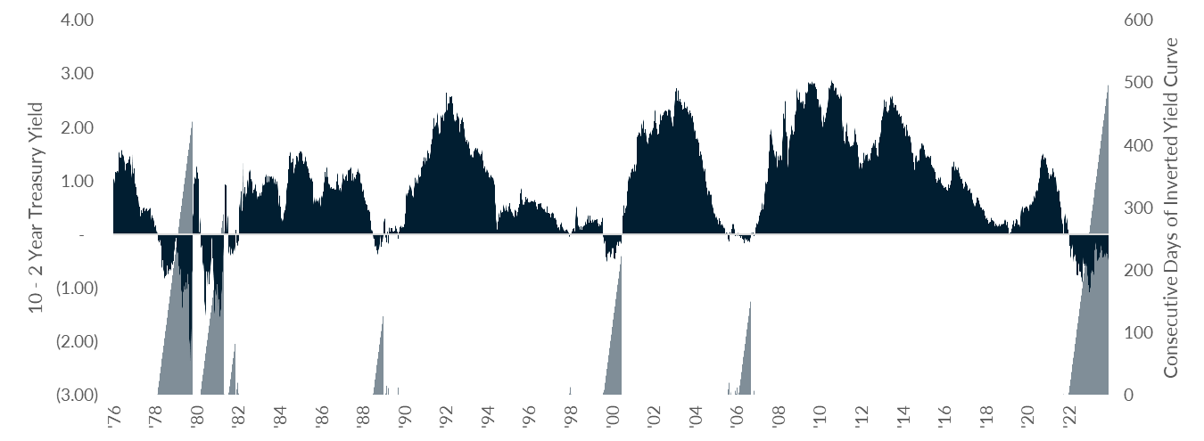
Fixed Income Markets
Record Long Yield Curve Inversion
Source: Bloomberg, Modelist

Slide 19
Fixed Income Markets
Fixed Income Asset Class Total Return (%)
Source: Bloomberg, Modelist
Returns greater than 1-year are annualized.

Slide 20
Global Macro
Overview

Slide 21
US Economic Data
Last Month Positive Surprises
Source: YCharts, Modelist

Slide 22
US Economic Data
Last Month Negative Surprises
Source: YCharts, Modelist

Slide 23
US Economic Data
Next Month’s Calendar
Source: Bloomberg, Modelist

Slide 24
Actionable
insights

Slide 25
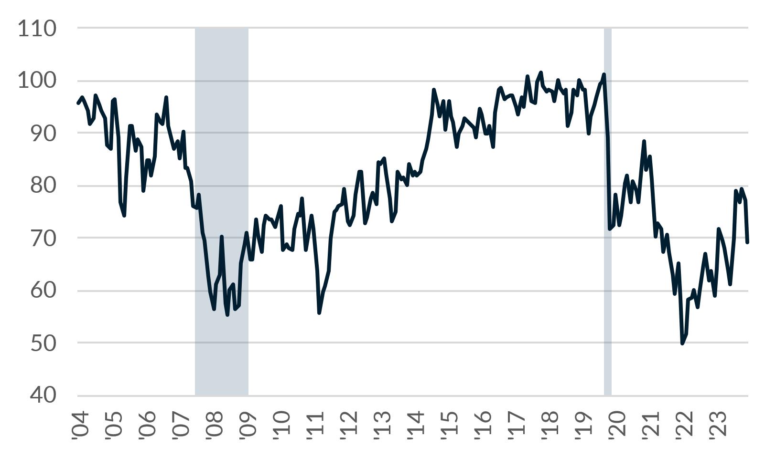
Consumer Sentiment
The University of Michigan Consumer Sentiment Index collects data on consumer attitudes and expectations, in order to determine the changes in consumers' willingness to buy and to predict their subsequent discretionary expenditures. This Index is comprised of measures of attitudes toward personal finances, general business conditions, and market conditions or prices.
The University of Michigan Consumer Sentiment Index
Component Contributions
US Recessions
Consumer Sentiment
Source: Bloomberg, Modelist

Slide 26
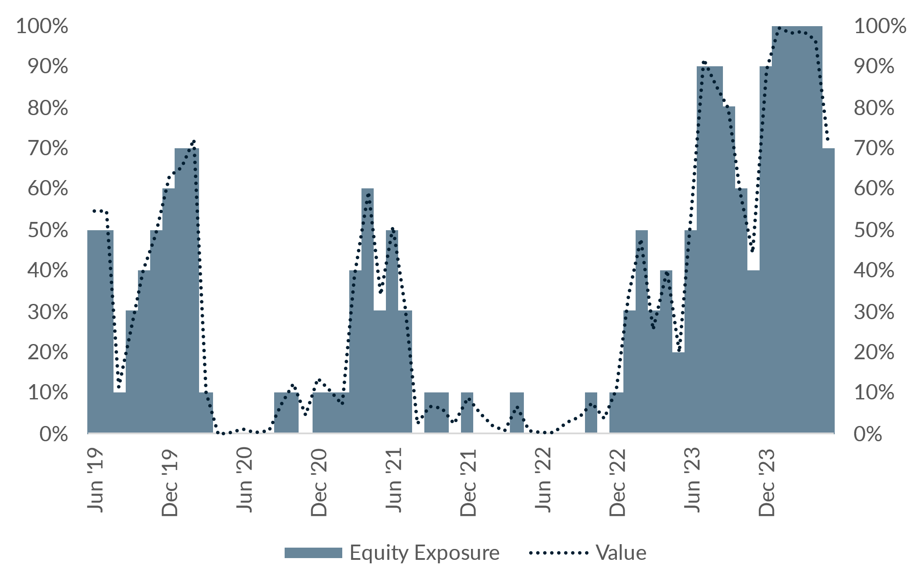
Consumer Sentiment
Consumer Sentiment Strategy
Commentary
The Consumer Sentiment Strategy is based on the University of Michigan's Consumer Sentiment Index reading for May 2024. The index reading of 69.1 remained above its 2-year average, indicating a strong consumer sentiment trend. As a result, the strategy maintained its allocation to Global Large Blend at 70% and Intermediate Core Bond at 30%. The strategy's decision to keep the allocation unchanged reflects its methodology of comparing the current sentiment to historical norms and adjusting the portfolio accordingly. The positive sentiment reading supports the strategy's continued emphasis on equity assets.
Source: Bloomberg, Modelist

Slide 27

Modelist
Overview
ADVISOR USE ONLY
27

Slide 28

evidence-based approach
Repeatable Process
At Modelist, we build upon a strong foundation of evidence-based investing strategies rooted in robust research and market analysis
Our team conducts thorough research into global macroeconomic trends, technical indicators, and fundamental factors. We distill this data into concise, comprehensible, and actionable insights, enabling financial advisors to seamlessly integrate these valuable perspectives into their models. This approach ensures that advisors can leverage the benefits of our in-depth research in a practical and easily understandable manner.
Informed Decisions
By leveraging these proven strategies, financial advisors gain the insights needed to make well-informed decisions aligned with their clients' goals
Data-Driven Advantage
Trust in your choices and enhance client experiences through research-backed approaches that stand the test of time
ADVISOR USE ONLY

Slide 29
Building Investment Models
Our team recommends specific investment strategies, considering market trends and the advisor's objectives.
Strategic
Tactical
Focuses on long-term investment goals, aligning portfolios with an investor's risk tolerance and time horizon through a stable asset allocation.
  Diversified Equity
  Diversified Fixed Income
  Risk Levels
  Target Date
  Risk Parity
Adopts a more active approach, adjusting the portfolio in response to market opportunities and trends.
  Relative Strength
  Relative Value
  Relative Quality
  Sector Strength
  Factor Strength
  Credit Management
  Duration Management
  Select Macroeconomic
  Leading Economic
  Coincident Economic
  Consumer Sentiment
  Growth Expectations
  Inflation Expectations
Specialized
Enhances portfolios by incorporating diverse assets and approaches, aiming for tailored objectives beyond traditional risk assessment.
  Alternative Assets
  Geographic Bias
  Enhanced Yield
ADVISOR USE ONLY

Slide 30
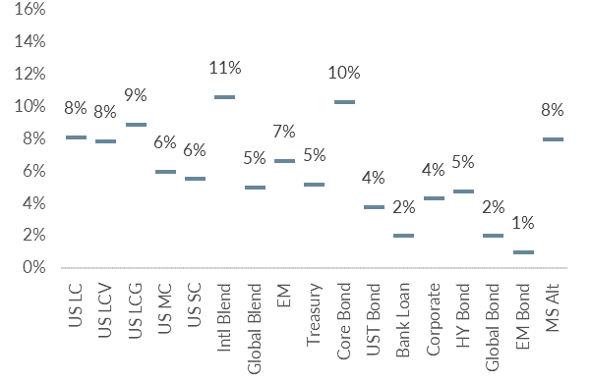
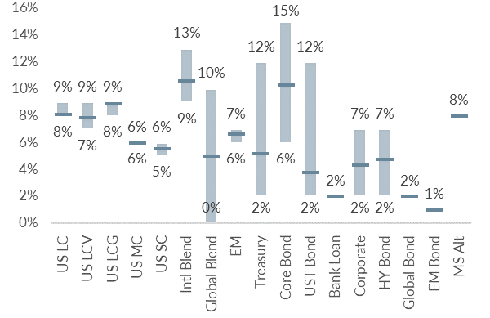
Building Investment Models
We skillfully blend various investment strategies into a unified, cohesive design that aligns with your clients' needs.
Diversified Model
Model with added Tactical Strategies
Coincident Economic Indicators
Duration Management
Asset Class Relative Strength
ADVISOR USE ONLY

Slide 31
Personalized models for the fiduciary advisor
Over 30 Strategies
Modelist Resources
Fully Transparent
Frequent Content
Competence
Advisor
Model Portfolios
Fully Customized
Credibility
Narrative Continuity
Communication
Your
Brand
Brand Optics
Compliant
Process Control
Fund Preferences
ADVISOR USE ONLY

Slide 32

Questions &
And answers
ADVISOR USE ONLY
32

Slide 33

Learn More
Unlock Opportunities
Modelist empowers you with tailored investment models, evidence-based strategies, and comprehensive support.
Elevate Your Business with Modelist
Explore Further
Dive deeper into the advantages that Modelist offers and discover how it can transform your advisory approach.
Take Action
612-887-9897
Elevate your advisory business by partnering with Modelist. Join us today and experience the difference for yourself.
hello@modelist.me
www.modelist.me
ADVISOR USE ONLY

Slide 34
Disclosures
Modelist Inc. is a registered investment adviser. Information presented is for educational purposes only and does not intend to make an offer or solicitation for the sale or purchase of any specific securities, investments, or investment strategies. Investments involve risk and, unless otherwise stated, are not guaranteed. Be sure to first consult with a qualified financial adviser and/or tax professional before implementing any strategy discussed herein. Past performance is not indicative of future performance.

