Slide 1

Modelist Market
Insights
Your Monthly Investment Review & Outlook

Slide 2


agenda
  Quick Recap
  Three Themes
  Equity Overview
  Fixed Income Overview
  Global Macro Overview
  Actionable Insights
  Disclosures

Slide 3



Modelist Fills the Industry Blind Spot
Do It Yourself
Value to Clients
Your Brand
Customized
Not Your Expertise
Lacks Compliance
High Cost (Time/Staff)
Outsource
Deep Expertise
Consistent Experience
Compliance
Lacks Transparency
Limited Control
Selling Someone Else
ADVISOR USE ONLY

Slide 4


Our TEAM
Joe Mallen
CEO
Kent Peterson, PhD
CIO
MSc from London Business School
BSB from University of Minnesota
Joe has garnered a significant following among financial advisors, recognized for his insightful market analysis and expertise. He's a source for financial media, quoted by CNBC, Bloomberg, The Wall Street Journal, Barron's, Reuters, MarketWatch, and Yahoo. His thought leadership extends to appearances on prominent industry platforms, including Animal Spirits, The Sherman Show, and TD Ameritrade.
PhD from Princeton University
BA from Cornell University
Kent has spent much of his career between Wall Street and London, excelling in global macro research for some of the world's top investment firms. He started his career at Bridgewater Associates and was recently Head of Global Market Solutions at Santander. His expertise in identifying economic trends has distinguished him as a leading strategist in the finance sector.
ADVISOR USE ONLY

Slide 5
Quick recap
US stock indexes continued to power upward into new high territory in February, led by large AI-centric stocks like Nvidia. Overseas, some select developed markets fared well, actually besting index returns in the US. In EM, February saw stocks rise, essentially offsetting the decline in January to leave emerging market equities in aggregate flat YTD as Chinese stocks came out of their funk. US bond yields traded in a 50 basis point range for the month, finishing close to their highs as CPI and other stats printed a bit higher than expectations and kicked the idea that the Fed would cut rates farther down the road. Not surprisingly, it was the middle part of the yield curve, where Fed policy expectations are priced in, that saw the biggest rise in yields. In other markets, the world was quieter. Gold, oil, and the US dollar ended the month pretty much where they started, while volatility remains subdued.
Source: Bloomberg, Modelist
Returns greater than 1-year are annualized.

Slide 6
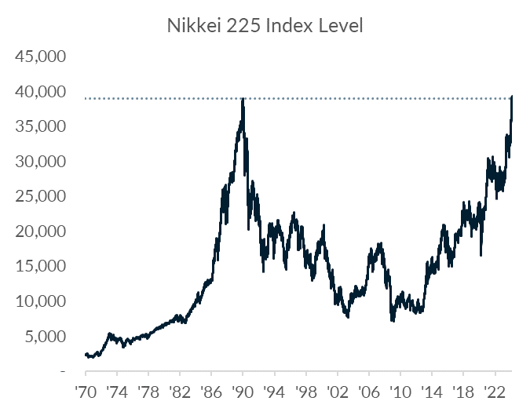
Three Themes
1
Japan's Market Revival: A Turnaround Tale of Corporate Resurgence and Economic Reforms
It's been 34 years since the Nikkei 225 made new highs, a sobering reminder that stocks can go nowhere for decades or decline up to 80%, especially when you have ineffective fiscal and central bank policy. Thankfully, a number of factors have combined to return Japanese firms to health: currency weakness has boosted exporters, corporate governance has been strengthened with firms more focused on profits and shareholder value, and higher inflation has allowed companies at last to raise prices and for wages to rise, boosting domestic demand.
Source: Bloomberg, Modelist

Slide 7
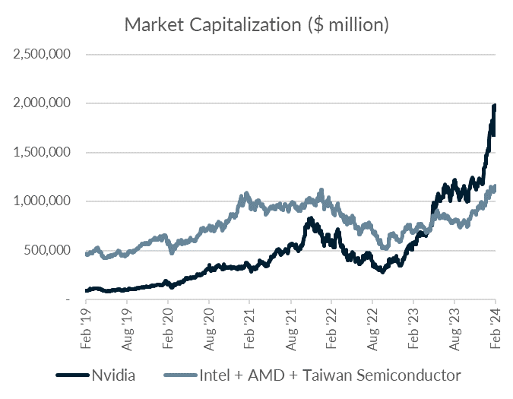
Three Themes
2
Nvidia's Earnings Surge: A New Era in Market Valuation and AI Leadership
On February 22, Nvidia announced earnings, beating sales and earnings estimates and sending its stock and the S&P 500 soaring. Nvidia now has a market capitalization of almost $2 trillion, making it the world’s fourth most valuable company. It is now worth 72% more than Intel, AMD, and Taiwan Semiconductor, who makes most of Nvidia's GPUs, combined. Whether they retain this valuation and their position at the forefront of the AI revolution remains to be seen. AMD has just produced a faster GPU chip. But for the time being, its huge market cap guarantees it will be a major driver of index returns for the foreseeable future.
Source: Bloomberg, Modelist

Slide 8
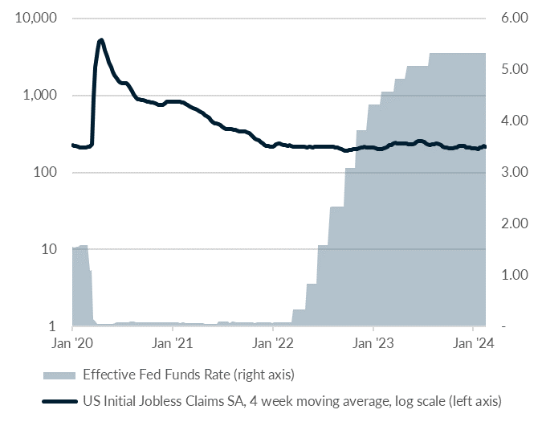
Three Themes
3
Resilient Employment Amid Rising Rates: The Unshaken Labor Market
When COVID appeared, the Fed cut rates to zero after unemployment spiked, but in 2022, inflation reared its ugly head, and the Fed hiked rates by over 500 basis points. What is extraordinary is how little impact the rise in rates has had on people finding jobs. The labor market remains buoyant for a number of reasons, including tight supply and the ability of the private sector to burn through excess savings accumulated during the COVID fiscal stimulus, keeping demand high. That savings is now gone, but wage growth remains at 4.5%, so until higher rates actually impact household spending or capital expenditures, jobs are likely to remain plentiful.
Source: Bloomberg, Modelist

Slide 9
Equity
Overview

Slide 10
US Equity markets
VIX Index
S&P 500 Index Trailing P/E Ratio & 10-Year Average
S&P 500 Index & 30-Day SMA (2 Standard Deviations)
S&P 500 Index Forward P/E Ratio & 10-Year Average
Source: Bloomberg, Modelist

Slide 11
US Equity markets
US Earnings Monitor (Q4 2023, 11/16/23 to 02/15/24)
Sales Surprise (Positive, Inline, Negative)
Earnings Surprise (Positive, Inline, Negative)
Average Sales Surprise
Average Earnings Surprise
Source: Bloomberg, Modelist

Slide 12
US Equity markets
US Style Box Total Return (%)
Source: Bloomberg, Modelist
Returns greater than 1-year are annualized.

Slide 13
US Equity markets
US Sector & Industry Total Return (%)
Source: Bloomberg, Modelist
Returns greater than 1-year are annualized.

Slide 14
international Equity markets
Developed & Emerging Markets Total Return (%)
Source: Bloomberg, Modelist
Returns greater than 1-year are annualized.

Slide 15
Fixed Income
Overview

Slide 16
Fixed Income Markets
US Federal Reserve Policy Monitor
Implied Fed Funds Rate (%)
US CPI YoY NSA & US PCE Core Price YoY SA (%)
US U-3 Unemployment Rate (%) (left) & US Initial Jobless Claims SA (1000s) (right)
Source: Bloomberg, Modelist

Slide 17
Fixed Income Markets
US 10 Year Treasury Yield (%)
Current Treasury Yield Curve & One-Year Ago (%)
US 10 Year minus 2 Year Treasury Yield (%)
High Yield Credit Spread (left) & A-Rated Credit Spread (right) (%)
Source: Bloomberg, Modelist

Slide 18
Fixed Income Markets
Fixed Income Asset Class Total Return (%)
Source: Bloomberg, Modelist
Returns greater than 1-year are annualized.

Slide 19
Global Macro
Overview

Slide 20
US Economic Data
Recent Releases
114.8
Source: YCharts, Modelist

Slide 21
US Economic Data
Next Month’s Calendar
Source: Bloomberg, Modelist

Slide 22
Actionable
insights

Slide 23
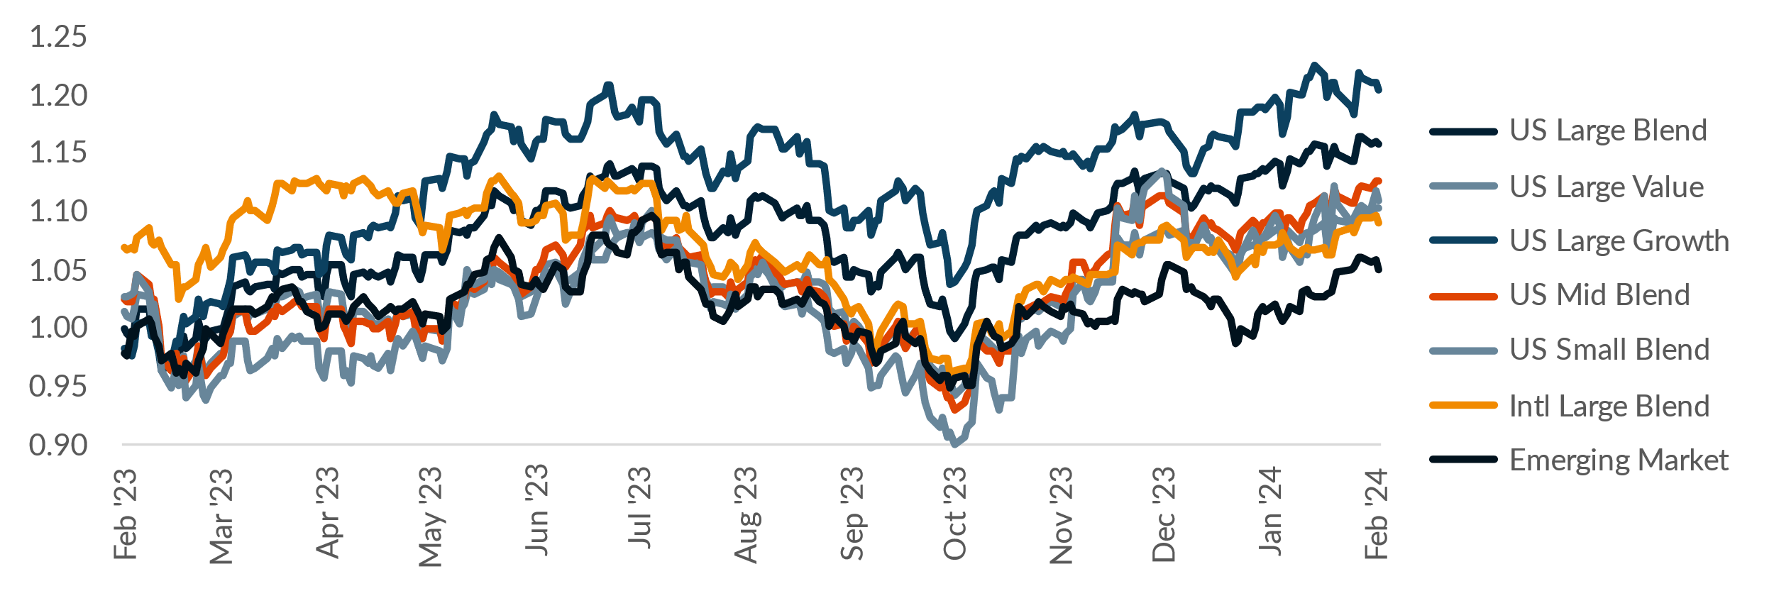
Equity Relative Strength
Asset Class Total Return Level / One-Year Moving Average
Equity Relative Strength
Source: Bloomberg, Modelist

Slide 24
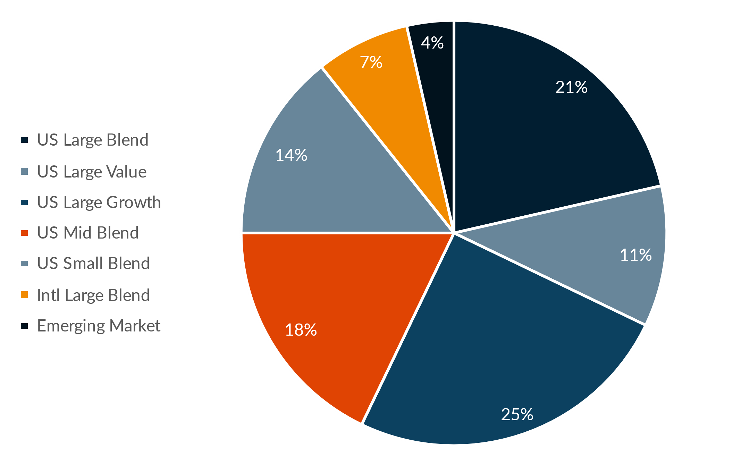
Equity Relative Strength
Asset Allocation of the Equity Relative Strength Method
Commentary
The Equity Relative Strength Strategy, based on one-year total returns, adjusts holdings to benefit from relative momentum in various equity classes, favoring assets which are outperforming. With Large Cap Growth and Large Cap Blend identified as strong performers, the strategy's increase in US Small Blend by 3.57% suggests that this class showed improved relative strength, warranting a greater portfolio share. Conversely, the reduction in Emerging Markets by 3.57% indicates underperformance relative to other classes within the evaluation period. This rebalancing reflects the method's commitment to capitalizing on relative performance, systematically shifting weight towards asset classes with superior momentum.
Source: Bloomberg, Modelist

Slide 25
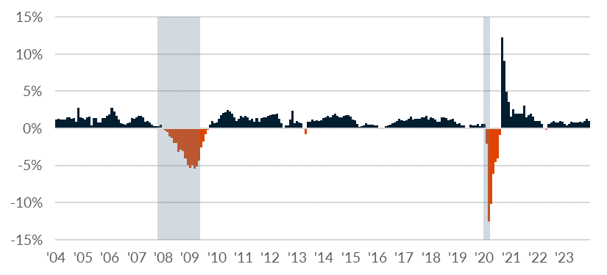
Coincident Economic Indicators
The Conference Board Coincident Economic Index (CEI) Six-Month % Change
Component Contributions
US Recessions
Coincident Economic Indicators
Source: Bloomberg, Modelist

Slide 26
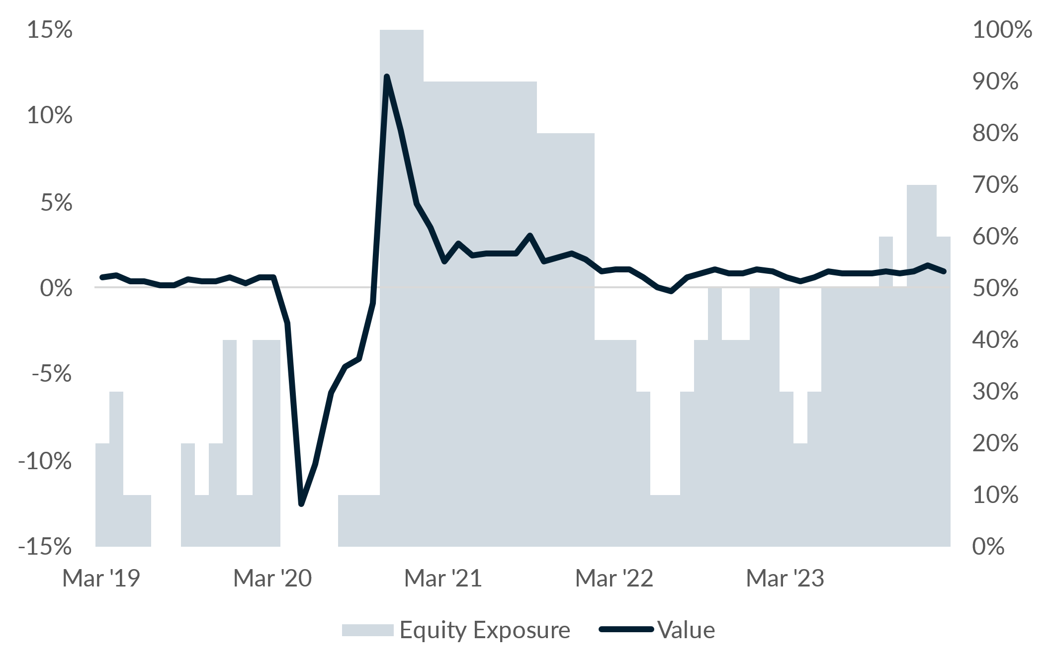
Coincident Economic Indicators
The Conference Board Coincident Economic Index (CEI) Six-Month % Change
Commentary
The Coincident Economic Indicators Strategy, leveraging recent CEI data, adjusted its portfolio in response to a 0.99% increase in the CEI over the past six months. This positive change suggests an improving economic landscape, prompting the strategy to increase its Global Large Blend equity position by 10%. Consequently, to balance this equity overweight, the allocation in Intermediate Core Bonds was reduced by 10%. The method's decision reflects a confidence in equities derived from strengthening economic indicators, aligning the portfolio to capitalize on potential economic growth and corresponding equity market performance.
Source: Bloomberg, Modelist

Slide 27

Modelist
Overview
ADVISOR USE ONLY
27

Slide 28

evidence-based approach
Repeatable Process
At Modelist, we build upon a strong foundation of evidence-based investing strategies rooted in robust research and market analysis
Our team conducts thorough research into global macroeconomic trends, technical indicators, and fundamental factors. We distill this data into concise, comprehensible, and actionable insights, enabling financial advisors to seamlessly integrate these valuable perspectives into their models. This approach ensures that advisors can leverage the benefits of our in-depth research in a practical and easily understandable manner.
Informed Decisions
By leveraging these proven strategies, financial advisors gain the insights needed to make well-informed decisions aligned with their clients' goals
Data-Driven Advantage
Trust in your choices and enhance client experiences through research-backed approaches that stand the test of time
ADVISOR USE ONLY

Slide 29
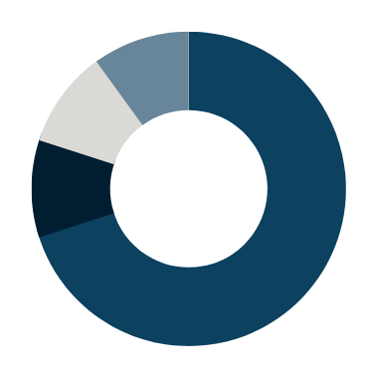

Building Investment Models
Our team recommends specific investment strategies, considering market trends and the advisor's objectives.
Macroeconomic
Fundamental
Technical
Inflation Expectations
Relative Value
Duration Management
Economic Growth Expectations
Relative Quality
Yield Spreads
Leading Economic Indicators
Alternative Assets
Asset Class Relative Strength
Coincident Economic Indicators
All Weather Adjustment
Asset Class Trend Following
Consumer Sentiment
Enhanced Yield
Equity Trend Following
News Sentiment
Cash Plus
Sector Relative Strength
ADVISOR USE ONLY

Slide 30
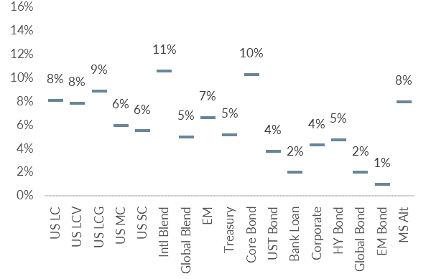
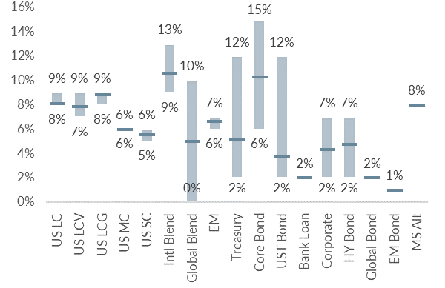
Building Investment Models
We skillfully blend various investment strategies into a unified, cohesive design that aligns with your clients' needs.
Diversified Model
Model with added Tactical Strategies
Coincident Economic Indicators
Duration Management
Asset Class Relative Strength
ADVISOR USE ONLY

Slide 31
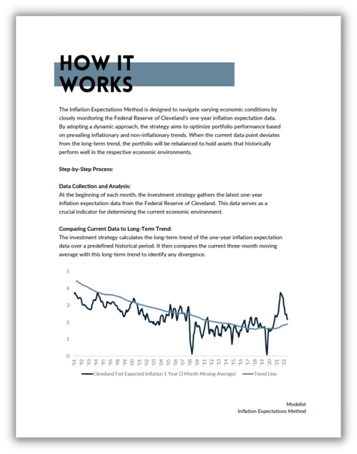
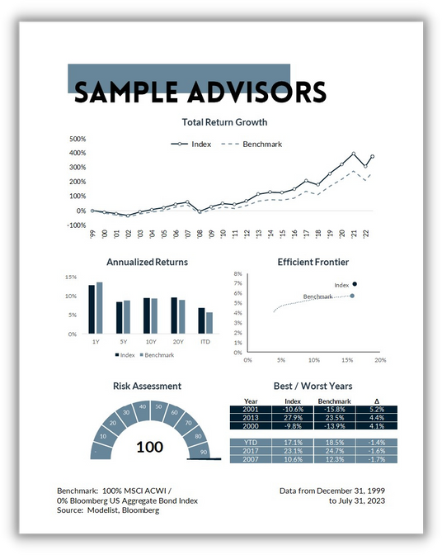
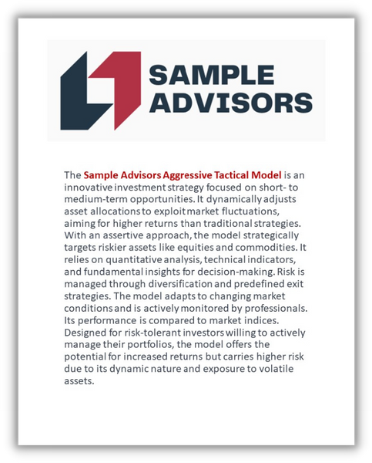
Supporting Collateral and
White-Labeled Branding
Access to Research
White-Labeled Branding
Comprehensive Collateral
Benefit from our in-depth research on investment strategies to strengthen your compliance documentation.
Access supporting collateral, including educational resources, marketing materials, and more.
Customized resources to your brand, effectively showcasing the value of your investment approach to clients.
ADVISOR USE ONLY

Slide 32
Personalized models for the fiduciary advisor
Over 30 Strategies
Modelist Resources
Fully Transparent
Frequent Content
Competence
Advisor
Model Portfolios
Fully Customized
Credibility
Narrative Continuity
Communication
Your
Brand
Brand Optics
Compliant
Process Control
Fund Preferences
ADVISOR USE ONLY

Slide 33

Questions &
And answers
ADVISOR USE ONLY
33

Slide 34

Learn More
Unlock Opportunities
Modelist empowers you with tailored investment models, evidence-based strategies, and comprehensive support.
Elevate Your Business with Modelist
Explore Further
Dive deeper into the advantages that Modelist offers and discover how it can transform your advisory approach.
Take Action
612-887-9897
Elevate your advisory business by partnering with Modelist. Join us today and experience the difference for yourself.
hello@modelist.me
www.modelist.me
ADVISOR USE ONLY

Slide 35
Disclosures
Modelist Inc. is a registered investment adviser. Information presented is for educational purposes only and does not intend to make an offer or solicitation for the sale or purchase of any specific securities, investments, or investment strategies. Investments involve risk and, unless otherwise stated, are not guaranteed. Be sure to first consult with a qualified financial adviser and/or tax professional before implementing any strategy discussed herein. Past performance is not indicative of future performance.

