Slide 1

Modelist Market
Insights
Your Monthly Investment Review & Outlook

Slide 2


agenda
  Quick Recap
  Three Themes
  Equity Overview
  Fixed Income Overview
  Global Macro Overview
  Actionable Insights
  Modelist Overview
  Q&A
  Disclosures

Slide 3



Modelist Fills the Industry Blind Spot
Do It Yourself
Value to Clients
Your Brand
Customized
Not Your Expertise
Lacks Compliance
High Cost (Time/Staff)
Outsource
Deep Expertise
Consistent Experience
Compliance
Lacks Transparency
Limited Control
Selling Someone Else
ADVISOR USE ONLY

Slide 4


Our TEAM
Joe Mallen
CEO
Kent Peterson, PhD
CIO
MSc from London Business School
BSB from University of Minnesota
Joe has garnered a significant following among financial advisors, recognized for his insightful market analysis and expertise. He's a source for financial media, quoted by CNBC, Bloomberg, The Wall Street Journal, Barron's, Reuters, MarketWatch, and Yahoo. His thought leadership extends to appearances on prominent industry platforms, including Animal Spirits, The Sherman Show, and TD Ameritrade.
PhD from Princeton University
BA from Cornell University
Kent has spent much of his career between Wall Street and London, excelling in global macro research for some of the world's top investment firms. He started his career at Bridgewater Associates and was recently Head of Global Market Solutions at Santander. His expertise in identifying economic trends has distinguished him as a leading strategist in the finance sector.
ADVISOR USE ONLY

Slide 5
Quick recap
Despite peaking mid-month, US stocks continued their annual march to new highs in June, with all three headline indexes rising. The Nasdaq led the way, up over 6%, followed by the S&P 500, which closed almost 3.6% higher. At mid-year, both indexes are now safely up in double digits, thanks to the tech giants and the AI narrative of a better world ahead. In contrast, the Dow and the rest of the US market are in positive territory but show more middling single-digit gains. Overseas, the story is similar. Global developed stocks fell in June, pulled down by French political chaos, though they remain positive year-to-date. Meanwhile, EM equities had a positive June, rising over 3%, bringing year-to-date returns above their developed market counterparts.
Signs of economic weakness and negative consumer surveys helped lower yields on Treasuries from 9 to 12 basis points, producing positive bond returns in what has been a rocky and ultimately sideways market for bond investors not in T-bills.
In other markets, the US dollar moved upward, mostly against a falling Japanese yen, while the VIX and gold barely budged. By contrast, crude oil had a strong June, climbing 4.81% to close at $81.54 a barrel. Most other major commodities, notably copper and grains, experienced large sell-offs, bringing broader commodity indexes back to earth. Finally, Bitcoin traded at the lower end of the range it has been in since late March.
Source: Bloomberg, Modelist
Returns greater than 1-year are annualized.

Slide 6
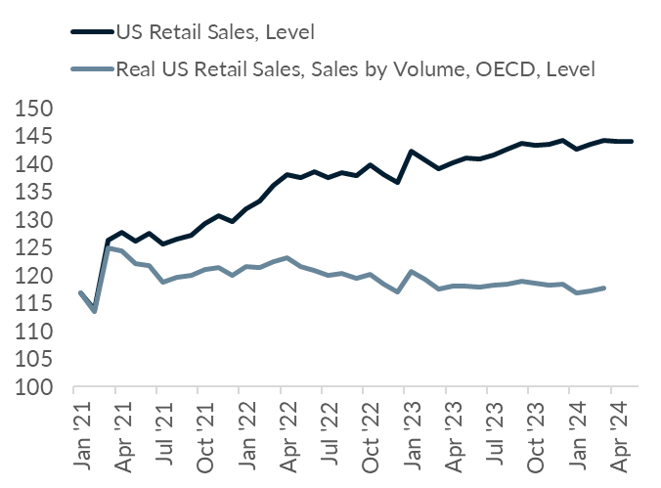
Three Themes
1
How Inflation is Masking America's Retail Decline
One of the big fundamental economic stories of June was the anemic pace of Retail Sales, which came in below forecast and also saw prior months revised downward. Retail Sales growth, however, consists of two separate measures thrown together. Sales growth is a combination of the number of units sold as well as changes in the prices for each unit that was sold. The dark blue line in the chart is the headline Retail Sales Index you hear about on the news. It's been growing pretty nicely for the last few years. The lower line is the measure of US retail sales when you remove the changes in prices, and only look at the growth in the volume of goods, aka Real Retail Sales. What it's telling you is that Americans have been slowly buying less and less stuff since March of 2021, and that almost all of US Retail Sales growth has come from inflation. Put simply, Americans are buying less than they were, but paying more for fewer items.
Source: Bloomberg, Modelist

Slide 7
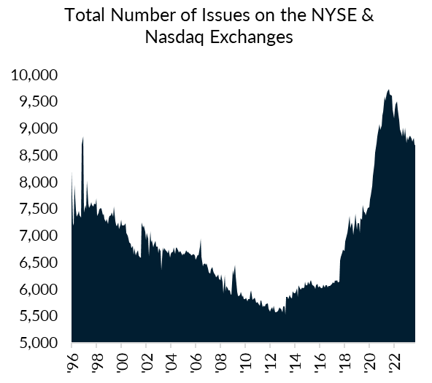
Three Themes
2
Wall Street's Diet Plan: Shedding Stocks, Gaining Value
While we hear constant news about how Fed cuts and the AI productivity miracle are driving this bull market, one overlooked factor is how good old supply and demand may be affecting price action. It makes the news that private equity is frozen by higher rates and unable to cash out in a dead IPO market, but the shrinking number of companies available to trade is probably also an important factor driving prices upward. The number of issues on the two major US exchanges peaked in March 2022 at 9,723 and has declined 10% to 8,682 as of the end of May. This is the largest percentage decline in the number of stocks trading on major exchanges since 2012, and the largest two-year decline in the total number of issues since January 2009 at the peak of the financial crisis. Time will tell whether this continues, or whether an eventual decline in US rates reopens the IPO gates to new issuance. The number of securities skyrocketed above historic norms from 2018-2021. From a low of 5,500 securities in 2013, we had added over 4,000 new stocks to the public markets by 2022. Sometimes, like now, a pause may do equities some good.
Source: Bloomberg, Modelist

Slide 8
Three Themes
3
Sell in May and Go Away?
The market adage "Sell in May and go away" suggests investors avoid the summer months due to inferior returns. We analyzed S&P 500 total returns since 1989 to test this theory. Our findings show that historically, the four-month summer period had the worst performance, though May and June exceeded average returns. October-December proved the most profitable, while September consistently underperformed. Recent data from the past decade challenges this wisdom. While August and September remain weak, the May-August period outperformed January-April. However, we caution against making investment decisions based on this analysis due to limited sample size and underlying logic. For instance, December investments have been profitable since 1989 but were previously unfavorable. This seasonal pattern is an interesting observation, but we don't recommend acting on it for practical investment strategies.
Source: Bloomberg, Modelist

Slide 9
Equity
Overview

Slide 10
US Equity markets
VIX Index
S&P 500 Index Trailing P/E Ratio & 10-Year Average
S&P 500 Index & 30-Day SMA (2 Standard Deviations)
S&P 500 Index Forward P/E Ratio & 10-Year Average
Source: Bloomberg, Modelist

Slide 11
US Equity markets
2024 is the 15th Best Start to a Year since 1945
(S&P 500 Total Return Index)
Source: Bloomberg, Modelist

Slide 12
US Equity markets
US Style Box Total Return (%)
Source: Bloomberg, Modelist
Returns greater than 1-year are annualized.

Slide 13
US Equity markets
US Sector & Industry Total Return (%)
Source: Bloomberg, Modelist
Returns greater than 1-year are annualized.

Slide 14
international Equity markets
Developed & Emerging Markets Total Return (%)
Source: Bloomberg, Modelist
Returns greater than 1-year are annualized.

Slide 15
Fixed Income
Overview

Slide 16
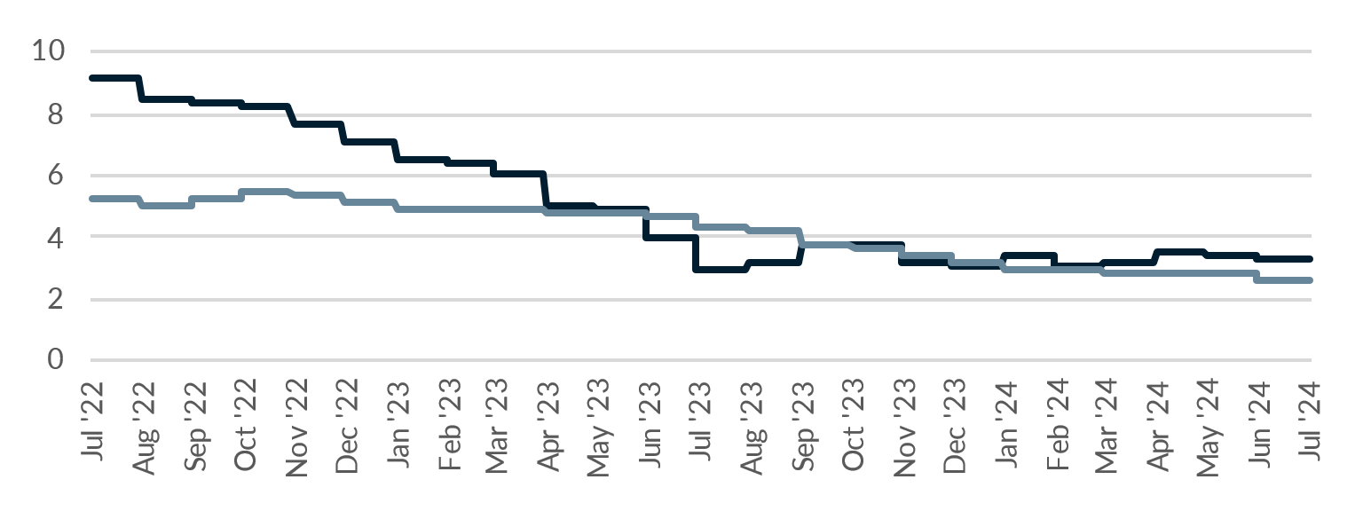
Fixed Income Markets
US Federal Reserve Policy Monitor
Implied Fed Funds Rate (%)
US CPI YoY NSA & US PCE Core Price YoY SA (%)
US U-3 Unemployment Rate (%) (left) & US Initial Jobless Claims SA (1000s) (right)
Source: Bloomberg, Modelist

Slide 17
Fixed Income Markets
US 10 Year Treasury Yield (%)
Current Treasury Yield Curve & One-Year Ago (%)
US 10 Year minus 2 Year Treasury Yield (%)
High Yield Credit Spread (left) & A-Rated Credit Spread (right) (%)
Source: Bloomberg, Modelist

Slide 18
Fixed Income markets
2024 is the 10th Worst Start to a Year since 1977
(Bloomberg US Aggregate Bond Index Total Return)
Source: Bloomberg, Modelist

Slide 19
Fixed Income Markets
Fixed Income Asset Class Total Return (%)
Source: Bloomberg, Modelist
Returns greater than 1-year are annualized.

Slide 20
Global Macro
Overview

Slide 21
US Economic Data
Last Month Positive Surprises
Source: YCharts, Modelist

Slide 22
US Economic Data
Last Month Negative Surprises
Source: YCharts, Modelist

Slide 23
US Economic Data
Next Month’s Calendar
Source: Bloomberg, Modelist

Slide 24
Actionable
insights

Slide 25
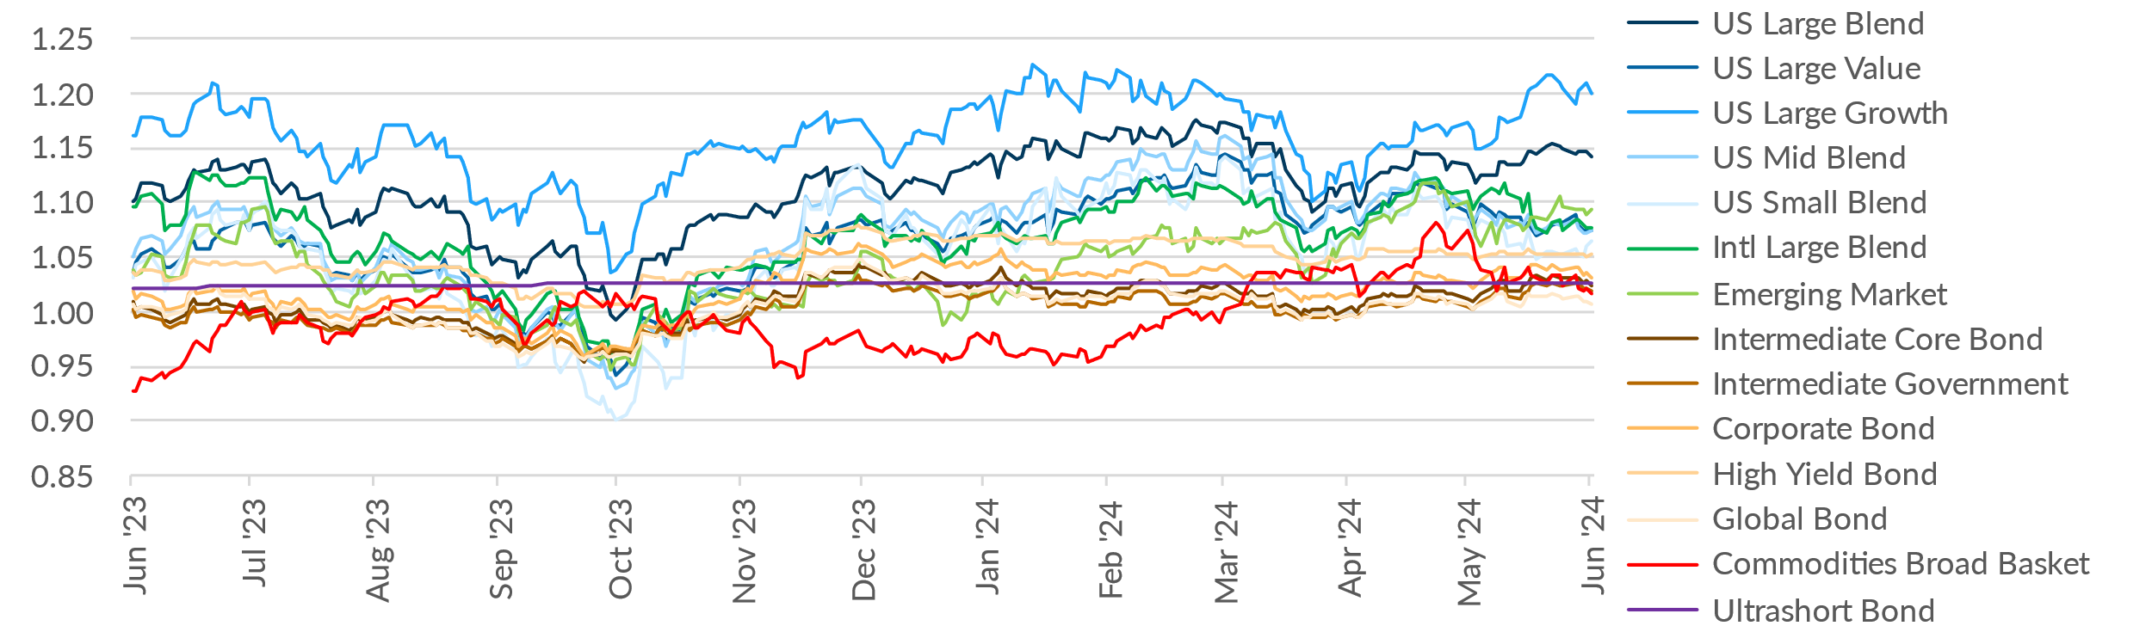
Asset Class Relative Strength
Relative strength, in the context of asset class momentum, is a measure used to gauge the performance of an asset class against its peers, often indicating its potential for future returns. Specifically, it assesses how far away the current total return index is from its one-year moving average. This metric is crucial for identifying trends and momentum within the market. An asset class whose total return index is significantly above its one-year moving average typically demonstrates strong relative strength, suggesting it's outperforming the market average and may continue to do so. Conversely, a security well below this average may indicate weakness.
Asset Class Total Return Level / One-Year Moving Average
Asset Class Relative Strength
Source: Bloomberg, Modelist

Slide 26
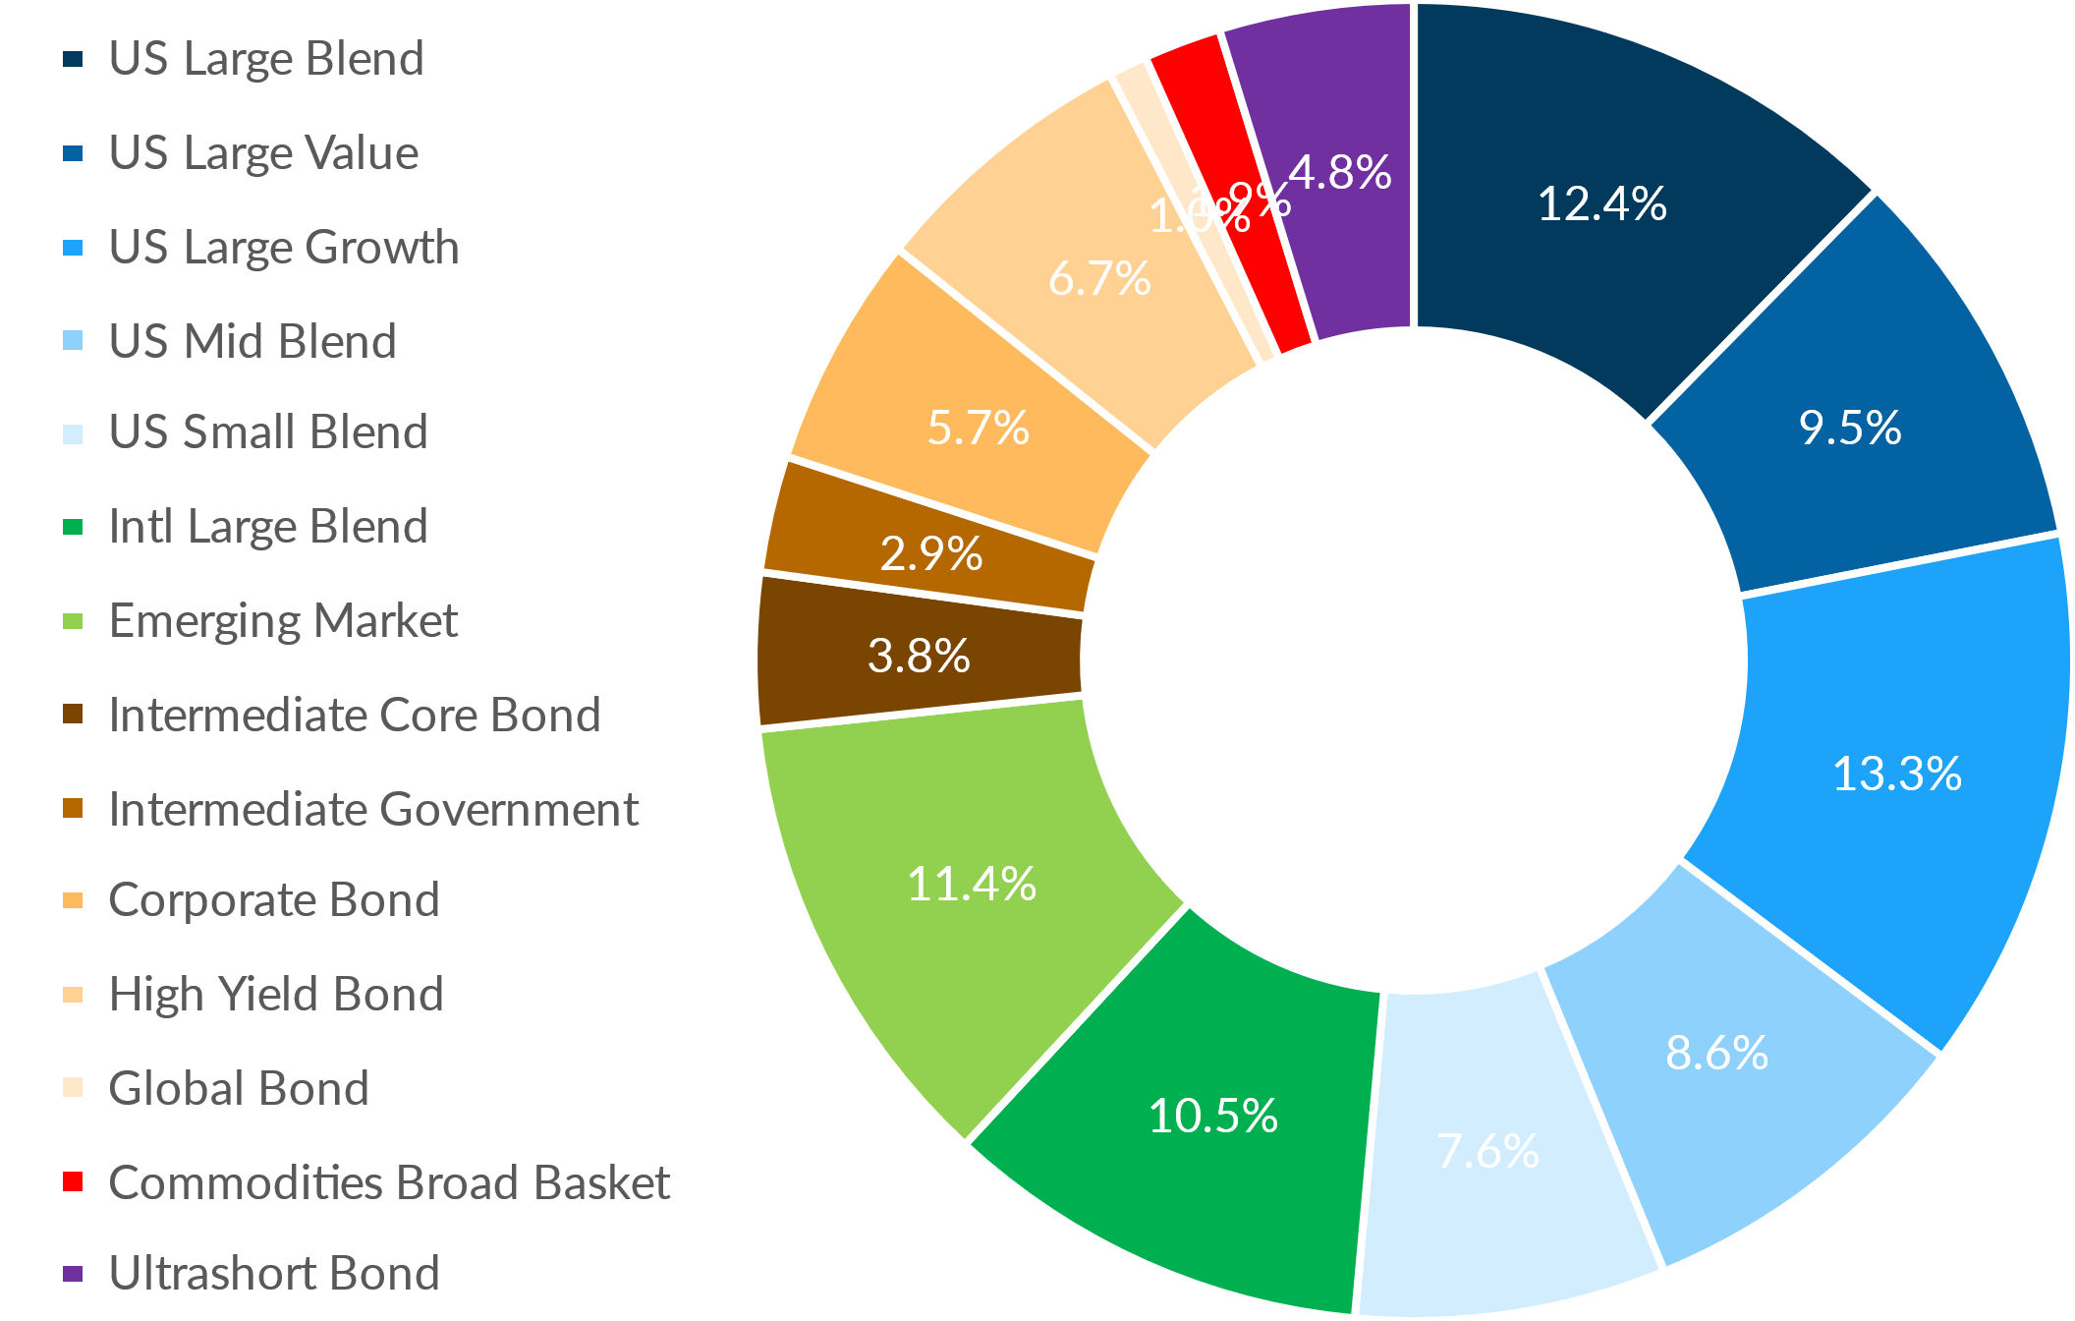
Asset Class Relative Strength
Asset Allocation of the Asset Class Relative Strength Strategy
Commentary
The Asset Class Relative Strength Strategy, which relies on the one-year total return of asset classes, reflects recent performance shifts. As of 06/30/24, large cap growth and small cap stocks are among the top performers, resulting in increased weightings. Conversely, assets with weaker returns, such as US Large Value and US Mid Blend, have decreased allocations. Notable adjustments include a 3.81% increase in Emerging Markets and a decrease in Commodities Broad Basket by the same amount. Monthly reassessment ensures the portfolio dynamically adjusts to exploit prevailing market trends, enhancing overall performance.
Source: Bloomberg, Modelist

Slide 27

Modelist
Overview
ADVISOR USE ONLY
27

Slide 28

evidence-based approach
Repeatable Process
At Modelist, we build upon a strong foundation of evidence-based investing strategies rooted in robust research and market analysis
Our team conducts thorough research into global macroeconomic trends, technical indicators, and fundamental factors. We distill this data into concise, comprehensible, and actionable insights, enabling financial advisors to seamlessly integrate these valuable perspectives into their models. This approach ensures that advisors can leverage the benefits of our in-depth research in a practical and easily understandable manner.
Informed Decisions
By leveraging these proven strategies, financial advisors gain the insights needed to make well-informed decisions aligned with their clients' goals
Data-Driven Advantage
Trust in your choices and enhance client experiences through research-backed approaches that stand the test of time
ADVISOR USE ONLY

Slide 29
Building Investment Models
Our team recommends specific investment strategies, considering market trends and the advisor's objectives.
Strategic
Tactical
Focuses on long-term investment goals, aligning portfolios with an investor's risk tolerance and time horizon through a stable asset allocation.
  Diversified Equity
  Diversified Fixed Income
  Risk Levels
  Target Date
  Risk Parity
Adopts a more active approach, adjusting the portfolio in response to market opportunities and trends.
  Relative Strength
  Relative Value
  Relative Quality
  Sector Strength
  Factor Strength
  Credit Management
  Duration Management
  Select Macroeconomic
  Leading Economic
  Coincident Economic
  Consumer Sentiment
  Growth Expectations
  Inflation Expectations
Specialized
Enhances portfolios by incorporating diverse assets and approaches, aiming for tailored objectives beyond traditional risk assessment.
  Alternative Assets
  Geographic Bias
  Enhanced Yield
ADVISOR USE ONLY

Slide 30
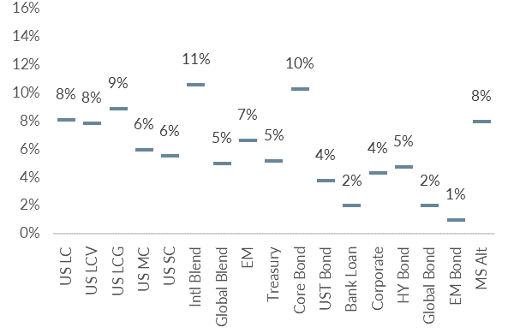
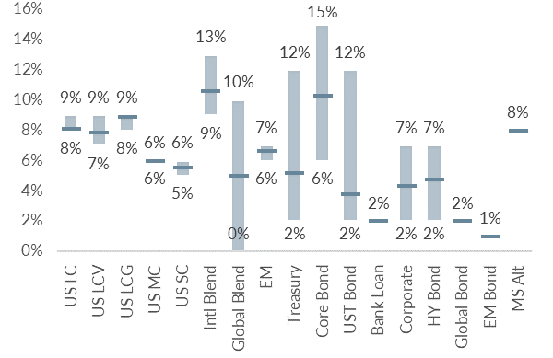
Building Investment Models
We skillfully blend various investment strategies into a unified, cohesive design that aligns with your clients' needs.
Diversified Model
Model with added Tactical Strategies
Coincident Economic Indicators
Duration Management
Asset Class Relative Strength
ADVISOR USE ONLY

Slide 31
Personalized models for the fiduciary advisor
Over 30 Strategies
Modelist Resources
Fully Transparent
Frequent Content
Competence
Advisor
Model Portfolios
Fully Customized
Credibility
Narrative Continuity
Communication
Your
Brand
Brand Optics
Compliant
Process Control
Fund Preferences
ADVISOR USE ONLY

Slide 32

Questions &
And answers
ADVISOR USE ONLY
32

Slide 33

Learn More
Unlock Opportunities
Modelist empowers you with tailored investment models, evidence-based strategies, and comprehensive support.
Elevate Your Business with Modelist
Explore Further
Dive deeper into the advantages that Modelist offers and discover how it can transform your advisory approach.
Take Action
612-887-9897
Elevate your advisory business by partnering with Modelist. Join us today and experience the difference for yourself.
hello@modelist.me
www.modelist.me
ADVISOR USE ONLY

Slide 34
Disclosures
Modelist Inc. is a registered investment adviser. Information presented is for educational purposes only and does not intend to make an offer or solicitation for the sale or purchase of any specific securities, investments, or investment strategies. Investments involve risk and, unless otherwise stated, are not guaranteed. Be sure to first consult with a qualified financial adviser and/or tax professional before implementing any strategy discussed herein. Past performance is not indicative of future performance.

