Slide 1

Modelist Market
Insights
Your Monthly Investment Review & Outlook

Slide 2


agenda
  Quick Recap
  Three Themes
  Equity Overview
  Fixed Income Overview
  Global Macro Overview
  Actionable Insights
  Modelist Overview
  Q&A
  Disclosures

Slide 3



Modelist Fills the Industry Blind Spot
Do It Yourself
Value to Clients
Your Brand
Customized
Not Your Expertise
Lacks Compliance
High Cost (Time/Staff)
Outsource
Deep Expertise
Consistent Experience
Compliance
Lacks Transparency
Limited Control
Selling Someone Else
ADVISOR USE ONLY

Slide 4


Our TEAM
Joe Mallen
CEO
Kent Peterson, PhD
CIO
MSc from London Business School
BSB from University of Minnesota
Joe has garnered a significant following among financial advisors, recognized for his insightful market analysis and expertise. He's a source for financial media, quoted by CNBC, Bloomberg, The Wall Street Journal, Barron's, Reuters, MarketWatch, and Yahoo. His thought leadership extends to appearances on prominent industry platforms, including Animal Spirits, The Sherman Show, and TD Ameritrade.
PhD from Princeton University
BA from Cornell University
Kent has spent much of his career between Wall Street and London, excelling in global macro research for some of the world's top investment firms. He started his career at Bridgewater Associates and was recently Head of Global Market Solutions at Santander. His expertise in identifying economic trends has distinguished him as a leading strategist in the finance sector.
ADVISOR USE ONLY

Slide 5
Quick recap
It was a turbulent month for equities, with many of the trends from the past few months continuing into the first week before reversing violently. The AI-productivity stocks that have powered large-cap growth and tech indexes higher actually fell, sending the Nasdaq down 0.73% for July. Meanwhile, small-cap and value stocks, which had been in the doldrums, came roaring back to life, helping to more evenly distribute bull market gains outside of a few select stocks. As a result, the S&P 500 gained 1.22% for the month, while the Dow rose a stunning 4.55%. Small-cap value, as measured by the Russell 2000 Value Index, was up a remarkable 12.19%, and the Russell 2000 gained 10.16%. Overseas, developed markets were strong, with the EAFE gaining 2.96%, while EM was flat as Chinese market weakness offset gains in other markets.
Moderating inflation and consumption data helped bring Treasury yields lower in July, with the two-year shedding 50 basis points to finish at 4.26% as the market starts to price in the higher probability of a Fed rate cut in September. Ten-year yields also fell, but a more modest 37 basis points, to close at a yield of 4.03%.
In other markets, the VIX moved from unusually low levels to close out the month at a much more normal 16.36. Despite machinations in the Middle East, supply concerns led crude oil lower to $77.93 a barrel. Gold, by contrast, continued to move upward, ending the month at $2,447.60 an ounce. The US dollar fell during the month as the Japanese yen paused its decline, and Bitcoin fell slightly.
Source: Bloomberg, Modelist
Returns greater than 1-year are annualized.

Slide 6
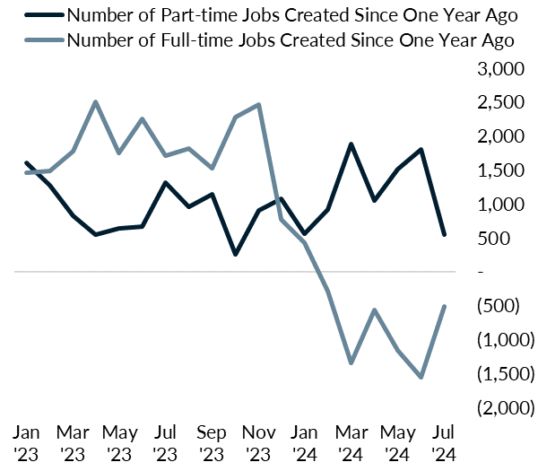
Three Themes
1
America's Part-Time Job Boom: A Full-Time Crisis?
Over the last year or so something strange and uncommon has happened to the American job market: 378,000 new jobs have been created since June 2023, but the composition of those getting jobs is unusual. Over this period, 1.103 million full-time workers have lost their jobs or quit, while 1.481 million part-time workers have gained employment. Put another way, all the gains in US employment for the last thirteen months are attributable to part-time jobs. Full-time employment peaked at 134.78 million jobs in June 2023 and has been in decline since. This is especially strange when you consider that part-time jobs are only 18% of the employed population vs. 82% full-time. American full-time workers are seeing their jobs slowly disappear, while the only people being hired are entering the job market on a less stable part-time basis. Is it any wonder that American Households are feeling less confident in consumer surveys, retail sales is stalling, and unemployment is starting to spike up?
Source: Bloomberg, Modelist

Slide 7
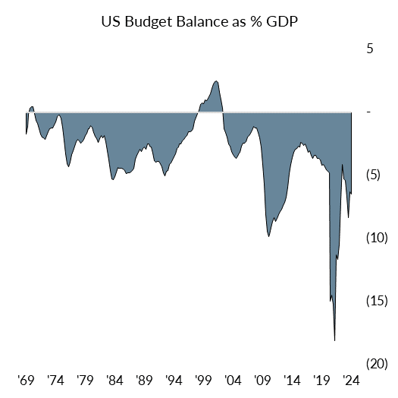
Three Themes
2
Deficit Delusion: America's Peacetime Spending Spree
There are certain circumstances where it makes a lot of sense to run a massive budget deficit: in war or to a avert an implosion like the 2008-09 financial crisis or an economic collapse from a pandemic. Unfortunately, none of those rare circumstances apply to 2024. There is no good reason for the government to be running a 5.56% budget deficit as it did during 2009 or COVID. Since the great financial crisis, US households and corporations have repaired their balance sheets while the balance sheet of the government has ballooned. US non-financial corporate debt is about 80% of GDP, US Household debt is about 77%, while US Government Debt is 124.7%. At present, there is no rationale, other than political gridlock, to maintain the current level of government spending: unemployment is just off record lows and US stocks are breaking new highs weekly. The private sector is buoyant with no need for the government to fill in a gap in economic demand. Households and corporations reduce their borrowing when defaults and rates start rising. Given the US government can effectively print money, a default is unlikely, but at some point, the bond market may ask the government for a higher price to borrow if they believe there is not enough revenue coming in. That would not be good for any asset class.
Source: Bloomberg, Modelist

Slide 8
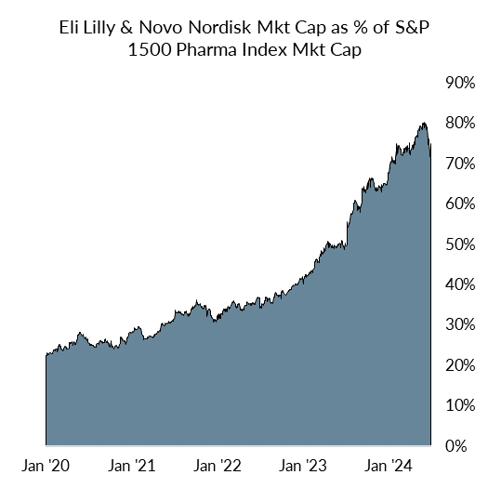
Three Themes
3
The Skinny on Fat Profits: Pharma's Weighty Gamble
While the AI revolution and Nvidia have grabbed most of the headlines this year, another compelling miracle story has been quietly driving several pharma stocks through the roof: weight loss drugs. As shown in the chart, Novo Nordisk’s Wegovy and Eli Lilly’s Mounjaro have demonstrated the ability to generate weight loss of 15-22.5% for patients, causing both firms’ market caps to soar relative to other pharmaceutical companies. The market for obesity drugs is estimated to reach $120 billion in the coming years, but these drugs are also proving to have other potential health benefits, suggesting that this estimate might be conservative. Among the two, Eli Lilly’s drug is proving to be especially effective. Unsurprisingly, LLY’s stock is up 55% year-to-date, and with another 10% rise, it would become the first $1 trillion pharma firm. But as with the AI sector, valuations are now stretched. Eli Lilly trades at a PE ratio of 90, compared to 30 for the pharmaceutical industry as a whole. Only time will tell if the market pricing is reasonable, but it will be interesting to see both how the pricing action plays out and the potential medical revolution these drugs produce.
Source: Bloomberg, Modelist

Slide 9
Equity
Overview

Slide 10
US Equity markets
VIX Index
S&P 500 Index Trailing P/E Ratio & 10-Year Average
S&P 500 Index & 30-Day SMA (2 Standard Deviations)
S&P 500 Index Forward P/E Ratio & 10-Year Average
Source: Bloomberg, Modelist

Slide 11
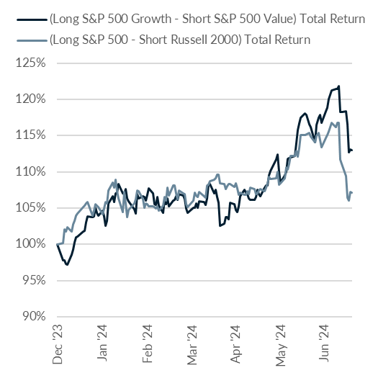
US Equity markets
The Great Reversal: AI Giants Stumble, Underdogs Rise
Since the start of 2024, as the AI-productivity narrative took center stage in the financial markets, the easiest long-short trade for sophisticated equity index and global macro traders has been to get long exposure to large cap growth stocks either via the S&P 500 Growth Index or via the S&P 500 itself, and hedge that exposure either by shorting Value stocks like the S&P 500 Value Index or Small Caps via the Russell 2000. Both small cap stocks and Value are “factors” that have been in the doldrums for years, so they are an easy target for short hedging. As you can see in the chart, that trade has worked beautifully in 2024, until the last three weeks, when everyone was for one reason or another—stop losses, gamma squeeze, or just profit taking—forced out of that profitable position at the same time, resulting in a huge liquidity squeeze that decimated all the big names that have run up like Nvidia , and brought back from the dead a slew of undervalued and small names that investors have forgotten. What happens from here is anyone’s guess. Is this a healthy rotation in leadership, or simply a one-off liquidity event because a crowded trade got unwound? The next few weeks and months will give us the answer.
Source: Bloomberg, Modelist

Slide 12
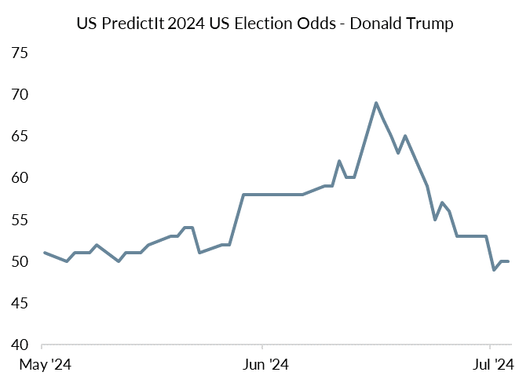
US Equity markets
Fun with Election Odds
Biden Withdraws
Debate
Assassination Attempt
Source: Bloomberg, Modelist

Slide 13
US Equity markets
US Style Box Total Return (%)
Source: Bloomberg, Modelist
Returns greater than 1-year are annualized.

Slide 14
US Equity markets
US Sector & Industry Total Return (%)
Source: Bloomberg, Modelist
Returns greater than 1-year are annualized.

Slide 15
international Equity markets
Developed & Emerging Markets Total Return (%)
Source: Bloomberg, Modelist
Returns greater than 1-year are annualized.

Slide 16
Fixed Income
Overview

Slide 17
Fixed Income Markets
US Federal Reserve Policy Monitor
Implied Fed Funds Rate (%)
US CPI YoY NSA & US PCE Core Price YoY SA (%)
US U-3 Unemployment Rate (%) (left) & US Initial Jobless Claims SA (1000s) (right)
Source: Bloomberg, Modelist

Slide 18
Fixed Income Markets
US 10 Year Treasury Yield (%)
Current Treasury Yield Curve & One-Year Ago (%)
US 10 Year minus 2 Year Treasury Yield (%)
High Yield Credit Spread (left) & A-Rated Credit Spread (right) (%)
Source: Bloomberg, Modelist

Slide 19
Fixed Income Markets
Fixed Income Asset Class Total Return (%)
Source: Bloomberg, Modelist
Returns greater than 1-year are annualized.

Slide 20
Global Macro
Overview

Slide 21
US Economic Data
Last Month Positive Surprises
Source: YCharts, Modelist

Slide 22
US Economic Data
Last Month Negative Surprises
Source: YCharts, Modelist

Slide 23
US Economic Data
Next Month’s Calendar
Source: Bloomberg, Modelist

Slide 24
Actionable
insights

Slide 25
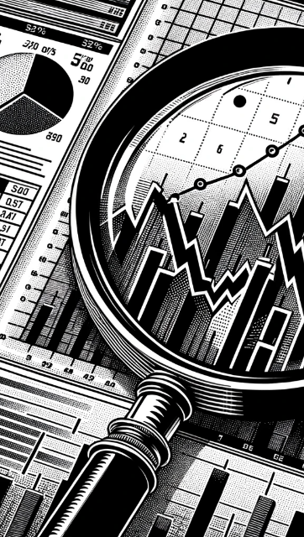
evidence-based approach
Repeatable Process
At Modelist, we build upon a strong foundation of evidence-based investing strategies rooted in robust research and market analysis
Our team conducts thorough research into global macroeconomic trends, technical indicators, and fundamental factors. We distill this data into concise, comprehensible, and actionable insights, enabling financial advisors to seamlessly integrate these valuable perspectives into their models. This approach ensures that advisors can leverage the benefits of our in-depth research in a practical and easily understandable manner.
Informed Decisions
By leveraging these proven strategies, financial advisors gain the insights needed to make well-informed decisions aligned with their clients' goals
Data-Driven Advantage
Trust in your choices and enhance client experiences through research-backed approaches that stand the test of time
ADVISOR USE ONLY

Slide 26
Building Investment Models
Our team recommends specific investment strategies, considering market trends and the advisor's objectives.
Strategic
Tactical
Focuses on long-term investment goals, aligning portfolios with an investor's risk tolerance and time horizon through a stable asset allocation.
  Diversified Equity
  Diversified Fixed Income
  Risk Levels
  Target Date
  Risk Parity
Adopts a more active approach, adjusting the portfolio in response to market opportunities and trends.
  Relative Strength
  Relative Value
  Relative Quality
  Sector Strength
  Factor Strength
  Credit Management
  Duration Management
  Select Macroeconomic
  Leading Economic
  Coincident Economic
  Consumer Sentiment
  Growth Expectations
  Inflation Expectations
Specialized
Enhances portfolios by incorporating diverse assets and approaches, aiming for tailored objectives beyond traditional risk assessment.
  Alternative Assets
  Geographic Bias
  Enhanced Yield
ADVISOR USE ONLY

Slide 27
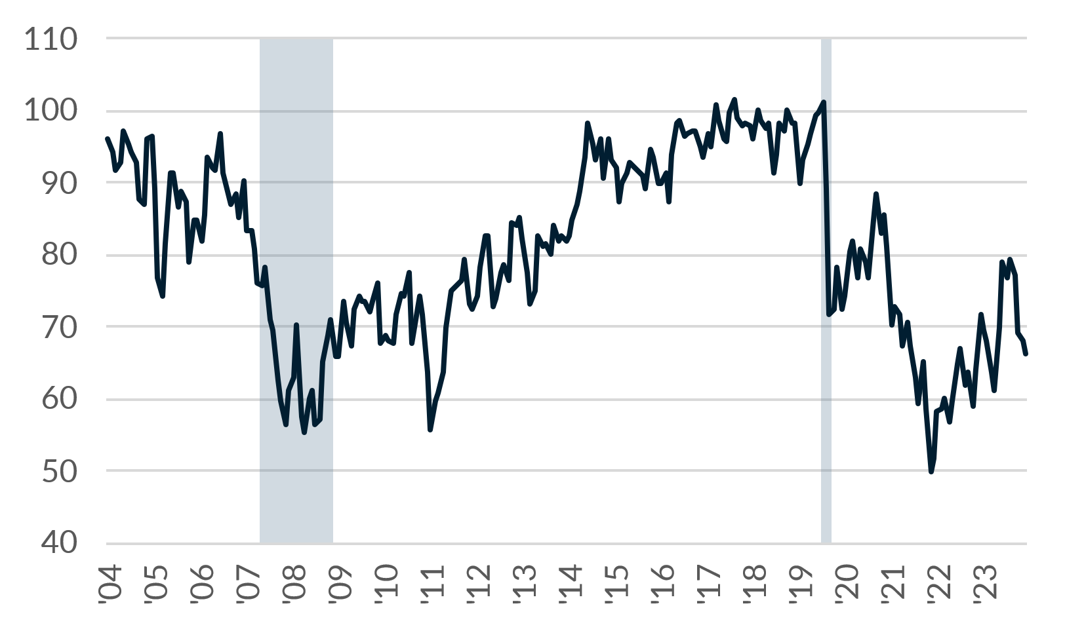
Consumer Sentiment
The University of Michigan Consumer Sentiment Index collects data on consumer attitudes and expectations, in order to determine the changes in consumers' willingness to buy and to predict their subsequent discretionary expenditures. This Index is comprised of measures of attitudes toward personal finances, general business conditions, and market conditions or prices.
The University of Michigan Consumer Sentiment Index
Component Contributions
US Recessions
Consumer Sentiment
Source: Bloomberg, Modelist

Slide 28
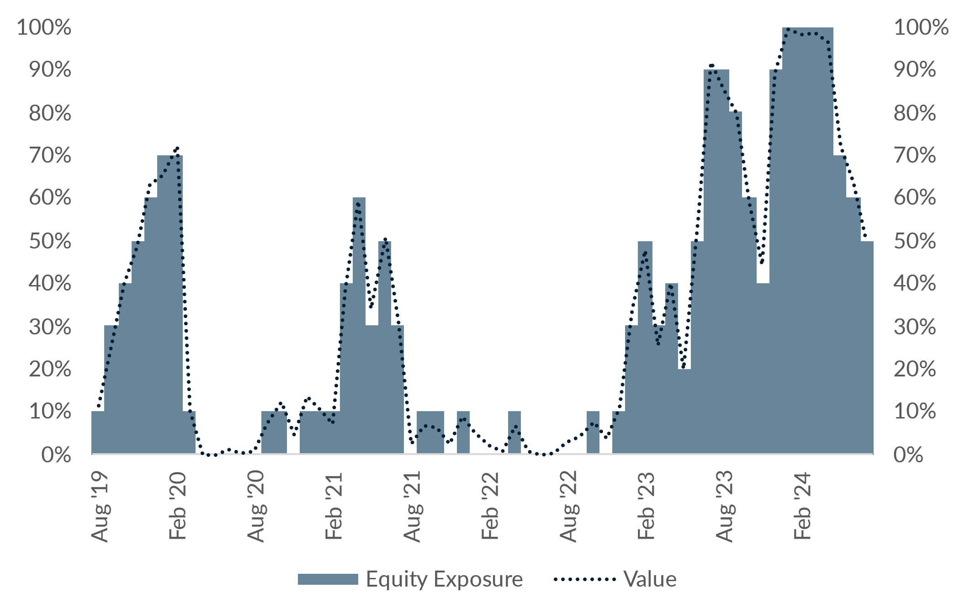
Consumer Sentiment
Consumer Sentiment Strategy
Commentary
The Consumer Sentiment Strategy's recent adjustments reflect the July consumer sentiment reading of 66.4, which is at the 2-year average. This indicates a neutral trend in consumer confidence. As the strategy allocates more to global equity when sentiment is strong (above the 5-year average) and less when weak, the current reading suggests a slight weakening. This explains why there was a 10% shift from Global Large Blend to Intermediate Core Bond, reducing equity exposure and increasing fixed income exposure. The change aligns with the strategy's principle of adjusting asset allocation based on consumer sentiment trends relative to historical data.
Source: Bloomberg, Modelist

Slide 29

Modelist
Overview
ADVISOR USE ONLY
29

Slide 30
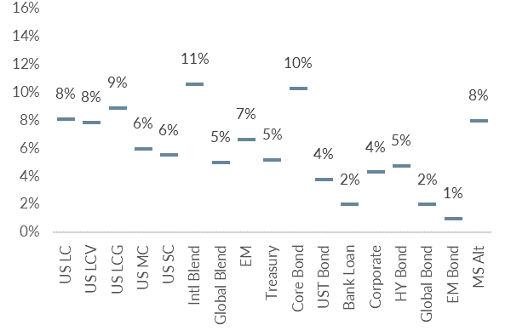
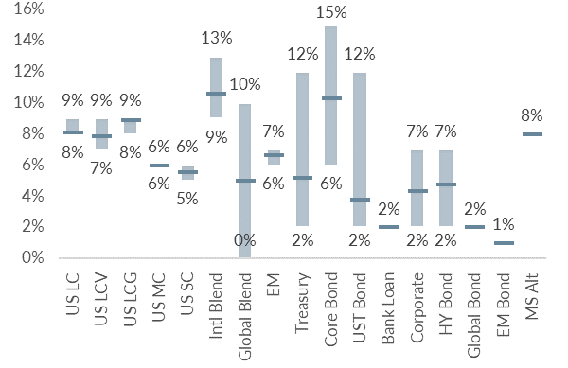
Building Investment Models
We skillfully blend various investment strategies into a unified, cohesive design that aligns with your clients' needs.
Diversified Model
Model with added Tactical Strategies
Coincident Economic Indicators
Duration Management
Asset Class Relative Strength
ADVISOR USE ONLY

Slide 31
Personalized models for the fiduciary advisor
Over 30 Strategies
Modelist Resources
Fully Transparent
Frequent Content
Competence
Advisor
Model Portfolios
Fully Customized
Credibility
Narrative Continuity
Communication
Your
Brand
Brand Optics
Compliant
Process Control
Fund Preferences
ADVISOR USE ONLY

Slide 32

Questions &
And answers
ADVISOR USE ONLY
32

Slide 33

Learn More
Unlock Opportunities
Modelist empowers you with tailored investment models, evidence-based strategies, and comprehensive support.
Elevate Your Business with Modelist
Explore Further
Dive deeper into the advantages that Modelist offers and discover how it can transform your advisory approach.
Take Action
612-887-9897
Elevate your advisory business by partnering with Modelist. Join us today and experience the difference for yourself.
hello@modelist.me
www.modelist.me
ADVISOR USE ONLY

Slide 34
Disclosures
Modelist Inc. is a registered investment adviser. Information presented is for educational purposes only and does not intend to make an offer or solicitation for the sale or purchase of any specific securities, investments, or investment strategies. Investments involve risk and, unless otherwise stated, are not guaranteed. Be sure to first consult with a qualified financial adviser and/or tax professional before implementing any strategy discussed herein. Past performance is not indicative of future performance.

