Slide 1
PRESENTED BY:
CAN YOU STAY RETIRED?
Advisor Name
Firm Name

Slide 2

Traditional vs. Modern View of Retirement
Notes:
The Traditional Retirement Planning Process
Worked for many years at the same company.
Retired at about age 65 and received a comfortable pension.
Relied upon Social Security for supplemental retirement income.
Focused primarily on money during their retirement planning process.
Generally lived their retirement years as an extended vacation.
Didn’t always know how to fill their time without work.
Thought end-of-life planning was relatively simple.
Insurance from their insurance agent
· Stocks and bonds from their broker
· Certificates of deposit from their bank
The Modern Retirement Planning Process
Many of us have worked for several companies during our careers; others have been self-employed for some or all our working lives.
This sense of self-reliance developed over the course of your career will help you enormously as you prepare for a largely self-directed retirement. After all, the way people perceive retirement and how they plan for it has changed substantially.
1. Determine the outcome you want to achieve.
2. Educate yourself to make informed decisions.
3. Analyze your current financial situation.
4. Develop a comprehensive financial plan to address all possible scenarios, including:
a. Job loss
b. Health problems or disability
c. Changes to Social Security benefits
d. Death in the family
5. Implement the plan, selecting the financial products necessary for a coordinated portfolio.
6. Review your plan and adjust over time.

Slide 3

ONLY 18% OF WORKERS PLAN TO RETIRE BEFORE AGE 60.
BUT ABOUT 3X AS MANY (34%) ACTUALLY DO.
IN FACT, ONLY 6% OF WORKERS MAKE IT TO 70 BEFORE RETIRING, A FRACTION OF THE NUMBER WHO ONCE INTENDED TO WORK TO THAT AGE.

Slide 4
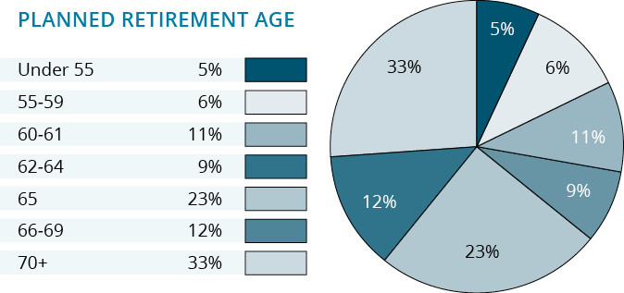
Americans Retire Earlier Than Expected1
1The 2023 Retirement Confidence Survey: Greenwald & Associates; Employee Benefit Research Institute.

Slide 5
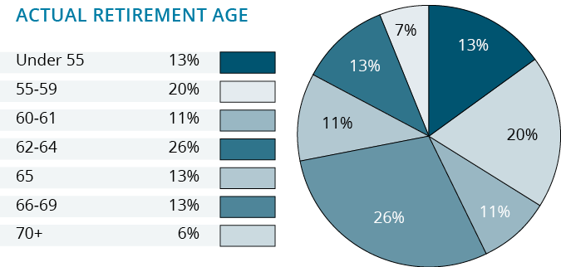
Americans Retire Earlier Than Expected 1
1The 2023 Retirement Confidence Survey: Greenwald & Associates; Employee Benefit Research Institute.

Slide 6
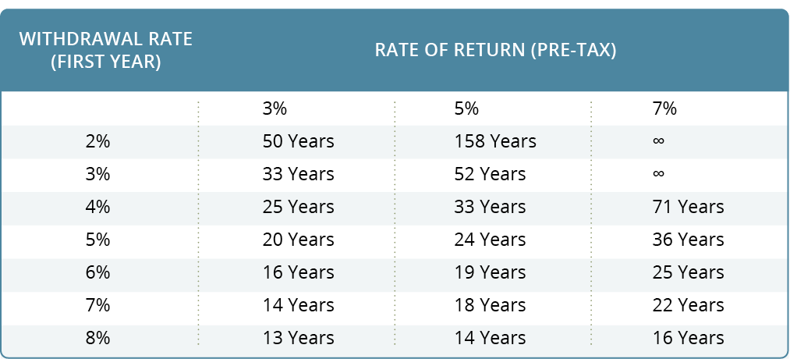
Determining Your Monthly Expenses

Slide 7
Defining YOUR Plan

Slide 8
The 5 Steps
Step 1: Determine Your Monthly Expenses
Step 2: Determine your Retirement Income Sources
Step 3: Asset Location + Asset Allocation
Step 4: Protect Your Income Sources
Step 5: Understanding Inflation in Retirement
Determine What You Need to Retire

Slide 9
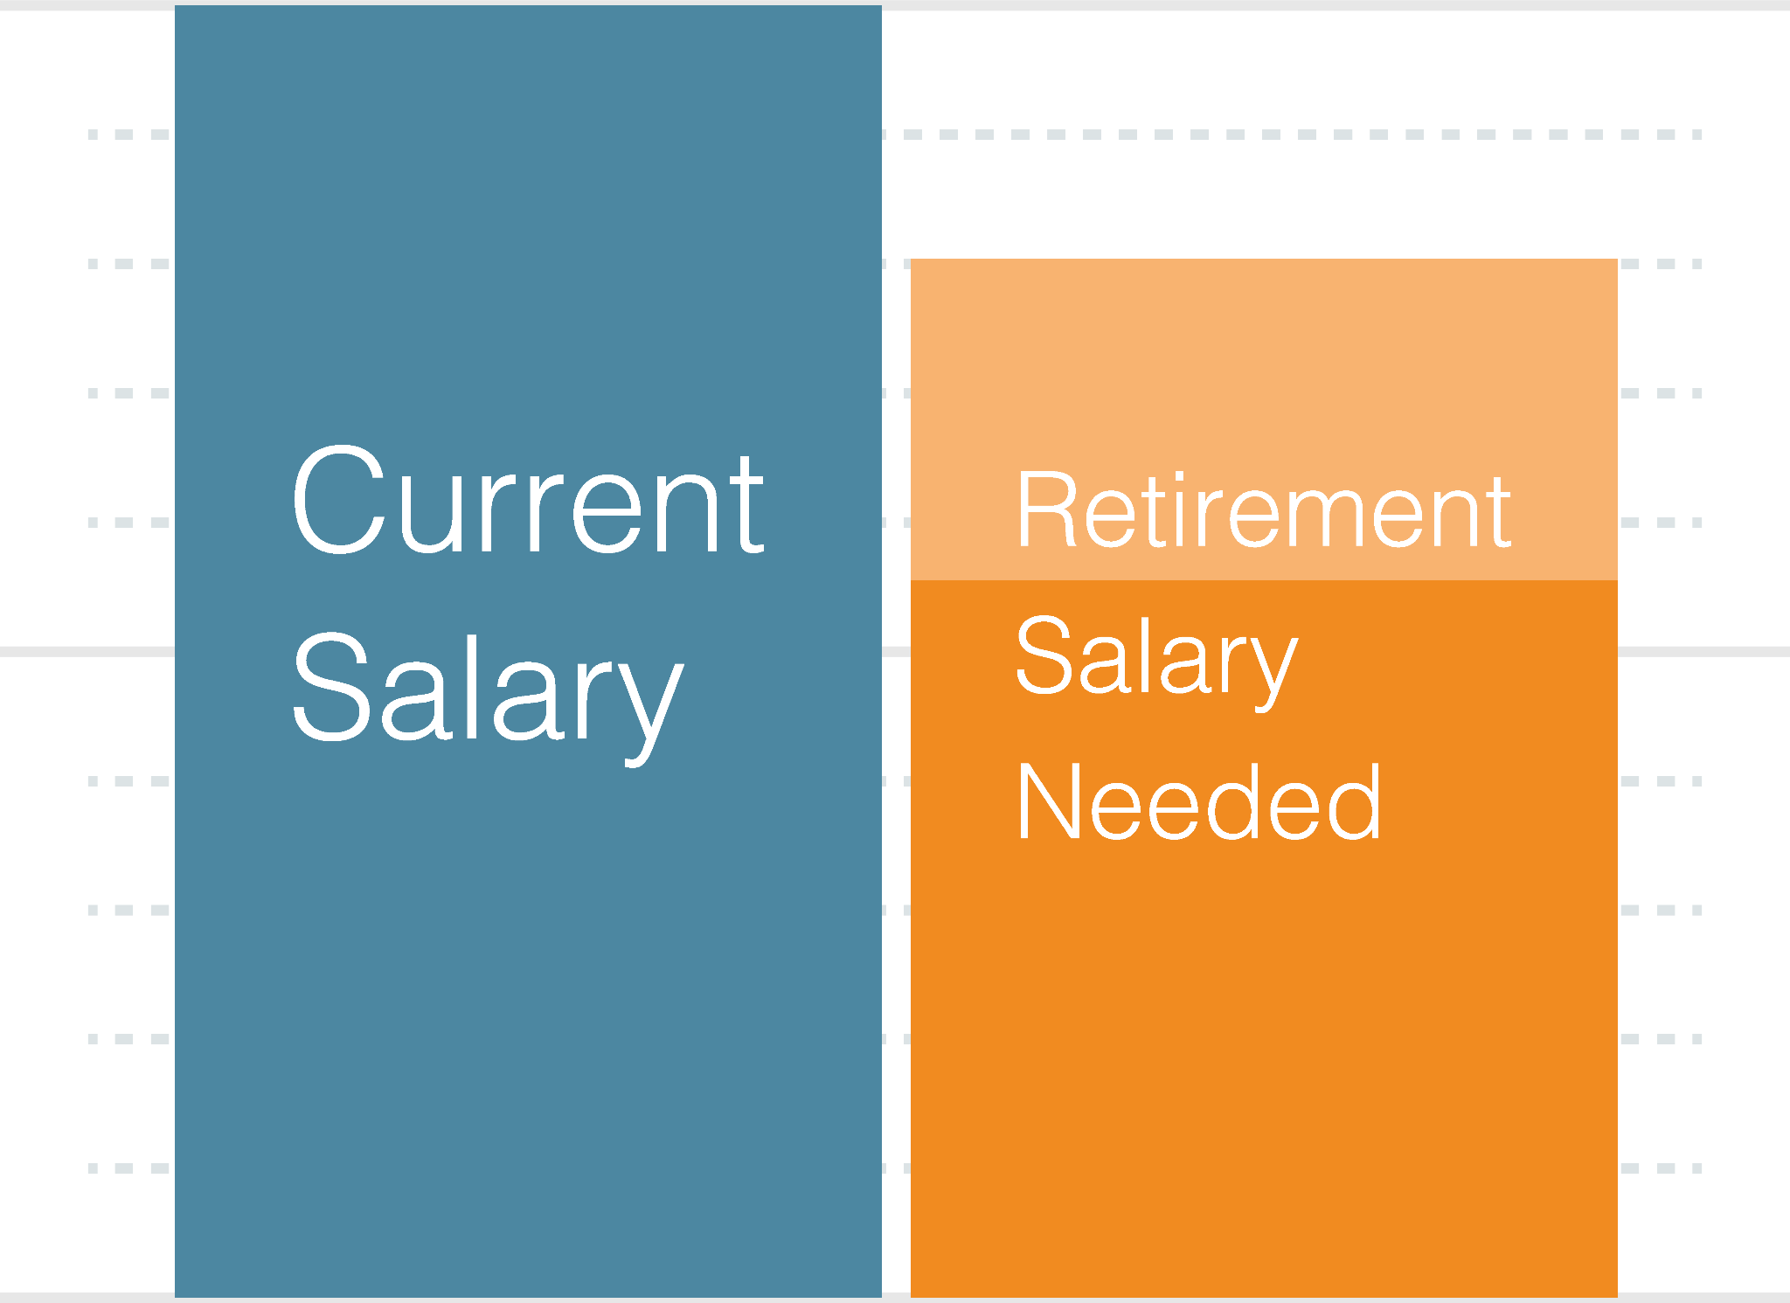
Step 1
Determining Your Monthly Expenses
Over a 25 year retirement, your expenses may average 80% of working income - but it’s not a straight line.
Let’s take a look at reality….
Notes:
Over a 25 year retirement your expenses may average 80% of working income.
But it's not a straight line
Many people spend as much or more in their first 5 years of retirement
Traveling, Moving closer to family and friends, doing all the things they put off until now.
Do it while your health and wealth allow
After that things can settle into an 80-85% rhythm
A subset of this slide is the

Slide 10
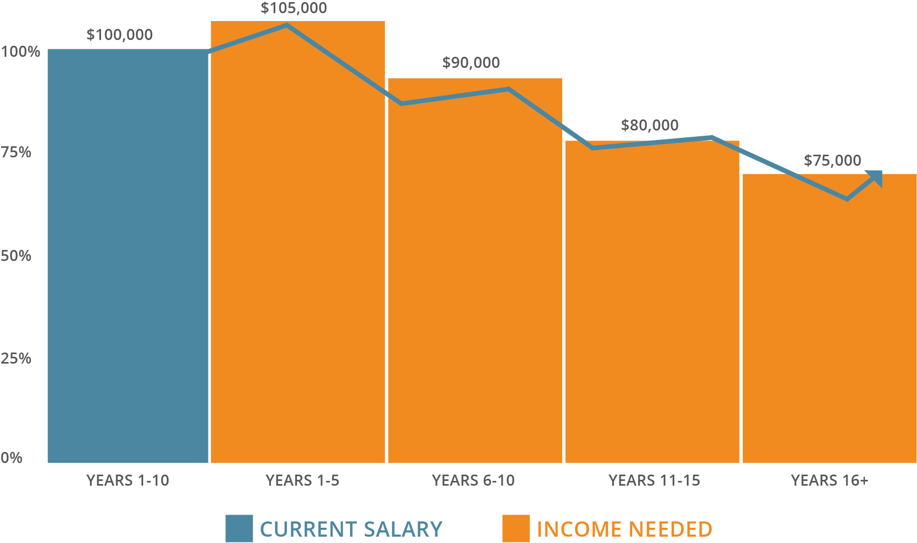
Client hypothetical
Notes:
Over a 25 year retirement your expenses may average 80% of working income.
But it's not a straight line
Many people spend as much or more in their first 5 years of retirement
Traveling, Moving closer to family and friends, doing all the things they put off until now.
Do it while your health and wealth allow
After that things can settle into an 80-85% rhythm
A subset of this slide is the

Slide 11
Step 1
Top 5 Retirement Expenses
A retirement income plan is much more than just an investment plan.
Housing
Travel/Transportation
Healthcare
Food
Utilities

Slide 12
Step 2
Determine Your Retirement Income Sources
Social Security
Retirement Accounts (401K, IRA, Roth IRA etc.)
Savings and Investment accounts
Pension

Slide 13
Net Worth & Cash Flow Statements
The most basic way to take a financial snapshot is to create two documents:
1.Your Net Worth Statement
2.Your Cash Flow Statement

Slide 14
Net Worth & Cash Flow Statements
Your Net Worth Statement
•Creates a snapshot of your financial situation
•Use it to evaluate how you are progressing toward your goals
Your Cash Flow Statement
•Measures how much money came in versus how much went out
•Can be measured on a monthly basis or annual basis
•Helpful in determining how your money is spent, whether you have extra money to invest and how you can manage your finances

Slide 15
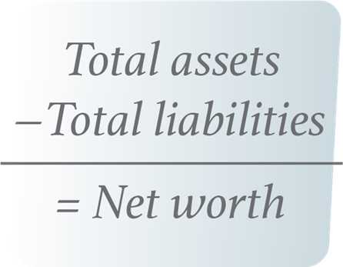
Create Your Net Worth Statement
•Add the realistic market value of your assets
•Add up your liabilities
•Subtract your total liabilities from your total assets
•The resulting total is your net worth

Slide 16
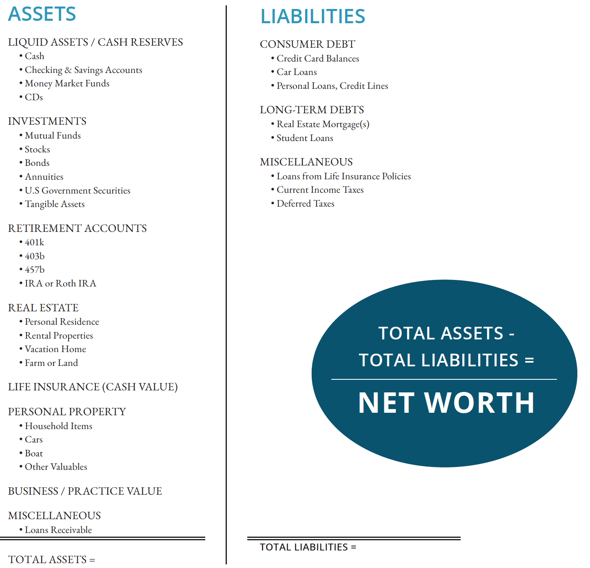
Example

Slide 17
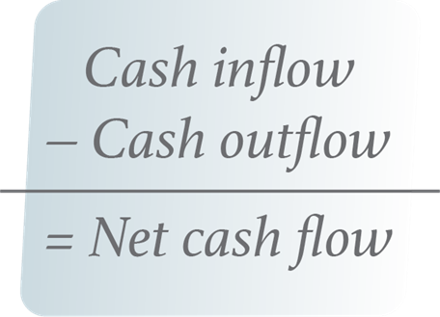
Create Your Cash Flow Statement
•Add up your total income and earnings
•Add up your savings, fixed and variable expenses
•Subtract your expenses from your income to determine net cash flow
Net cash flow is the remaining amount of cash available each year

Slide 18
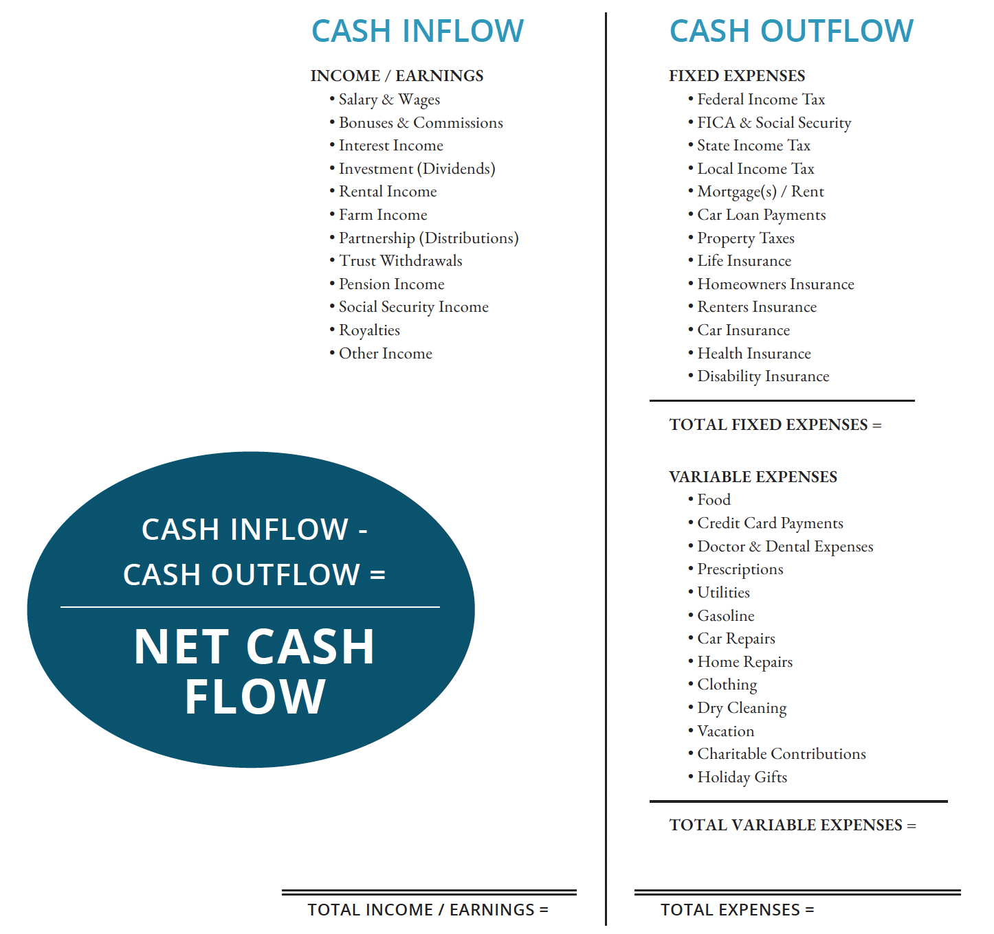
Example

Slide 19
Step 3
Asset Location and Asset Allocation
Asset Location:
How are you optimizing your strategy for taxable accounts, tax-free accounts, and tax deferred accounts?
Asset Allocation:
Investment plan aimed to balance risk and return by aligning to your goals, risk tolerance and risk capacity.

Slide 20
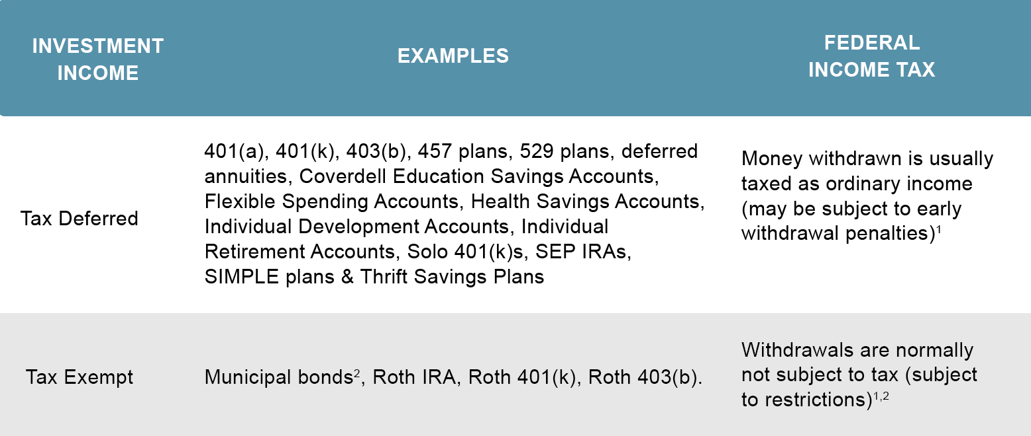
Optimizing Asset Location
INVESTMENT INCOME | FEDERAL INCOME TAX IMPACT
Taxable | Money withdrawn is usually taxed as ordinary income, but withdrawals are not typically restricted
Tax Deferred | Money withdrawn is usually taxed as ordinary income and may be subject to early withdrawal penalties
Tax Exempt | Withdrawals are normally not subject to tax, but may be subject to restrictions

Slide 21
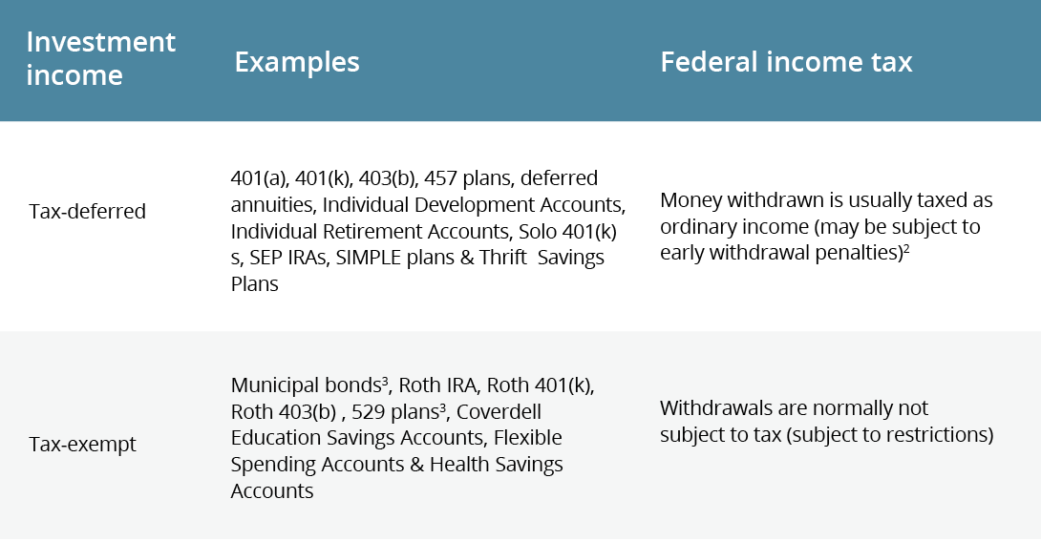
Optimizing Asset Location

Slide 22
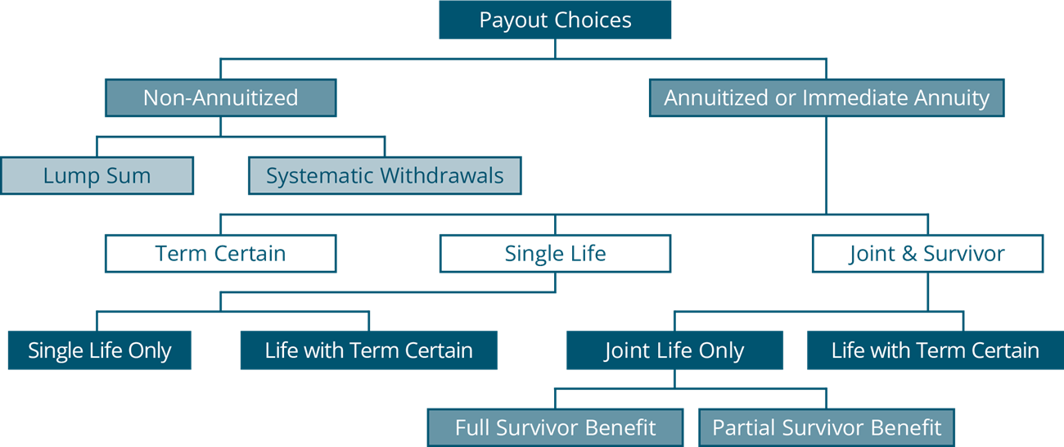
Annuity Withdrawal Choices

Slide 23
Annuity Withdrawal Choices
Non-Annuitized Withdrawals
•Taxation of non-annuitized withdrawals is based on a last in, first out method
•Any increase in value is taxed before return of principal
•Surrender, withdrawal charges and tax penalties may apply
Annuitized Withdrawals
•A portion of each annuitized withdrawal is considered a tax-free return of principal until the initial investment has been fully recovered
•Future withdrawals are taxed as ordinary income

Slide 24
Step 4
Protecting Your Income Sources
Average return is fine before you’re taking money out, but when you start taking money out in retirement, it matters a lot.

Slide 25
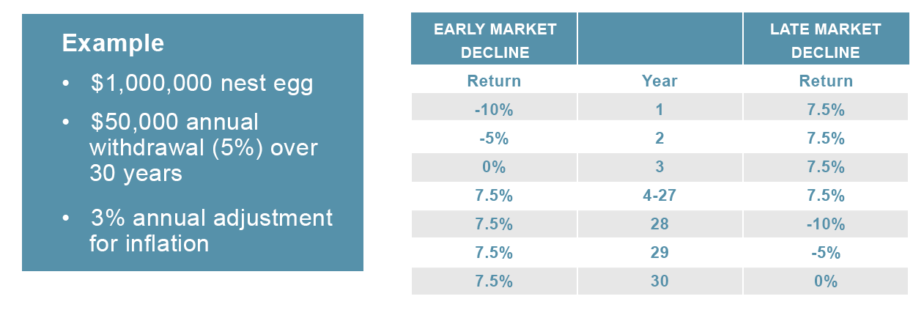
Step 4
Impact of Down Markets
Systematic withdrawals are subject to market fluctuations.
It can make a significant difference when a down market occurs.
Note: Return is annualized percentage. Inflation adjustment compounded annually. Withdrawals take at the beginning of the year. Sales charges and taxes are not considered. Hypothetical illustration, not typical of actual returns or representative of any specific investment.

Slide 26
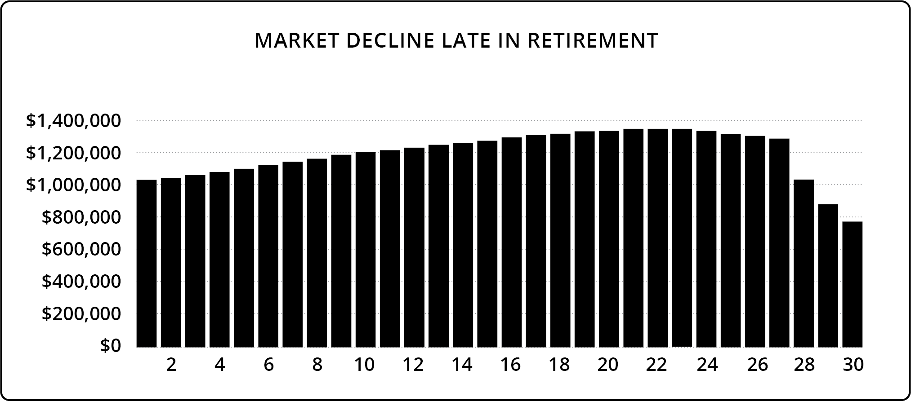
Step 4
Scenario 1:
Years 1-27: 7.5% annual return
Year 28: 10% market decline
Year 29: 5% market decline
Year 30: 0% market change
$50,000 annual withdrawal, adjusted yearly for 3% inflation

Slide 27
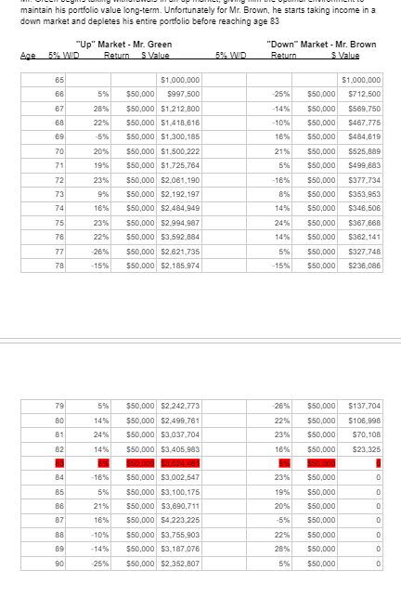
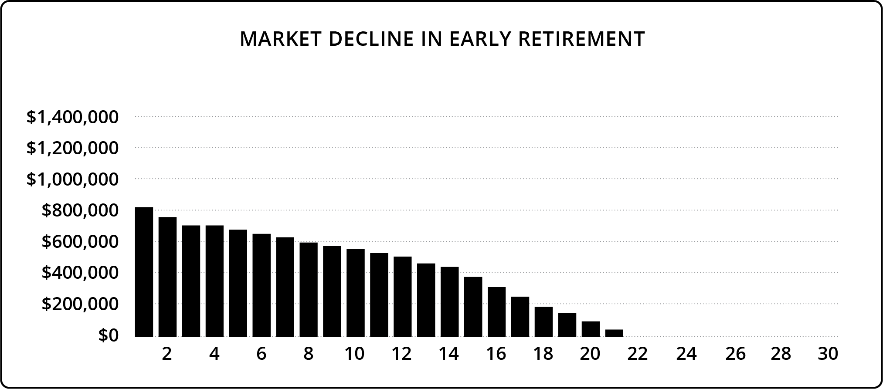
Step 4
Scenario 2:
Year 1: 10% market decline
Year 2: 5% market decline
Year 3: 0% market change
Years 4-30: 7.5% annual return
$50,000 annual withdrawal, adjusted yearly for 3% inflation

Slide 28
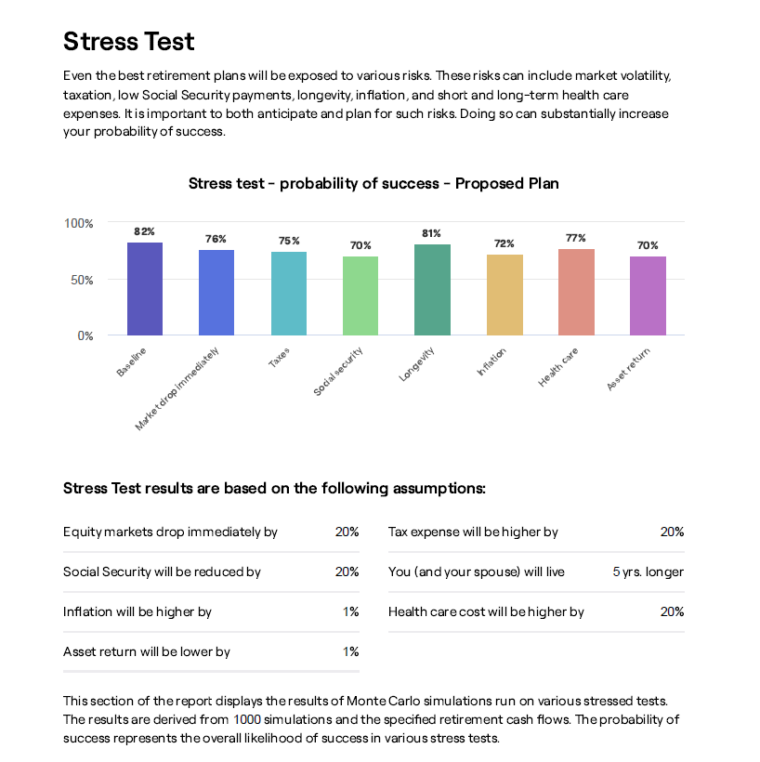
Step 5
Stress testing your plan
Notes:
Image Source: RightCapital → Desgin: layout as is with source info
Nobody has a crystal ball
No advisor know what’s going to happen next, but what we can do is prepare as best we can, have a plan and stress test taht plan using many, many different market circumstances
Running thousands of different scenarios, changing variables.

Slide 29
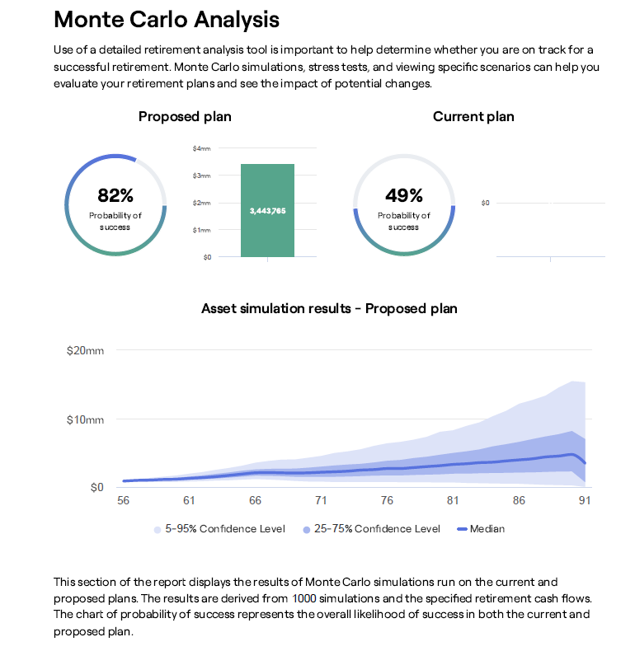
Step 5
Probability of success
Notes:
Image Source: RightCapital → Desgin: layout as is with source info
Nobody has a crystal ball
No advisor know what’s going to happen next, but what we can do is prepare as best we can, have a plan and stress test taht plan using many, many different market circumstances
Running thousands of different scenarios, changing variables.

Slide 30
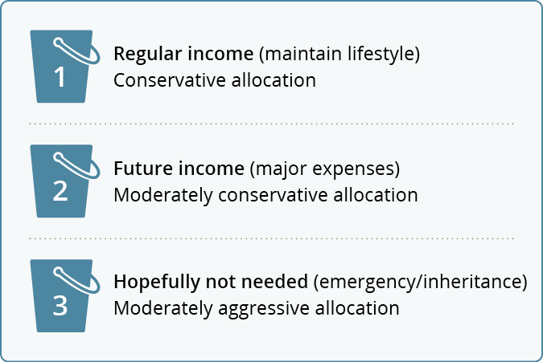
Risk Management Strategies
Asset Allocation for Retirees

Slide 31
Taxes
Accumulation Phase
  Optimize your tax locations and take advantage of tax deferral
Preservation Phase
  Lower taxes to protect what you’ve saved
Distribution Phase
  Understand how to access your distributions in the most tax efficient way
Understanding Taxes in the 3 Phases of Planning

Slide 32
Taxes
Accumulation Phase
  Optimize your tax locations and take advantage of tax deferral
Preservation Phase
  Lower taxes to protect what you’ve saved
Distribution Phase
  Understand how to access your distributions in the most tax efficient way
Understanding Taxes in the 3 Phases of Planning

Slide 33
Effective Tax Strategies
It’s advisable to examine your tax situation 2 years at a time with a goal to reduce overall tax liability.
Participate in your employer-sponsored retirement plan
Contribute to a traditional IRA and/or to flexible spending accounts
Consider tax implications before you retire
Itemize tax deductions
Consolidate deductible expenses
Take advantage of adjustments and tax credits
Use capital loss rules to your advantage
Understand when to buy and sell mutual funds
Position assets in different types of accounts
Don’t lose your deductions

Slide 34
Looking Forward

Slide 35
Taxes
Accumulation Phase
  Optimize your tax locations and take advantage of tax deferral
Preservation Phase
  Lower taxes to protect what you’ve saved
Distribution Phase
  Understand how to access your distributions in the most tax efficient way
Understanding Taxes in the
3 Phases of Planning

Slide 36
Optimizing Asset Location
INVESTMENT INCOME | FEDERAL INCOME TAX IMPACT
Taxable | Money withdrawn is usually taxed as ordinary income, but withdrawals are not typically restricted
Tax Deferred | Money withdrawn is usually taxed as ordinary income and may be subject to early withdrawal penalties
Tax Exempt | Withdrawals are normally not subject to tax, but may be subject to restrictions

Slide 37
Optimizing Asset Location

Slide 38
How to Make Your Money Last
It is important to calculate your retirement income withdrawal percentage an plan to make your money last.
If you’re not comfortable with how long your money may last, you may need to:
Slightly reduce your elective expenses.
Work part-time in retirement.
Invest somewhat aggressively.

Slide 39
How to Make Your Money Last
You can lower your odds of running out of money by:
Lowering your percentage rate of withdrawal.
Make any withdrawals in order to maximize tax efficiency.
Adjust the asset allocation of your portfolio.
Invest more money or a higher percentage into an annuity.

Slide 40
How to Make Your Money Last
What may happen if you don’t plan your retirement income:
End up with less money during retirement.
Outlive your money.
What may happen if you do plan your retirement income:
Enjoy your retirement and the money you have worked so hard to save.
Leave an inheritance to heirs.

