Slide 1
RETIREMENT INCOME PLANNING
PRESENTED BY:
Advisor Name
Firm Name

Slide 2

The Facets of Retirement

Slide 3

ONLY 18% OF WORKERS PLAN TO RETIRE BEFORE AGE 60.
BUT ABOUT 3X AS MANY (34%) ACTUALLY DO.
IN FACT, ONLY 6% OF WORKERS MAKE IT TO 70 BEFORE RETIRING, A FRACTION OF THE NUMBER WHO ONCE INTENDED TO WORK TO THAT AGE.

Slide 4
Goal-based Planning
Life Planning for Retirement
Values & Objectives
Retirement planning should not be focused solely on money
Financial security and success alone does not guarantee
a rich or fulfilling life
Financial freedom does provide more choices throughout life,
including your retirement years
Questions to Consider
What will be our primary source of income during retirement?
Will I work post-retirement? Will my partner?
What age do I want to retire? Does my partner know this?
Who should my partner speak to about financial advice if I am incapacitated?
Notes:
LIFE PLANNING FOR RETIREMENT
The increasing number of lifestyle choices and years in retirement have created additional personal responsibilities, especially in light of the ever-changing (and oftentimes uncertain) financial markets.
Values & Objectives
To help you prepare for the type of retirement you really want, you’ll need proper financial and lifestyle planning. It’s important to remember that:
Retirement planning should not be focused solely on money
Financial security and success alone does not guarantee a rich or fulfilling life
Financial freedom does provide more choices throughout life, including your retirement years

Slide 5
Do You Have a Plan?
A retirement income plan is much more than just an investment plan.
Investing
+ Taxes
+ Timing
+ Spending
+ Insurance
+ Income
+ Health

Slide 6
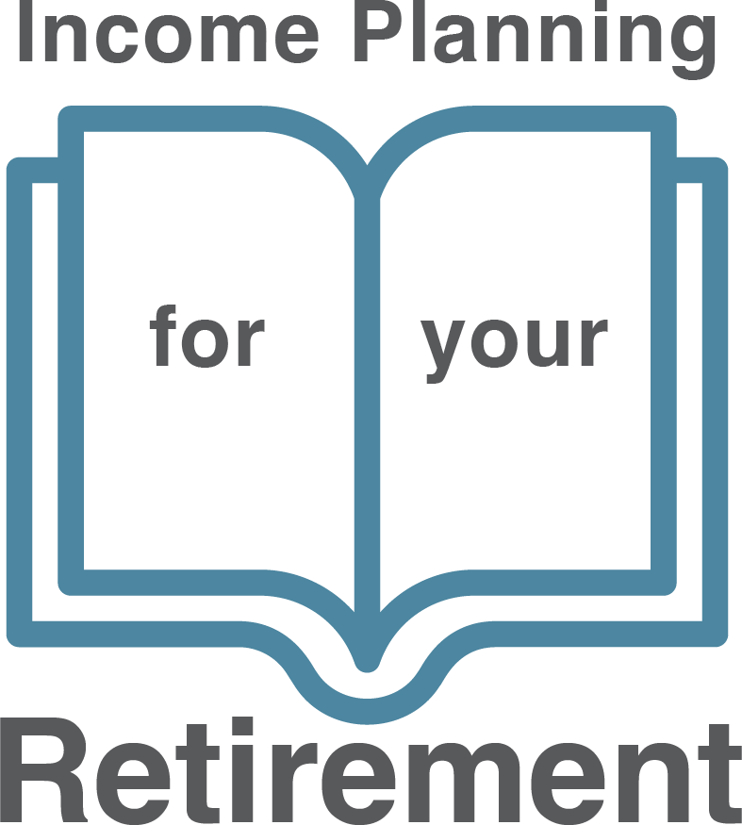

Notes:
Design: Generalize this for FEN, remove photo

Slide 7
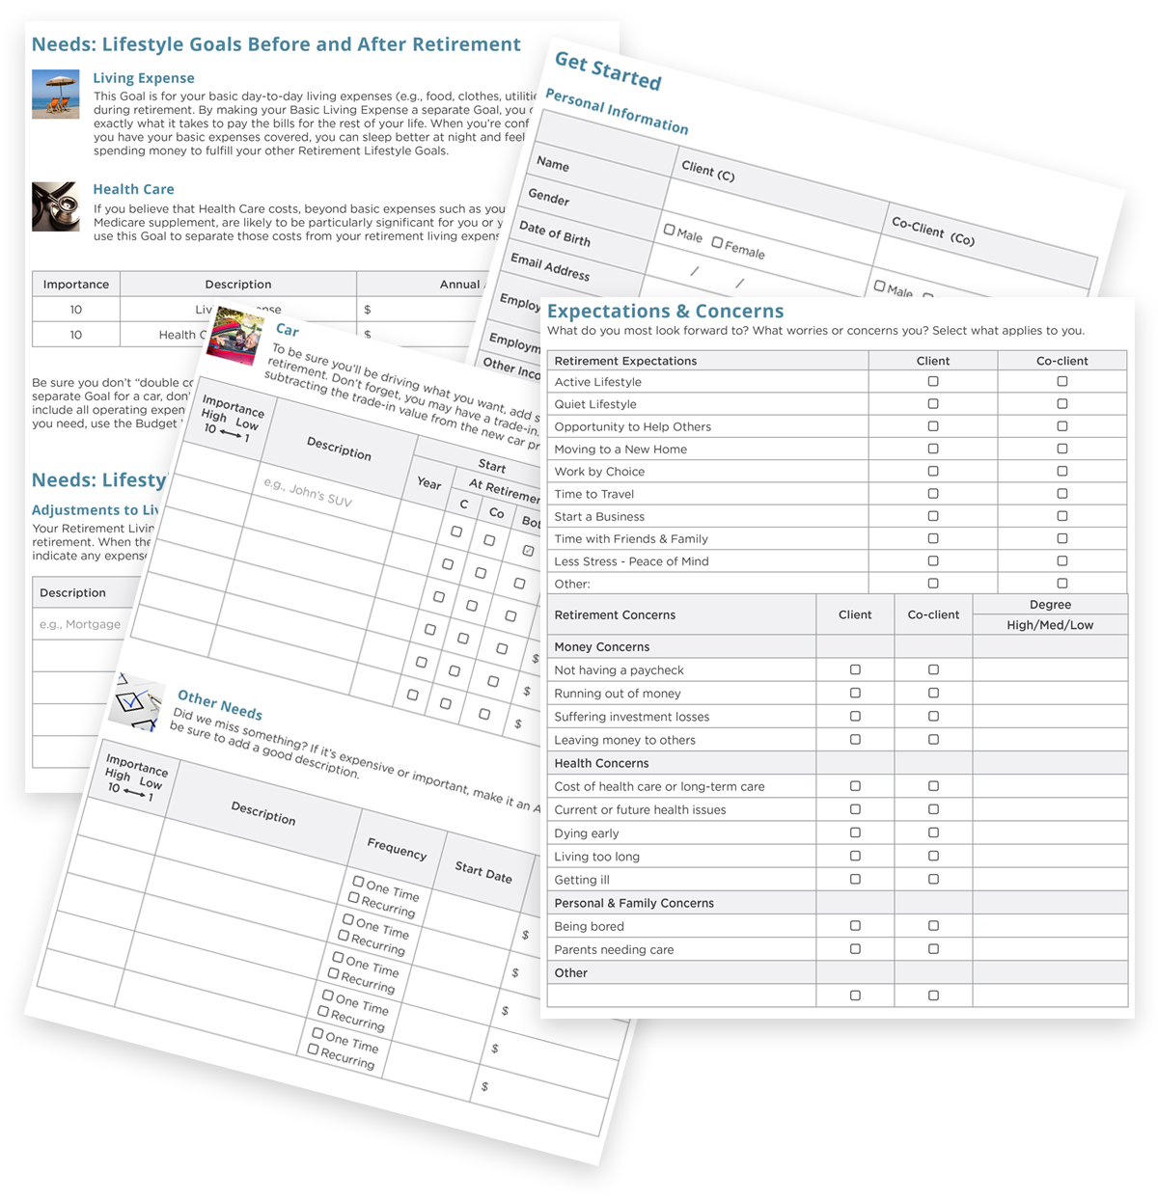
Income Planning for YOUR Retirement

Slide 8
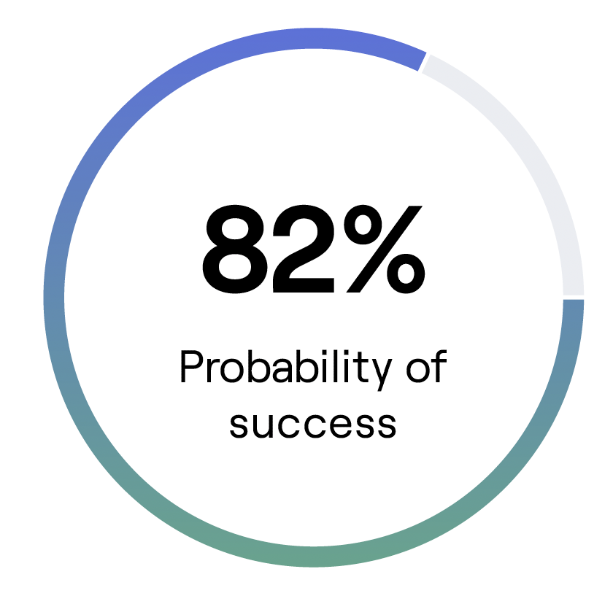
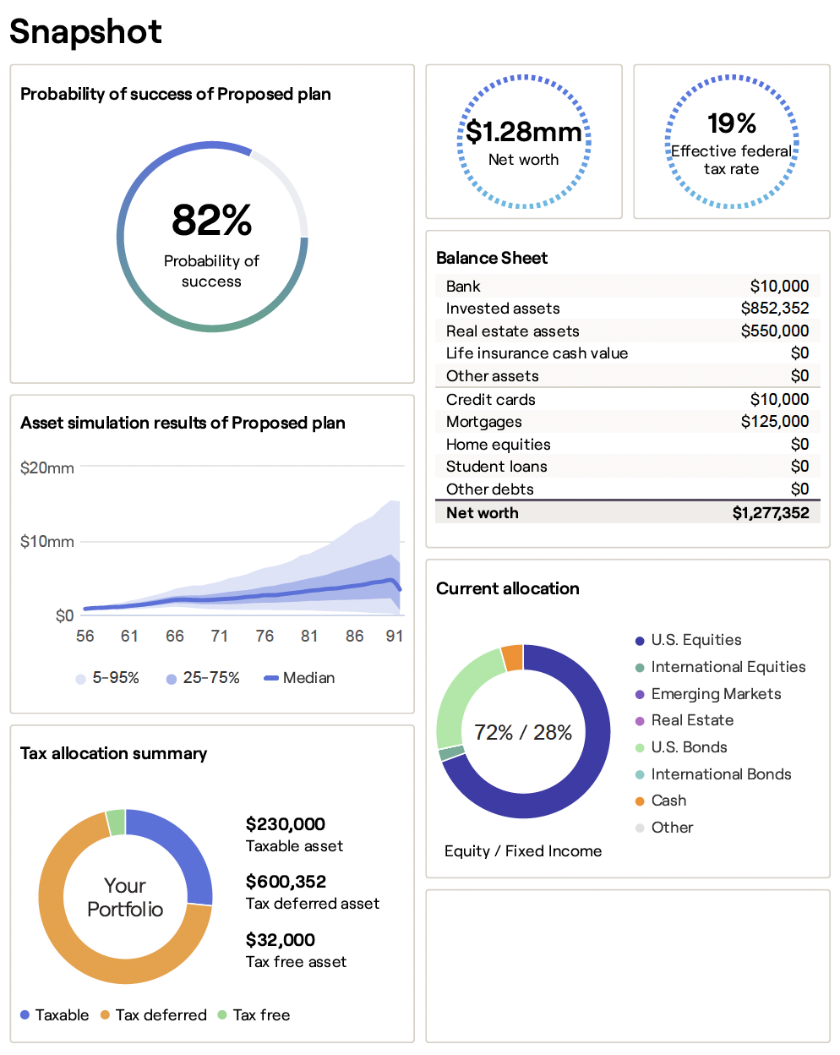
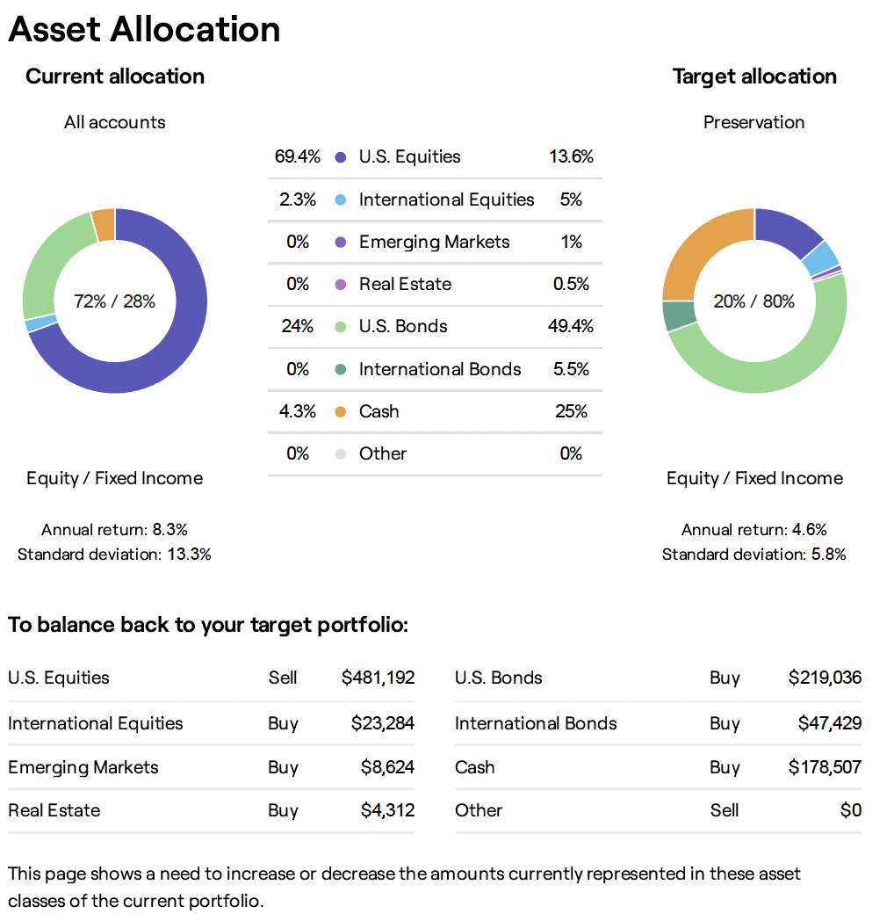
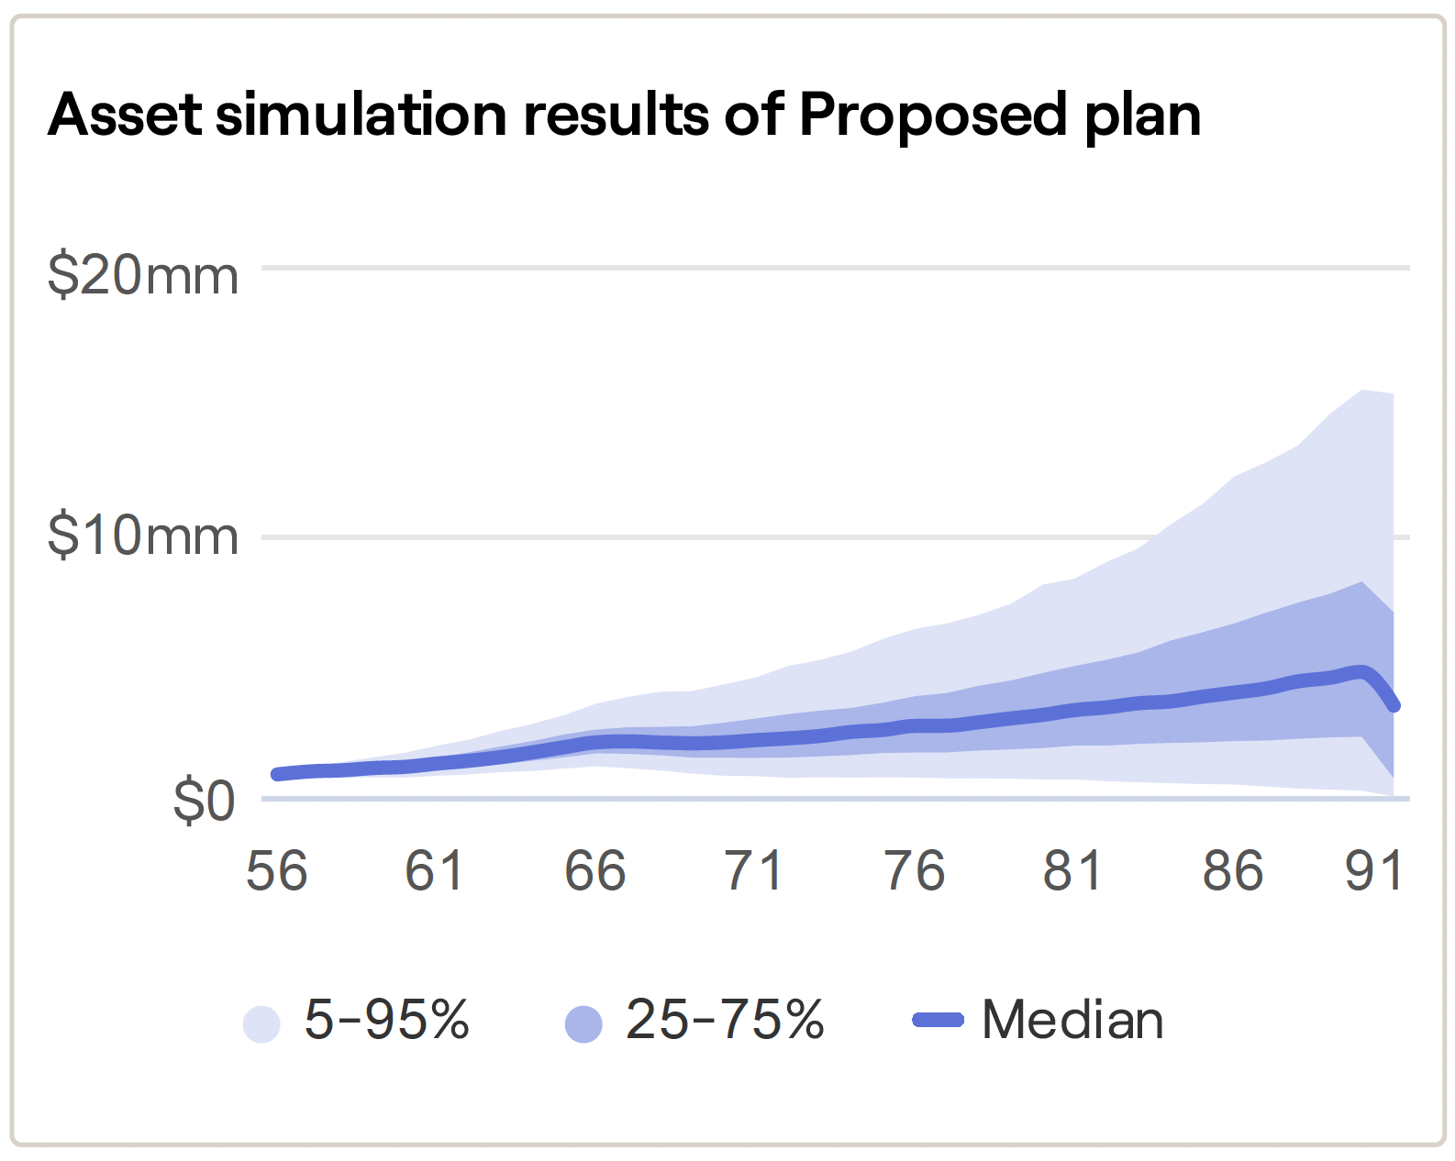
Using the plan
Notes:
Image Source: RightCapital → Design: layout snapshot as it is with source information
Planning Analytics (is a major component of what it means to put together a plan and structure it with specificity)

Slide 9
Defining YOUR Plan

Slide 10
The 5 Steps
Step 1: Determine Your Monthly Expenses
Step 2: Determine your Retirement Income Sources
Step 3: Asset Location + Asset Allocation
Step 4: Protect Your Income Sources
Step 5: Understanding Inflation in Retirement
Determine What You Need to Retire

Slide 11
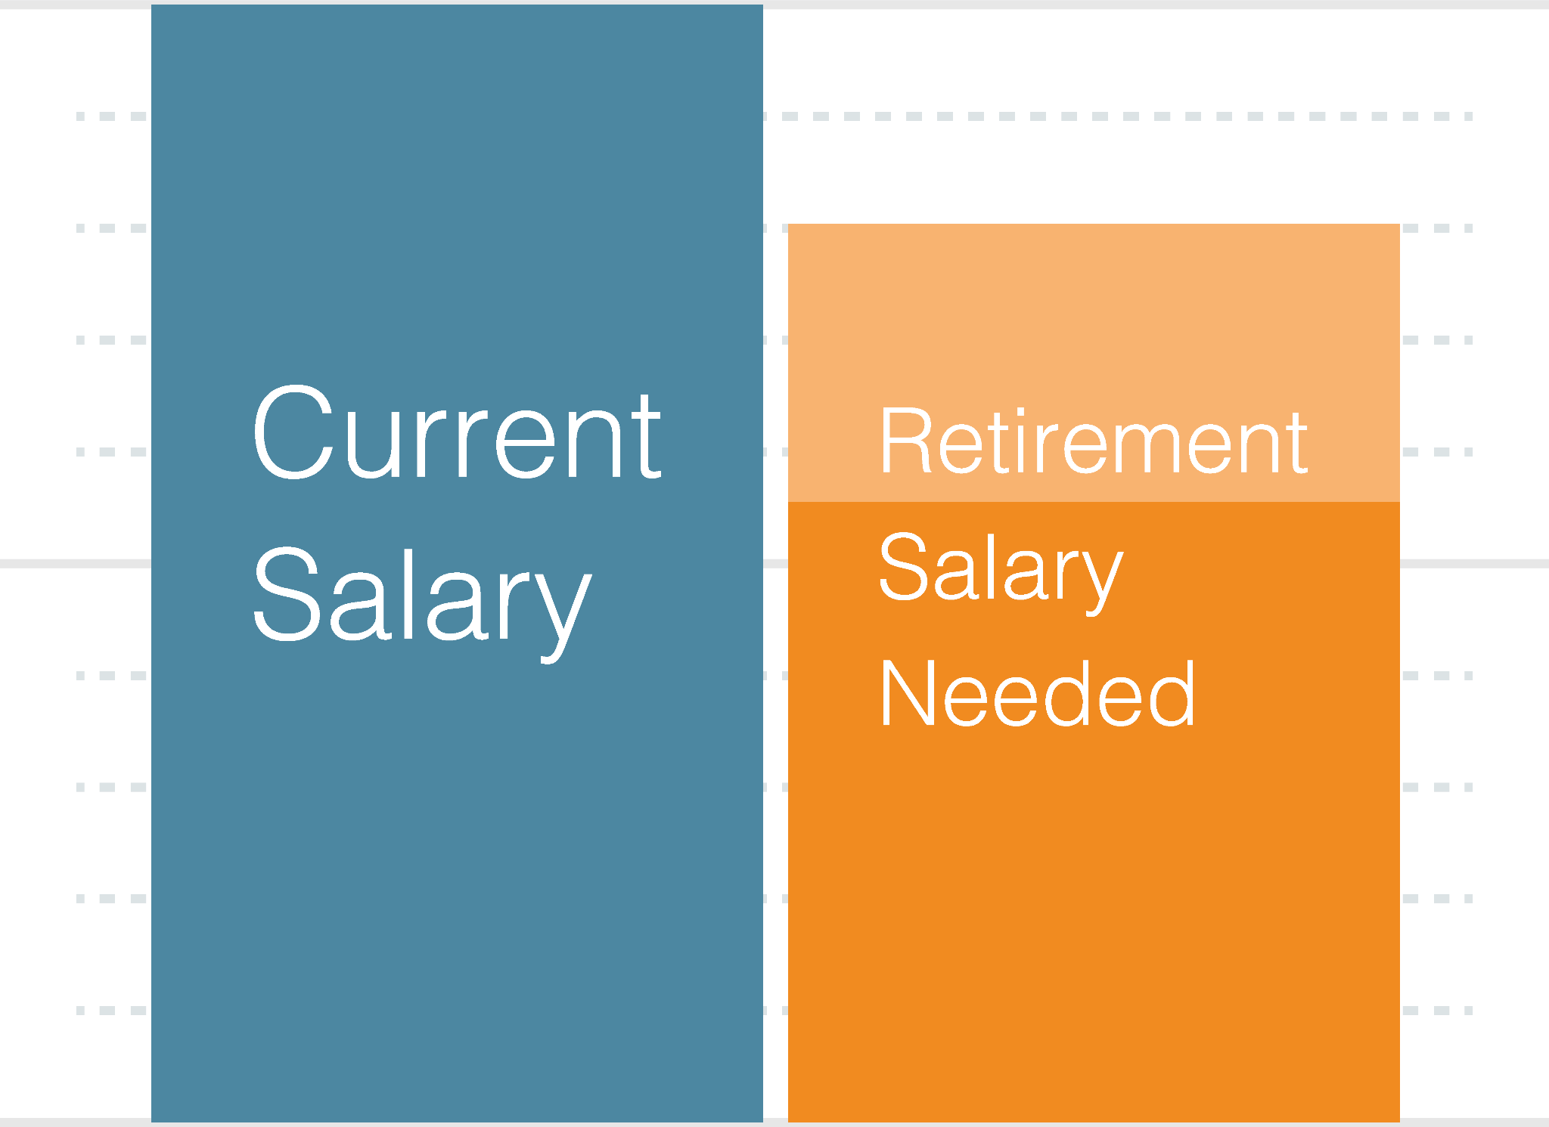
Step 1
Determining Your Monthly Expenses
Over a 25 year retirement, your expenses may average 80% of working income - but it’s not a straight line.
Let’s take a look at reality….
Notes:
Over a 25 year retirement your expenses may average 80% of working income.
But it's not a straight line
Many people spend as much or more in their first 5 years of retirement
Traveling, Moving closer to family and friends, doing all the things they put off until now.
Do it while your health and wealth allow
After that things can settle into an 80-85% rhythm
A subset of this slide is the

Slide 12
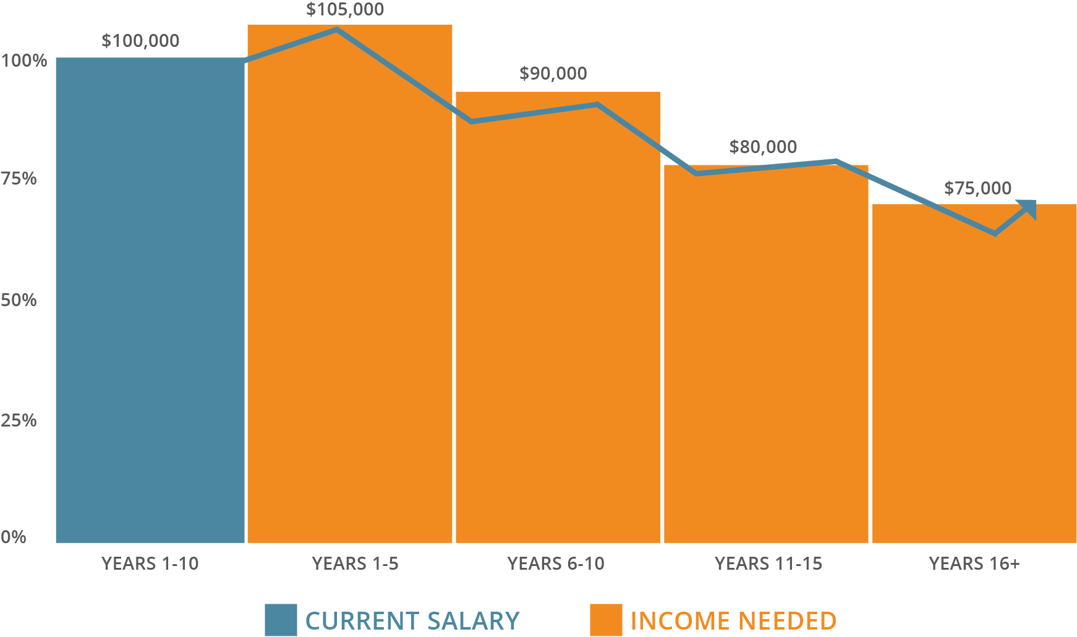
Client hypothetical
Notes:
Over a 25 year retirement your expenses may average 80% of working income.
But it's not a straight line
Many people spend as much or more in their first 5 years of retirement
Traveling, Moving closer to family and friends, doing all the things they put off until now.
Do it while your health and wealth allow
After that things can settle into an 80-85% rhythm
A subset of this slide is the

Slide 13
Step 1
Top 5 Retirement Expenses
A retirement income plan is much more than just an investment plan.
Housing
Travel/Transportation
Healthcare
Food
Utilities

Slide 14
Step 2
Determine Your Retirement Income Sources
Social Security
Retirement Accounts (401K, IRA, Roth IRA etc.)
Savings and Investment accounts
Pension

Slide 15
Step 3
Asset Location and Asset Allocation
Asset Location:
How are you optimizing your strategy for taxable accounts, tax-free accounts, and tax deferred accounts?
Asset Allocation:
Investment plan aimed to balance risk and return by aligning to your goals, risk tolerance and risk capacity.

Slide 16
Step 4
Protecting Your Income Sources
Average return is fine before you’re taking money out, but when you start taking money out in retirement, it matters a lot.

Slide 17
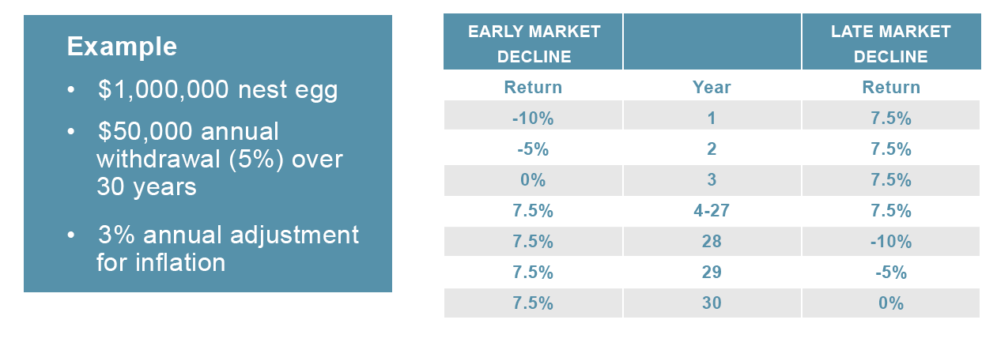
Step 4
Impact of Down Markets
Systematic withdrawals are subject to market fluctuations.
It can make a significant difference when a down market occurs.
Note: Return is annualized percentage. Inflation adjustment compounded annually. Withdrawals take at the beginning of the year. Sales charges and taxes are not considered. Hypothetical illustration, not typical of actual returns or representative of any specific investment.

Slide 18
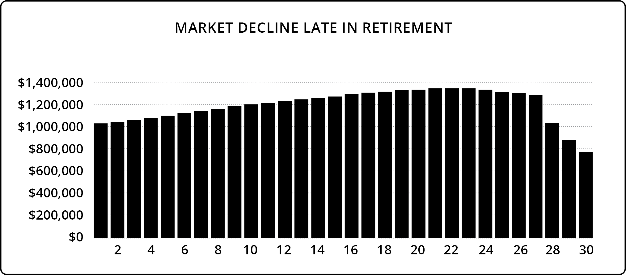
Step 4
Scenario 1:
Years 1-27: 7.5% annual return
Year 28: 10% market decline
Year 29: 5% market decline
Year 30: 0% market change
$50,000 annual withdrawal, adjusted yearly for 3% inflation

Slide 19
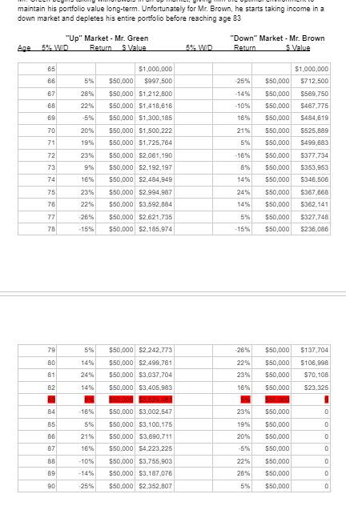
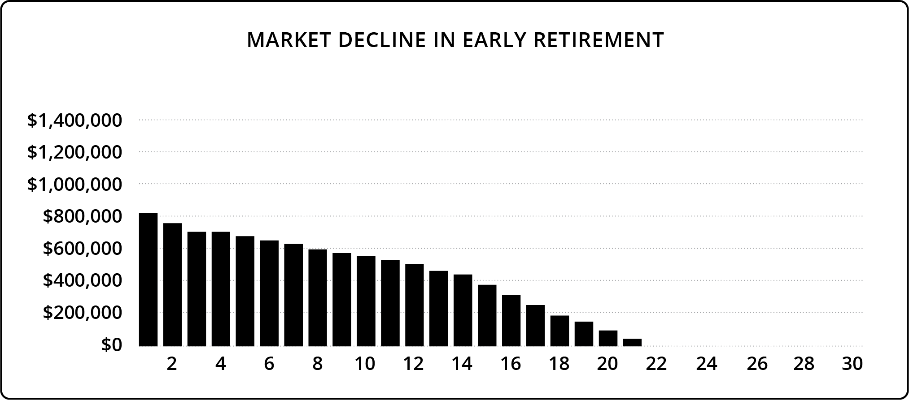
Step 4
Scenario 2:
Year 1: 10% market decline
Year 2: 5% market decline
Year 3: 0% market change
Years 4-30: 7.5% annual return
$50,000 annual withdrawal, adjusted yearly for 3% inflation

Slide 20
Investments
Dollar Cost Averaging
Dollar cost averaging is a technique used to reduce market risk but does not guarantee a profit or protect against loss
Contributing every month will result in more shares of the investment when the price is lower and fewer shares when the price is higher¹
This may result in an average cost per share that is lower than the average price over the same time period
Reverse Dollar Cost Averaging
Reverse dollar cost averaging refers to the techniques of dollar cost averaging when they are applied during a volatile market.
¹ Investors should consider their ability to continue their purchases through periods of all price levels.

Slide 21
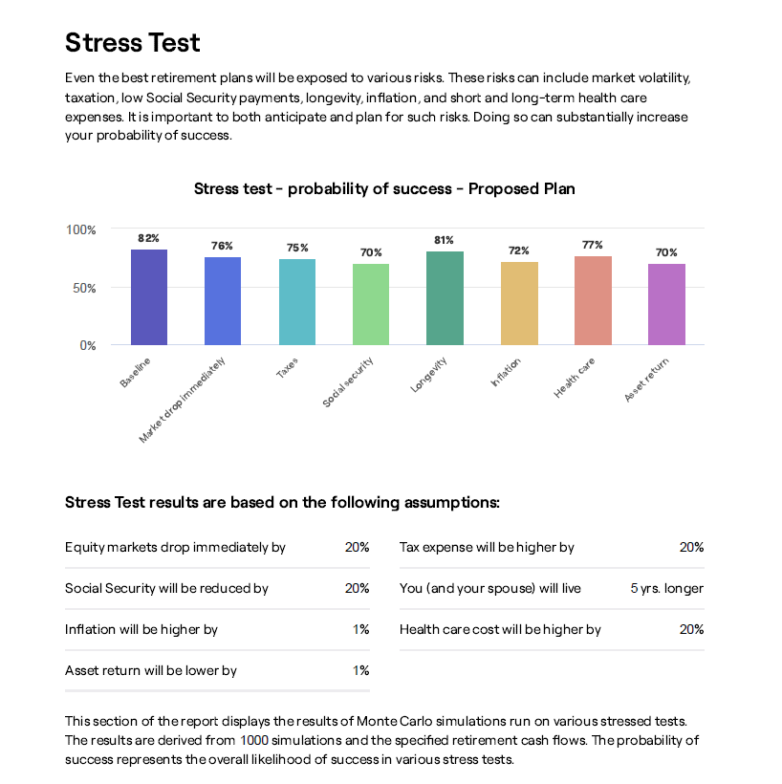
Step 5
Stress testing your plan
Notes:
Image Source: RightCapital → Desgin: layout as is with source info
Nobody has a crystal ball
No advisor know what’s going to happen next, but what we can do is prepare as best we can, have a plan and stress test taht plan using many, many different market circumstances
Running thousands of different scenarios, changing variables.

Slide 22
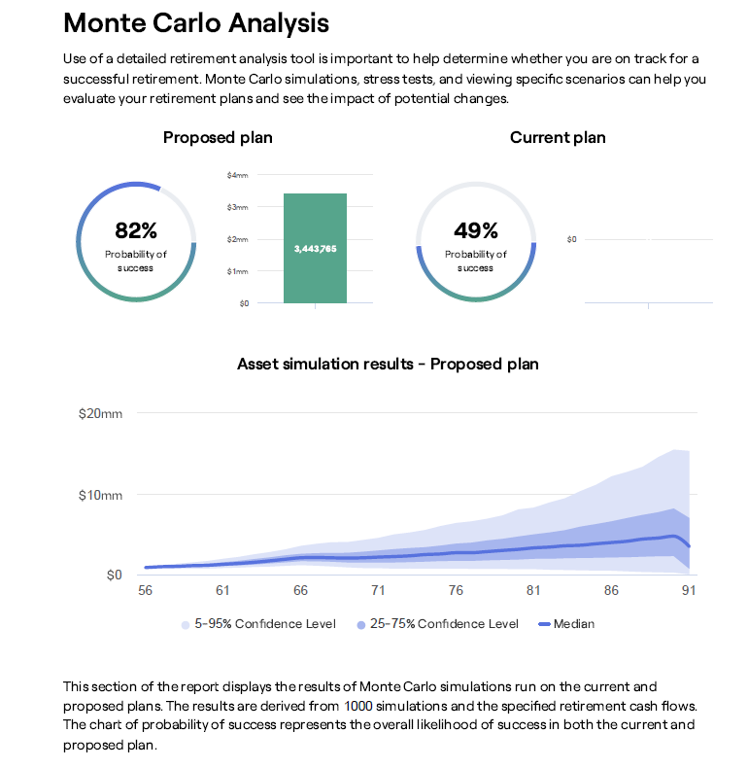
Step 5
Probability of success
Notes:
Image Source: RightCapital → Desgin: layout as is with source info
Nobody has a crystal ball
No advisor know what’s going to happen next, but what we can do is prepare as best we can, have a plan and stress test taht plan using many, many different market circumstances
Running thousands of different scenarios, changing variables.

Slide 23
Taxes
Accumulation Phase
  Optimize your tax locations and take advantage of tax deferral
Preservation Phase
  Lower taxes to protect what you’ve saved
Distribution Phase
  Understand how to access your distributions in the most tax efficient way
Understanding Taxes in the 3 Phases of Planning

Slide 24
Taxes
Accumulation Phase
  Optimize your tax locations and take advantage of tax deferral
Preservation Phase
  Lower taxes to protect what you’ve saved
Distribution Phase
  Understand how to access your distributions in the most tax efficient way
Understanding Taxes in the 3 Phases of Planning

Slide 25
Effective Tax Strategies
It’s advisable to examine your tax situation 2 years at a time with a goal to reduce overall tax liability.
Participate in your employer-sponsored retirement plan
Contribute to a traditional IRA and/or to flexible spending accounts
Consider tax implications before you retire
Itemize tax deductions
Consolidate deductible expenses
Take advantage of adjustments and tax credits
Use capital loss rules to your advantage
Understand when to buy and sell mutual funds
Position assets in different types of accounts
Don’t lose your deductions

Slide 26
Looking Forward

Slide 27
Taxes
Accumulation Phase
  Optimize your tax locations and take advantage of tax deferral
Preservation Phase
  Lower taxes to protect what you’ve saved
Distribution Phase
  Understand how to access your distributions in the most tax efficient way
Understanding Taxes in the
3 Phases of Planning

Slide 28
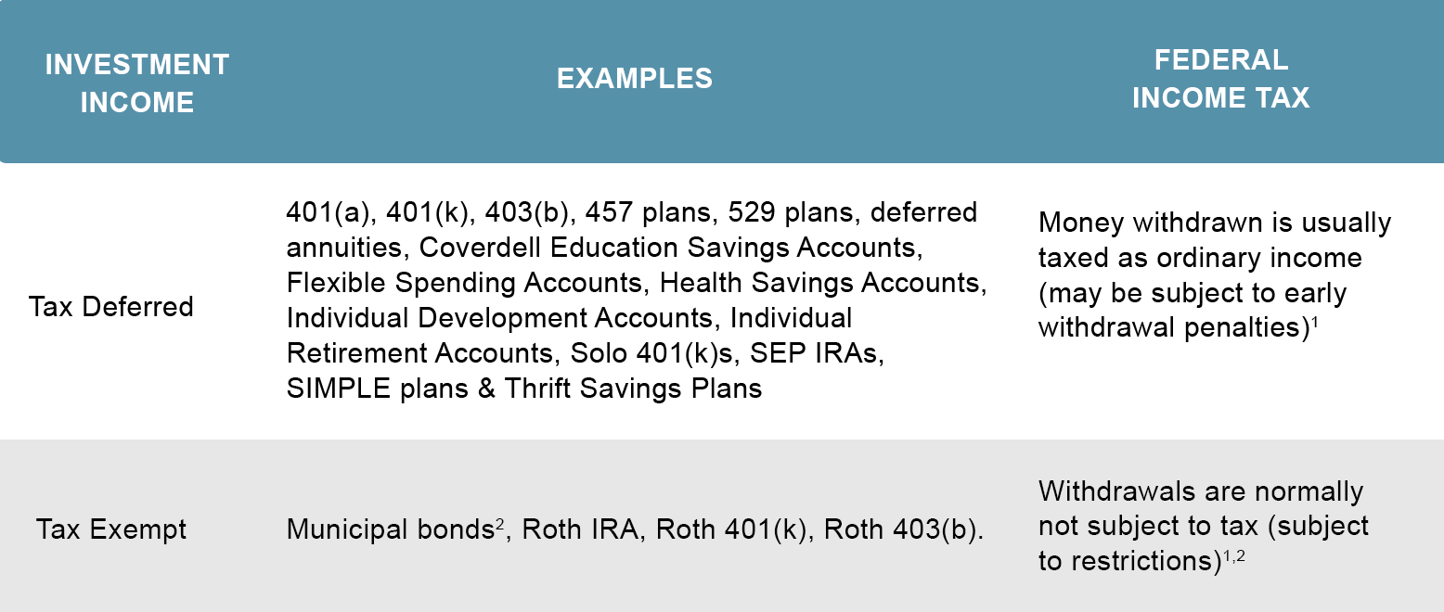
Optimizing Asset Location
INVESTMENT INCOME | FEDERAL INCOME TAX IMPACT
Taxable | Money withdrawn is usually taxed as ordinary income, but withdrawals are not typically restricted
Tax Deferred | Money withdrawn is usually taxed as ordinary income and may be subject to early withdrawal penalties
Tax Exempt | Withdrawals are normally not subject to tax, but may be subject to restrictions

Slide 29
Optimizing Asset Location

Slide 30
Appendix

Slide 31
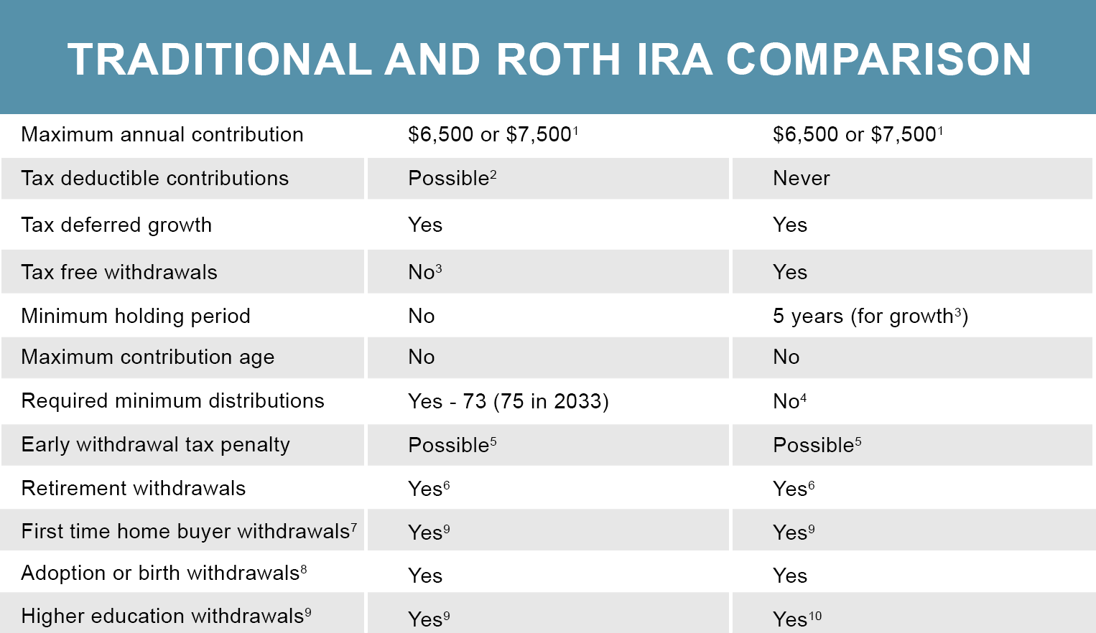
Retirement Income Sources
Review: IRA vs. Roth IRA

